Slide 1
HD 176582
Tzitlaly Barajas
Swarthmore College
Keck North East Consortium
Notes:
hi! I’m tzitlaly barajas, and today I’m here to talk to you about my research observing massive magnetic stars at swarthmore this summer…

Slide 2
the observatory
Peter van de Kamp Observatory at Swarthmore college
Location: 39° 54′08″N 75° 21′04″W
Average humidity: 70%
Average seeing: 3” - 5”
Notes:
This summer I had the opportunity to work at the peter van de kamp observatory at swarthmore college. It is located on the roof of the science center, at [39 54 08; 75 21 04] and at an altitude of 66m. As I discovered over the summer, Pennsylvania tends to be pretty humid over the summer, averaging about 70% humidity throughout the year. This means that on clear nights (~ 20%) our seeing averages about 3-5 arcsecs

Slide 3
the telescope
RCOS 0.6m
Ritchey-Chretien
Telescope
4k Apogee Alta CCD
Fov: 0.45 deg
Limit: mag
Notes:
Luckily for us, we have an awesome telescope. It is an 0.6m f/7.8 ritchey-chretien telescope (on a german equatorial Paramount ME mount) from RC optical systems. The ritchey chretien design means that both the primary and secondary mirrors are hyperbolic, which results in a larger fov than on comparable telescopes. Paired with the electronically cooled 4k Apogee camera that has an SNR of about laksdj, our field of view is about 27 arcminutes, or 0.45 degrees. On a clear night, this means that we can see stars as dim as lkasjdf magnitude. Our typical targets are usually between 5th and 10th magnitude.
This summer, Swarthmore also received a brand new eShel spectrograph that is used with an SBIG ST10XME 16-bit camera, which we spent a fair amount of time installing and calibrating* and covers the wavelength region from 4275 to 7115 angstroms with pretty high resolution. Though we were not able to calibrate, will be useful for future study of stars.
Side notes:
What is accumulation over time/dark, why don’t we take any?
Electronically cooled camera, what is our SNR?
How do we characterize resolution on spectra?
What are mag of actual stars, exp times

Slide 4
observing
Control telescope from adjacent room
Use Maxim dl to take images.
The Sky software to control telescope.
Notes:
Over the summer we all took turns observing a variety of objects. We control the telescope from the adjacent control room using The Sky software, and take images using Maxim dl. On a typical night we are usually up until about 3 or 4 in the morning, and usually cover 2 objects for a couple of hours each, as well as take flats and biases. At the beginning of the summer, we spent a good amount of time testing for periodic error in guiding, and correcting for it. A lot of observing is just working to eliminate sources of error. for example we used to just take dome flats to reduce our data, but we noticed that, especially in the u filter, the screen didn’t seem to be evenly illuminated, and so could introduce error into our photometry. To avoid this, we now take skyflats each night, which are a little harder to get, but just give a really nice, even illumination.
Side notes:
Best place to take skyflats in sky?
Display U flats here?
Focusmax, autoguide,

Slide 5
lightcurves
Reduce data using IRAF:
Subtract Bias
Divide by Skyflats
Use as many comparison as possible
Subtract magnitudes of comparison stars from target
Notes:
once we have processed the images, we use iraf to extract the relative magnitudes of the stars across the night. For the objects we studied this summer, we were looking for time variability, so we just have to be worry about getting relative magnitudes. To account for the variation introduced to our data by the changing airmass, atmosphere, and exposure times, we use as many stars of comparable brightness as we can find within the same image*, take an average of their magnitudes, and subtract that from the targets’ magnitude. By doing this, we can see how the stars’ intrinsic brightness changes over time. This lightcurve can tell us a lot about the object in question…
Side notes:
*As opposed to using landolt standards, because atmosphere is much more variable here. Downside is we have to check if these stars really aren’t variable.
**Leave problem of much dimmer stars, comparison graphs for later (when discussing 176?) or state here?
This is another example of something that had to be adjusted to get better results: at first we only used the couple brightest comparison stars and took a straight average of them. We saw that we could reduce the error in our data by using many more comparison stars, comparing them all to each other and seeing how they vary relative to each other, eliminating the ones that vary significantly, and subtracting the star’s magnitude by the weighted average of the comparison stars**

Slide 6
massive magnetic stars
B type Stars:
Classified by presence of H, HeI in spectra
Mass: 3 - 20 M_{sol}
Luminosity: 100 - 50k L_{sol}
Temperature: 10k - 30k K
Notes:
So what exactly are we studying? This summer, our main priority was observing massive magnetic stars, specifically Bp type stars. These are a subset of B- type stars, a classification of stars that are very blue, very massive, very luminous, and very short lived. They are classified by the presence of hydrogen and neutral helium in their spectra, and are relatively fast rotators, on the order of about lskdjf km/s. One thing to note is that, whereas magnetic fields are fairly common in smaller stars, in larger stars, not so much. That said…
Side notes:
Order of stars = obafgkm
B stars:
Mass = 3-20 solar mass
L = 100-50k solar L
Temp = 10k-30k K
Lifespan = tens of millions of years
Rot v = ? Km/s
Not magnetic

Slide 7
massive magnetic stars
Bp type stars:
Peculiar: unusual metal abundances on surface
Harbor global rigidly rotating magnetic fields
Stellar wind channeled and contained by magnetic field lines
Notes:
Now, I mentioned that I spent this summer studying BP stars. The “p” stands for “peculiar,” named for the distinctly unusual metal abundances distributed unevenly across the surfaces of these massive stars. Unlike the rest of the stars in the B category, Bp stars usually harbor large global magnetic fields. Photometric, spectroscopic, and magnetic variability are often observed in these stars. This may be due in part to the star’s peculiarity; emission from the localized deposits on the surface of the star would contribute to a periodic variability in photometry and spectra. The rest could be accounted for by emission and absorption from the magnetospheric plasma predicted in R. Townsend’s rigidly rotating magnetosphere/ oblique rotator model.
Since the star is so massive, it expels a very strong stellarr wind*. The global magnetic field, however, prevents this wind from escaping**, instead channeling the wind along its field lines and trapping it into a disk around the star. If the magnetic and rotation axes are offset from one another, the lskdjf*** on this disk work out so that it is oriented between the two equators, and as the angle between the two axes increases, the disk’s density distribution changes to become more concentrated into 2 clouds formed where the two equators cross. So why does this matter?
Side notes:
*what is a better way to say this? “giving off a large amount of high energy, high density plasma” sounds more exciting… but?
**what level of detail here? Walk them through forces and equations if have time…
Be stars:
- H balmer line in emission at some point
- Rapid rotators = ? Km/s
- Shells or disks around
Bp stars:
Large global magnetic fields (usually) of up to 10k G
Slow rotators(~ ? Km/s) possibly due to magnetic braking
Emission by localized deposits

Slide 8
massive magnetic stars
Variability in lightcurve caused by magnetosphere blocking light from stars
How much light is blocked is determined by:
Inclination
Obliquity
Rotational speed
Optical thickness
Notes:
Since these clouds are optically thick, when they cross in front of the star, they will block some of the light coming in from the star. We are able to see this variability here on Earth through the star’s lightcurve. What that lightcurve looks like depends on 4 factors: the observer’s inclination to the axis of rotation, obliquity of the magnetic axis to the rotational axis, the star’s rotational velocity, and the optical thickness of the disk.
Here we can see how it changes the lightcurve: [redisplay rrm model] a larger inclination means that our line of sight to the star is about perpendicular to the rotational axis, meaning the 2 clouds will most likely cross in front of the star, causing the 2 dips in the lightcurve seen over on the right. As we saw before, the angle of obliquity (how offset the magnetic axis is from the rotational axis) determines the distribution of matter in the disk. A larger offset means that more of the disk’s matter is concentrated into 2 clouds.* a faster rotational speed means the disk is pushed further out, and so we are less likely to see variation, as disk will only partly eclipse star, and optical thickness is just a measure of how opaque the stuff in the disk is to light, and therefore, how much light can still get through to us.**
By knowing how each of these factors affects how the brightness of the star will vary here on earth/ what the lightcurve would look like for each particular model, we are able to then take the lightcurve of a star we observe, and matching it to these models, characterize its magnetosphere according to these 4 parameters.
Side notes:
*effect on lc of having 2 clouds vs disk: at larger inclinations, will have flat, if diminished, lc
** Maybe move this paragraph to slide before
*** find different, more accurate way to say this

Slide 9
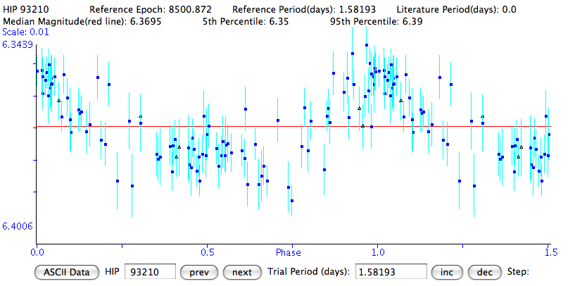
HD 176582
Spectrum indicative of magnetosphere
Period of 1.58 days determined from magnetic field data
Hipparcos data shows variability on the order of ~ 30-40 mmags
Notes:
Side notes:
Strong dipole field
Short rotation period
Spectroscopy indicative of magnetosphere
No recent photometry in literature
Goals for this, then are characterizing variability to get:
Characterization of it’s magnetosphere, I, b
Confirm period
- color dependence on variability

Slide 10
HD 176582
Results:
Period:
Variability across filters:
Characterization of magnetosphere:
Notes:
Side notes:
Ubvri filters, short exposures because object is bright (6.4mag)
Checked for variability in comparison stars
- used more comparison stars, weighted average of magnitudes didn’t change lc, but gave better estimates of error [images of before&after lightcurves]
Phased data, period, results… [display final lightcurve]
Comparable lightcurves from models show most likely i=, b= (very preliminary results)

