Slide 1
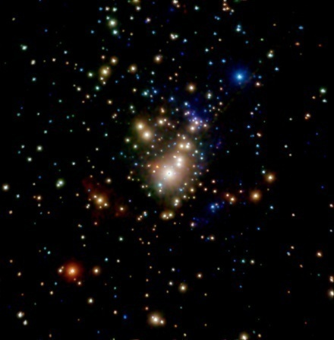
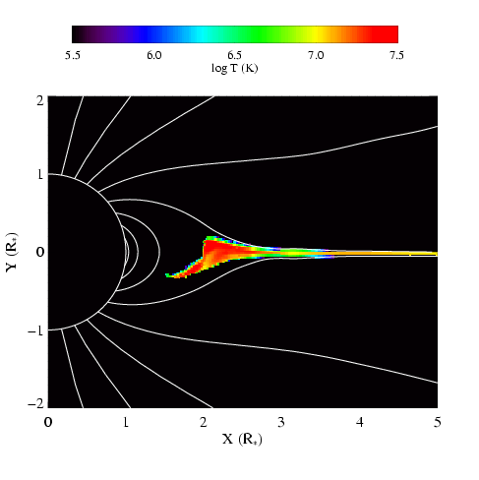
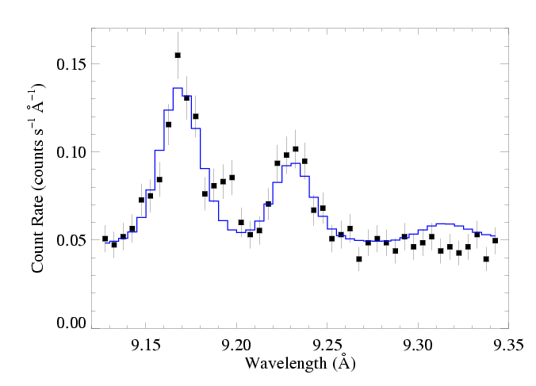
X-ray Diagnostics and Their Relationship to Magnetic Fields
David Cohen Swarthmore College

Slide 2
Notes:
2

Slide 3
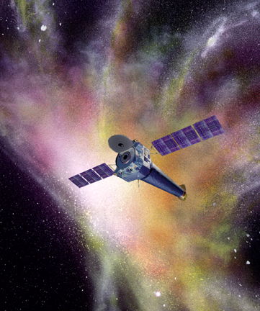
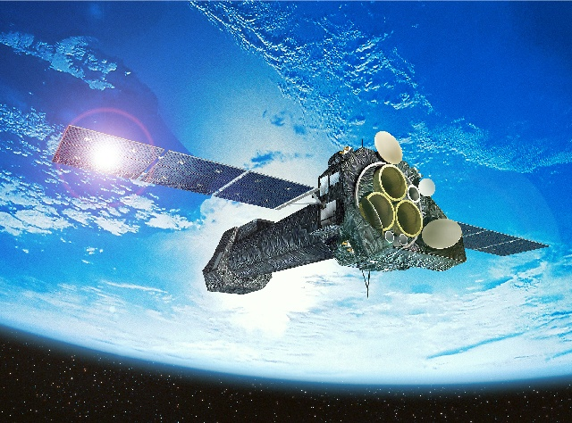
Launched 2000: superior sensitivity, spatial resolution, and spectral resolution
Chandra
XMM-Newton
sub-arcsecond resolution
Notes:
3

Slide 4
XMM-Newton
Both have CCD detectors for imaging spectroscopy (at low spectral resolution: R~20 to 50)
And – with lower sensitivity – both have grating spectrometers with resolutions of a few 100 to ~1000
Chandra
Notes:
4

Slide 5
Notes:
5

Slide 6
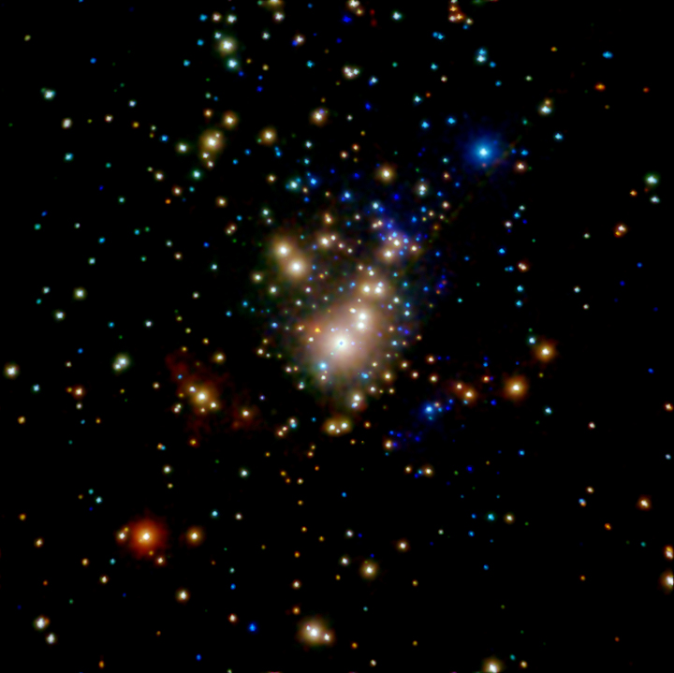
Chandra ACIS Orion Nebula Cluster (COUP)
θ¹ Ori C
Color coded according to photon energy (red: <1keV; green 1 to 2 keV; blue > 2 keV)

Slide 7
Notes:
7

Slide 8
Notes:
8

Slide 9
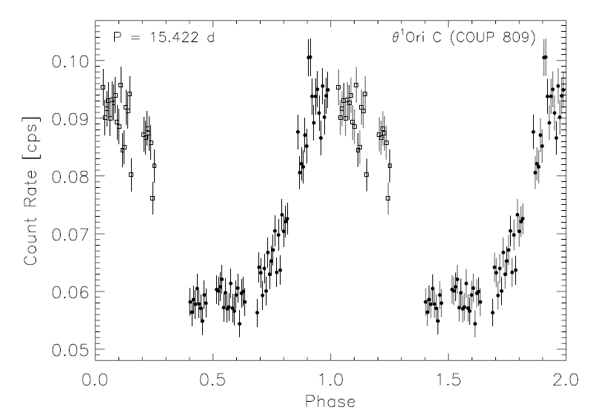
θ¹ Ori C: X-ray lightcurve
Stelzer et al. 2005
Notes:
9

Slide 10
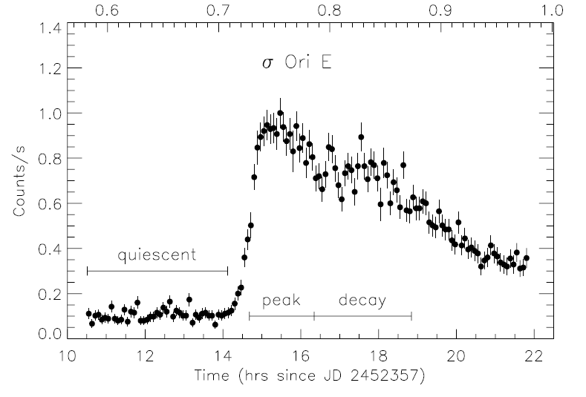
σ Ori E: XMM light curve
Sanz-Forcada et al. 2004
Notes:
10

Slide 11
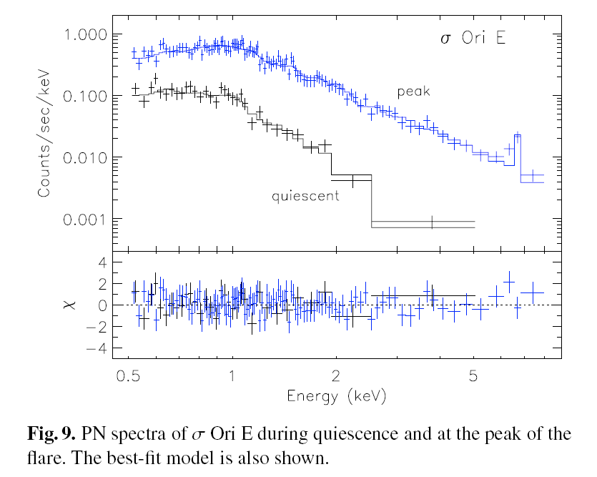
XMM EPIC spectrum of σ Ori E
Sanz-Forcada et al. 2004
Notes:
11

Slide 12
Differences between θ¹ Ori C and a normal O star
θ¹ Ori C
ζ Pup

Slide 13
Hot plasma emitting thermal x-rays
1 keV ~ 12 × 10⁶ K ~ 12 Å
Shock heating: Δv = 300 km gives T ~ 10⁶ K (and T ~ v²)
ROSAT 150 eV to 2 keV
Chandra, XMM 500 eV to 10 keV
Notes:
13

Slide 14
Notes:
14

Slide 15
Chandra grating spectra
θ¹ Ori C
θ¹ Ori C: hotter plasma, narrower emission lines
ζ Pup
ζ Pup: cooler plasma, broad emission lines

Slide 16
H-like/He-like ratio is temperature sensitive
θ¹ Ori C
Mg XII
Mg XI
Si XIV
Si XIII
ζ Pup

Slide 17
The magnetic O star – θ¹ Ori C – is hotter
θ¹ Ori C
Mg XII
Mg XI
Si XIV
Si XIII
ζ Pup

Slide 18
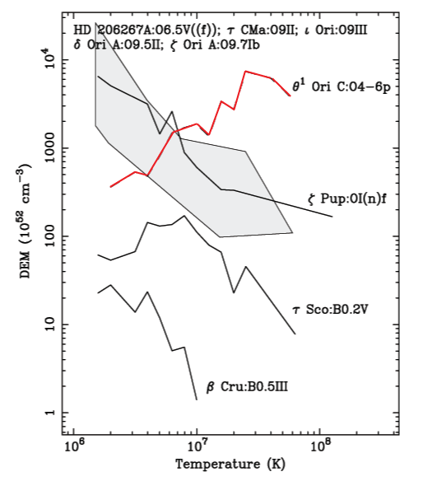
Differential Emission Measure (temperature distribution)
θ¹ Ori C is much hotter
Wojdowski & Schulz (2005)

Slide 19
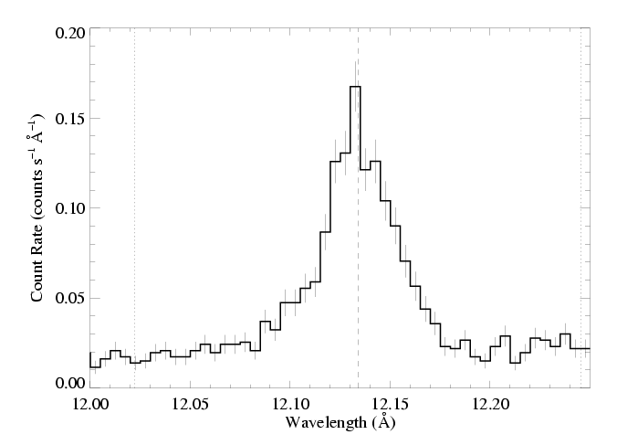
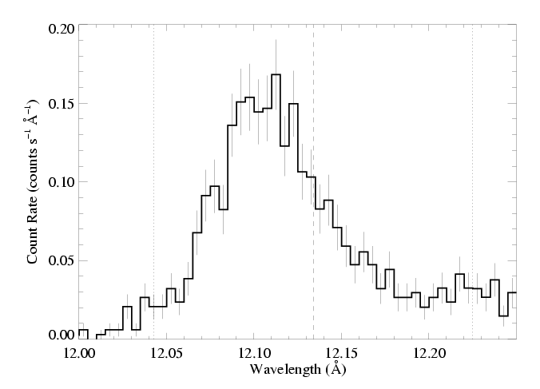
θ¹ Ori C (O7 V)
Emission lines are significantly narrower, too
1000 km s⁻¹
ζ Pup (O4 If)

Slide 20
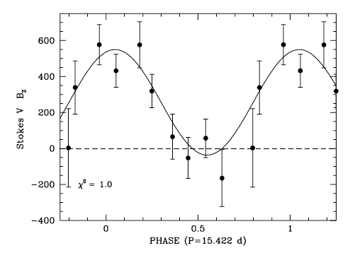
Dipole magnetic field
Wade et al. 2008
Notes:
20

Slide 21
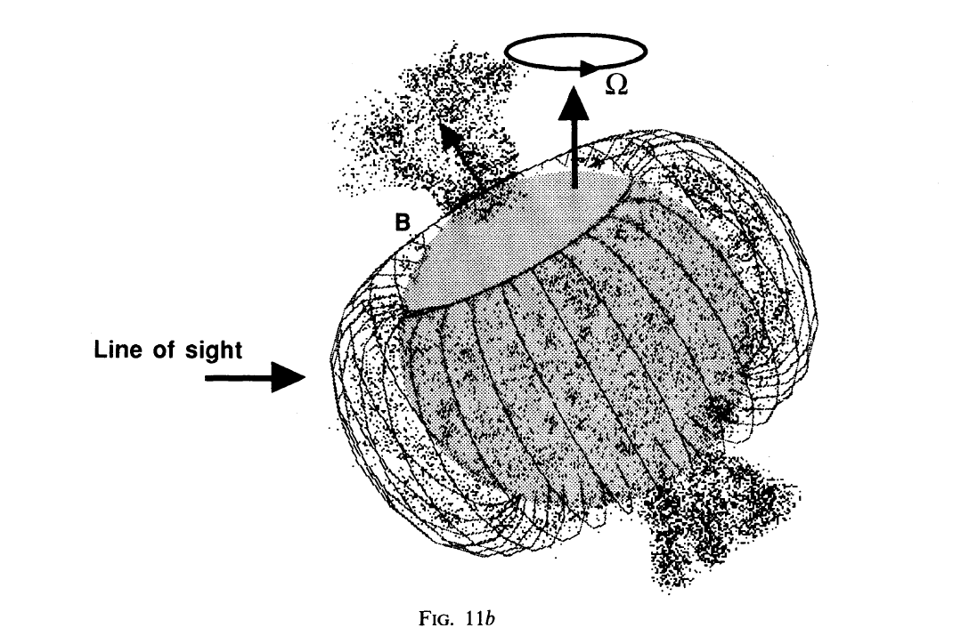
Shore & Brown, 1990
Notes:
21

Slide 22
Rotating tilted dipole
Simulation/visualization courtesy R. Townsend

Slide 23
Notes:
23

Slide 24
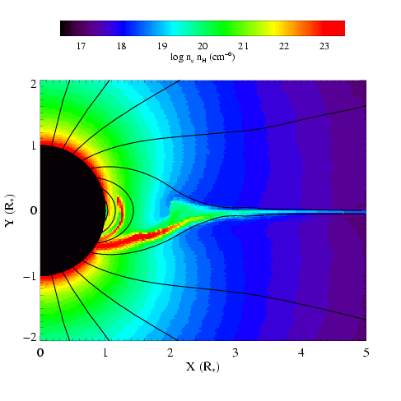
MHD simulations of magnetically channeled wind
temperature
emission measure
simulations by A. ud-Doula; Gagné et al. (2005)
Channeled collision is close to head-on: Δv > 1000 km s⁻¹ : T > 10⁷ K

Slide 25
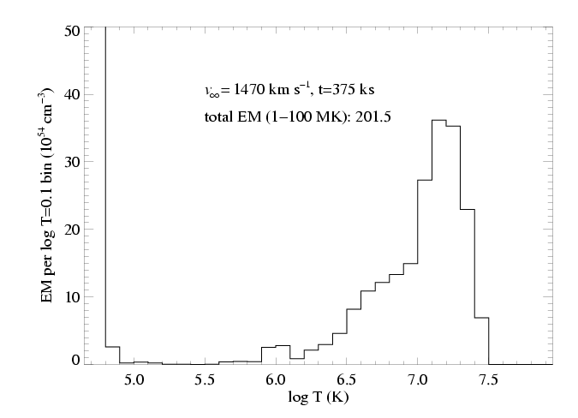
Differential emission measure (temperature distribution)
MHD simulation of θ¹ Ori C reproduces the observed differential emission measure
Wojdowski & Schulz (2005)

Slide 26
Notes:
26

Slide 27
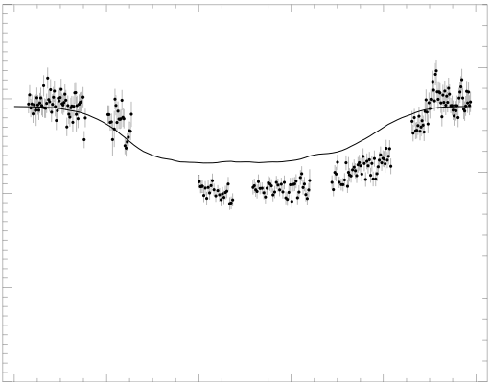
Chandra broadband count rate vs. rotational phase
0.4
1.5
0.3
1.0
0.2
Simulation EM (10⁵⁶ cm⁻³)
θ¹ Ori C ACIS-I count rate (s⁻¹)
0.1
0.5
0.0
0.0
0.0 0.2 0.4 0.6 0.8 1.0
Rotational phase (P=15.422 days)
Model from MHD simulation

Slide 28
The star itself occults the hot plasma torus
0.4
1.5
0.3
The closer the hot plasma is to the star, the deeper the dip in the x-ray light curve
1.0
0.2
Simulation EM (10⁵⁶ cm⁻³)
θ¹ Ori C ACIS-I count rate (s⁻¹)
0.1
0.5
0.0
0.0
0.0 0.2 0.4 0.6 0.8 1.0
Rotational phase (P=15.422 days)

Slide 29
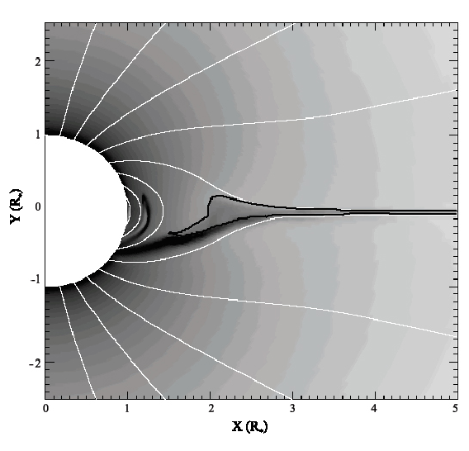
Emission measure
contour encloses T > 10⁶ K

Slide 30
Helium-like species’ forbidden-to-intercombination line ratios – f/i or z/(x+y) – provide information about the location of the hot plasma
…not the density, as is usually the case.

Slide 31
Helium-like ions (e.g. O⁺⁶, Ne⁺⁸, Mg⁺¹⁰, Si⁺¹², S⁺¹⁴) – schematic energy level diagram
1s2p ¹P
10-20 eV
1s2p ³P
1s2s ³S
resonance (w)
1-2 keV
forbidden (z)
intercombination (x+y)
g.s. 1s² ¹S

Slide 32
Ultraviolet light from the star’s photosphere drives photoexcitation out of the ³S level
1s2p ¹P
UV
1s2p ³P
1s2s ³S
resonance (w)
forbidden (z)
intercombination (x+y)
g.s. 1s² ¹S

Slide 33
The f/i ratio is thus a diagnostic of the local UV mean intensity…
1s2p ¹P
UV
1s2p ³P
1s2s ³S
resonance (w)
forbidden (z)
intercombination (x+y)
g.s. 1s² ¹S

Slide 34
…and thus the distance of the x-ray emitting plasma from the photosphere
1s2p ¹P
UV
1s2p ³P
1s2s ³S
resonance (w)
forbidden (z)
intercombination (x+y)
g.s. 1s² ¹S

Slide 35
R_{fir}=1.2 R*
R_{fir}=2.1 R*
R_{fir}=4.0 R*

Slide 36
He-like f/i ratios and the x-ray light curve both indicate that the hot plasma is somewhat closer to the photosphere of θ¹ Ori C than the MHD models predict.

Slide 37
Notes:
37

Slide 38
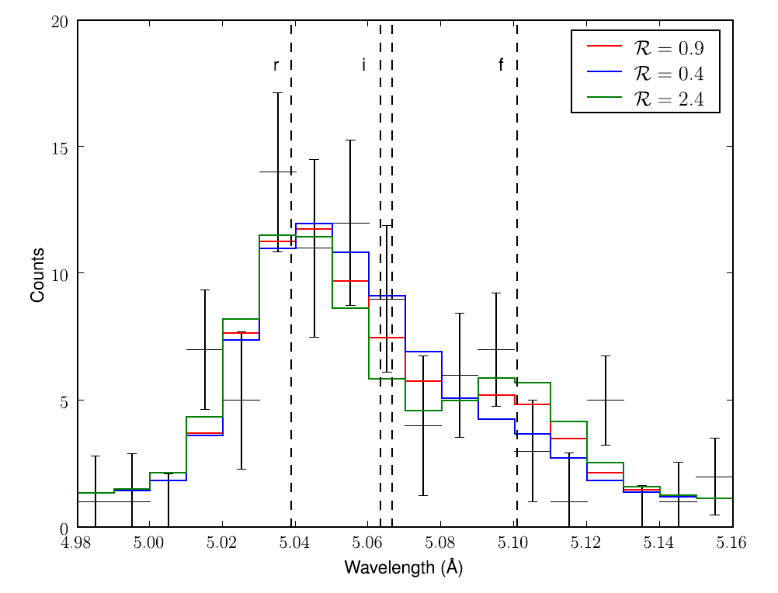
ζ Pup S XV Chandra MEG
Notes:
38

Slide 39
Notes:
39

Slide 40
Conclusions
Normal massive stars have x-ray line profiles consistent with the predictions of the wind instability model.
Photoelectric absorption’s effect on the profile shapes can be used as a mass-loss rate diagnostic: mass-loss rates are lower than previously thought.
Later-type massive stars have X-rays that are harder to understand, though…

Slide 41
Notes:
41

Slide 42
Notes:
42

Slide 43
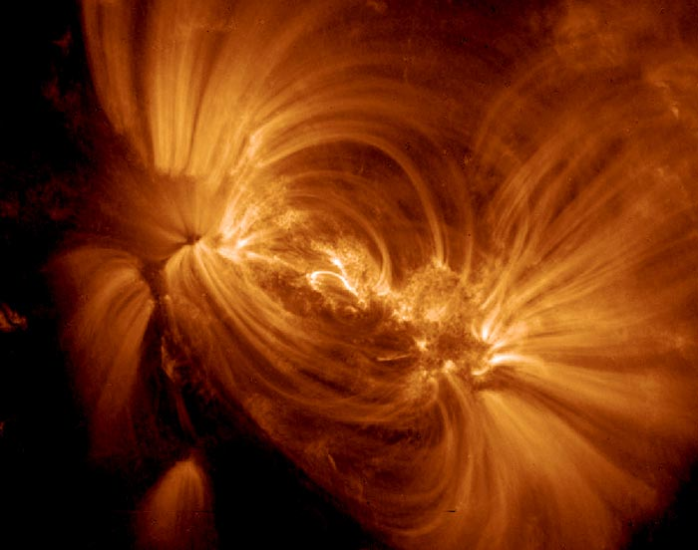

Slide 44
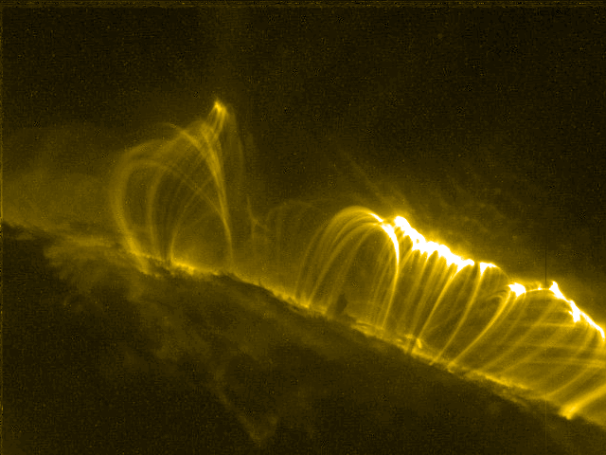

Slide 45
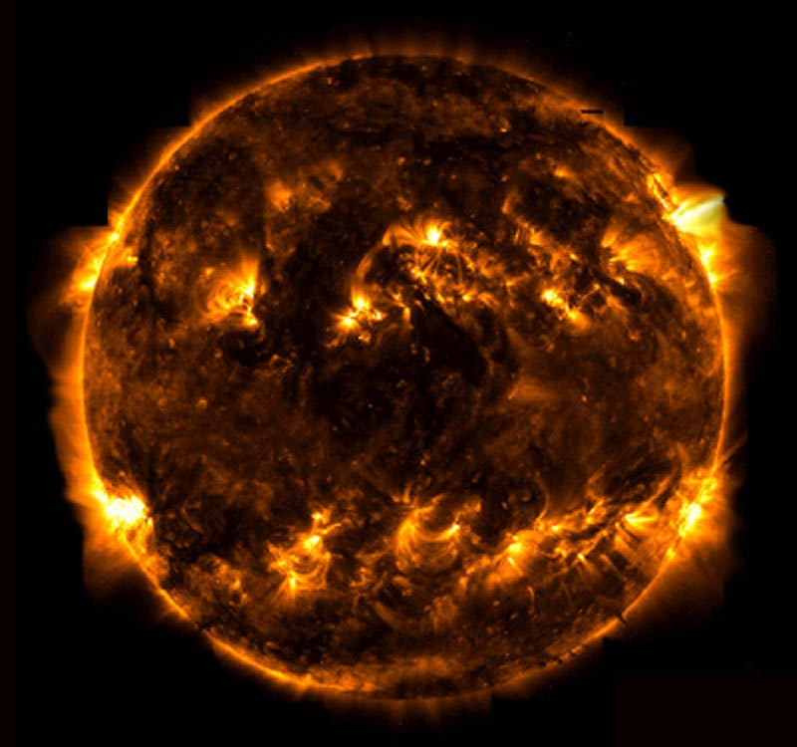
TRACE

Slide 46
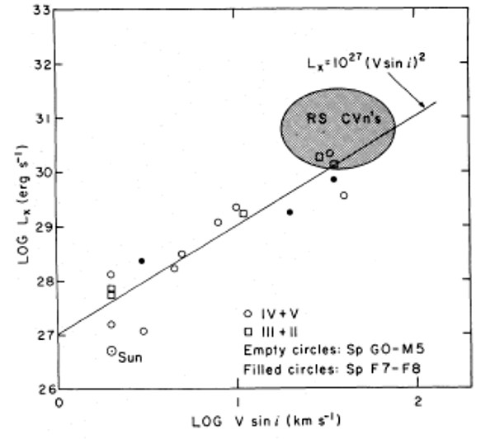
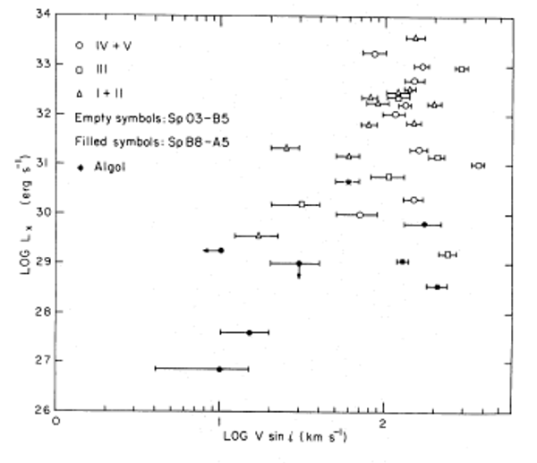
Stellar rotation vs. X-ray luminosity
low-mass stars
high-mass stars
No trend

Slide 47
Notes:
47

Slide 48
What about late O and early B stars with big filling factors and narrow lines?
Notes:
48

Slide 49
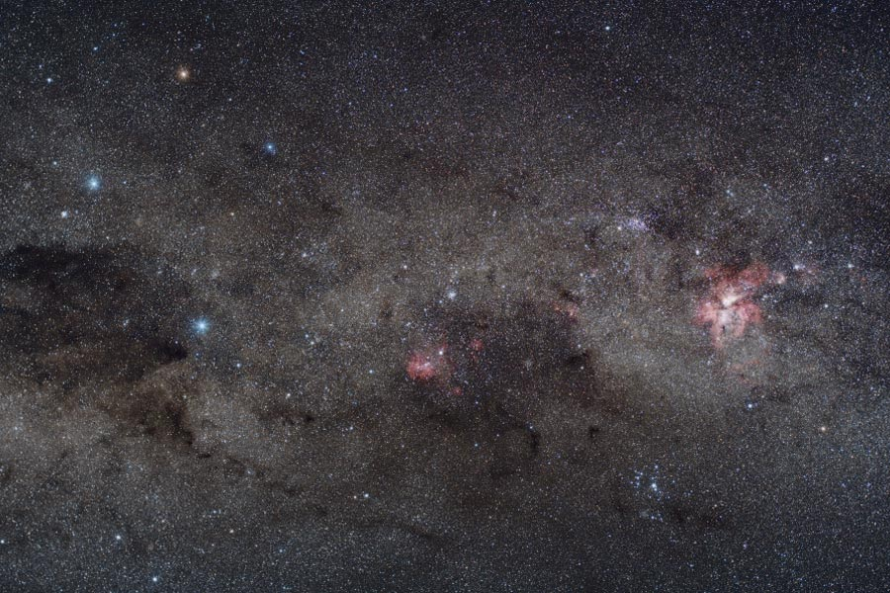
Yuri Beletsky (ESO)
Notes:
49

Slide 50
Notes:
50

Slide 51
Notes:
51

Slide 52
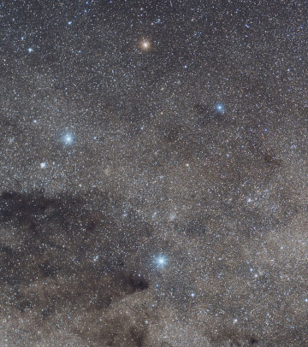
Crucis
aliases:
Mimosa
HD 111123
a massive (16 M_{sun}), luminous (34,000 L_{sun}), hot (30,000 K) star
…but not quite as hot, massive, and luminous as an O star: a B0.5 III star
Notes:
52

Slide 53
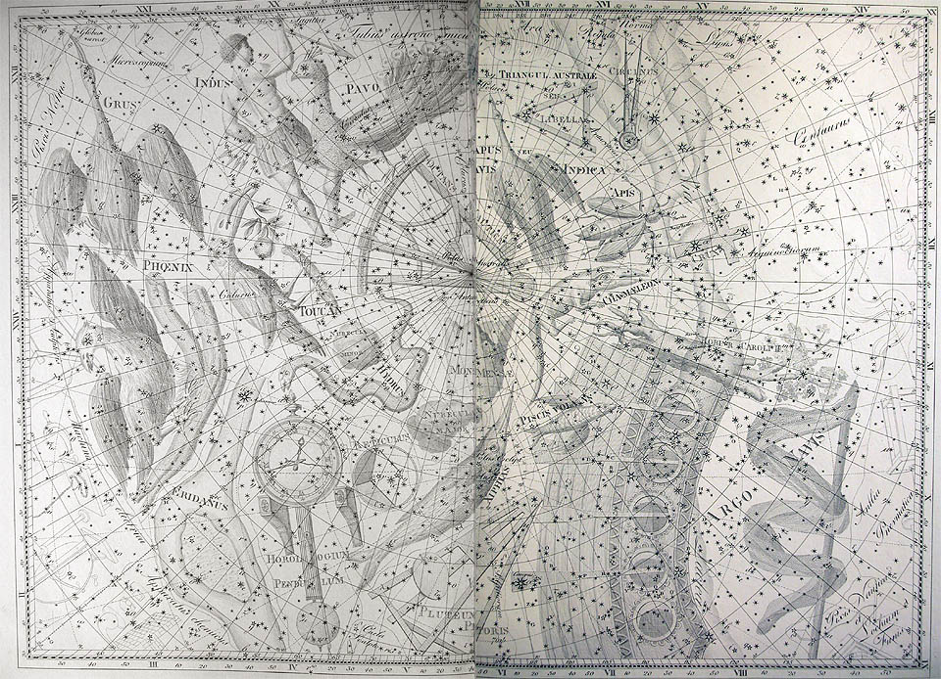
Notes:
53

Slide 54
Notes:
54

Slide 55
Notes:
55

Slide 56
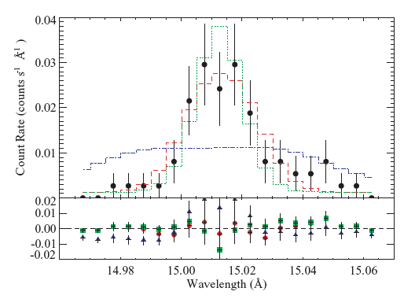
β Crucis (B0.5 V): lines are narrow!
unresolved
wind-broadened
best-fit
Fe XVII line
Notes:
56

Slide 57
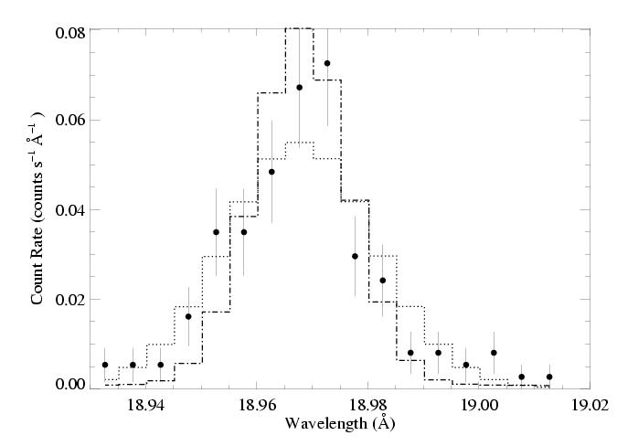
β Cru: O VIII Ly-α line
Notes:
57

Slide 58
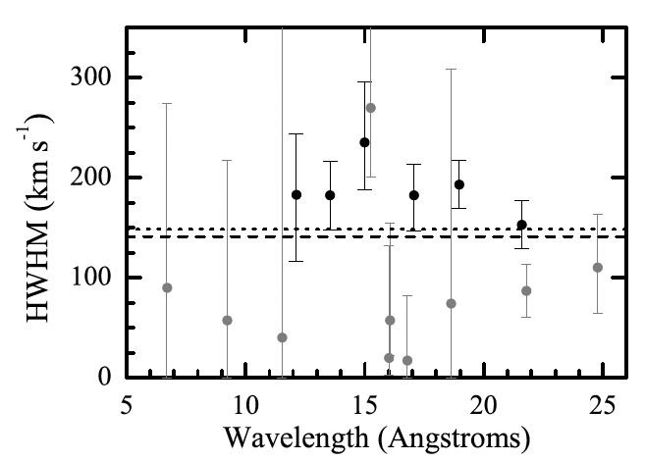
Notes:
58

Slide 59
Later-type massive stars with weaker winds… X-ray production is hard to explain…
Notes:
59

Slide 60
Notes:
60

Slide 61
But what about magnetic stars with soft X-rays?
Notes:
61

Slide 62
Notes:
62

Slide 63
Chandra HETGS/MEG spectrum (R ~ 1000 ~ 300 km s⁻¹)
ζ Pup
Si
Mg
Ne
Fe
O
H-like
He-like
Notes:
63

Slide 64
Notes:
64

Slide 65
What about zeta Ori?
Notes:
65

Slide 66
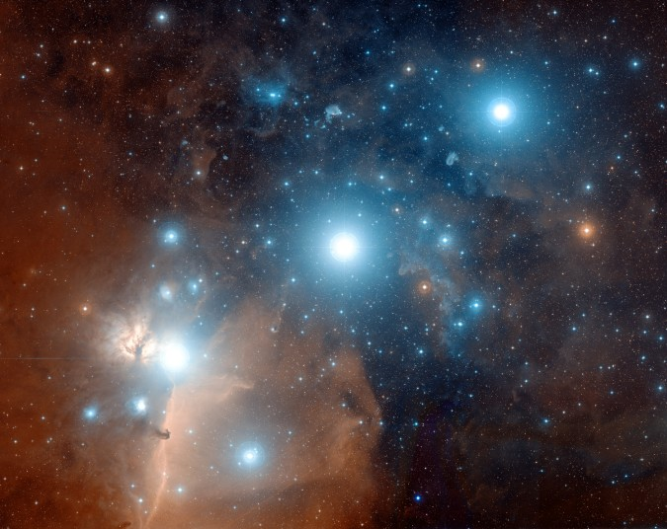
ζ Ori: O9.5

Slide 67
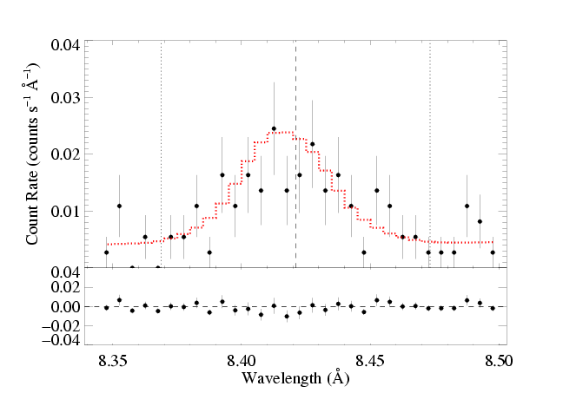
ζ Ori: O9.5 - less massive
Mg XII Lyman-α: τ* = 0.1

Slide 68
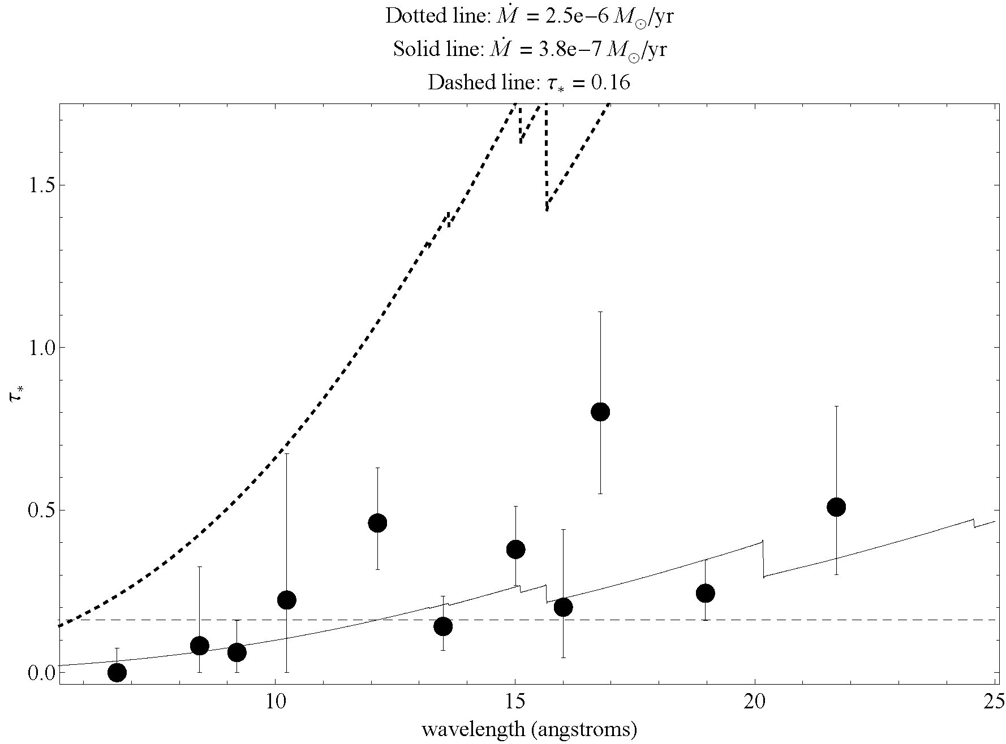

Slide 69
Notes:
69

Slide 70
Notes:
70

Slide 71
Notes:
71

Slide 72
Massive star X-rays vs. Solar-type X-rays

Slide 73
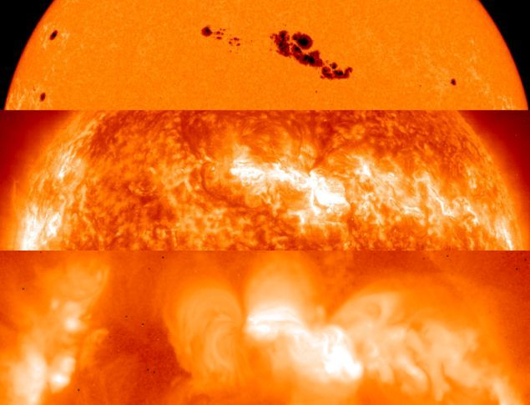
The Sun at different wavelengths
Optical 5800 K
SOHO EUV few 10⁵ K
YOKOH x-ray few 10⁶ K

Slide 74
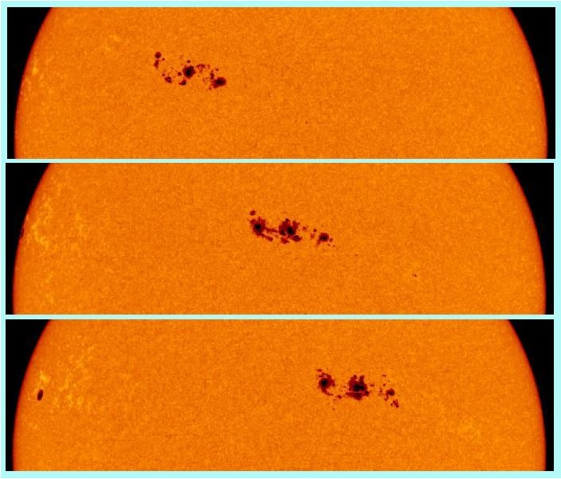
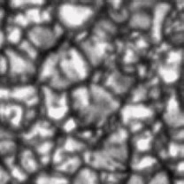
rotation
convection

Slide 75
Notes:
75

Slide 76
Notes:
76

Slide 77
Notes:
77

Slide 78
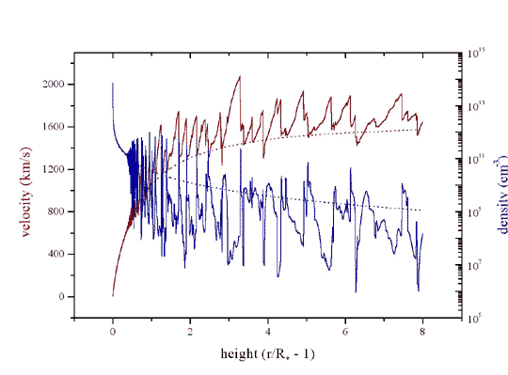
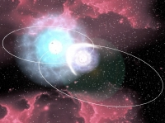
Three models for massive star x-ray emission
1. Instability driven shocks
2. Magnetically channeled wind shocks
3. Wind-wind interaction in close binaries
Notes:
78

Slide 79
Notes:
79

Slide 80
Chandra HETGS/MEG spectrum (R ~ 1000 ~ 300 km s⁻¹)
θ¹ Ori C
Si
Mg
Fe
Ne
H-like
He-like
Notes:
80

Slide 81
Notes:
81

Slide 82
ζ Pup
Low-mass star (Capella) for comparison
Notes:
82

Slide 83
ζ Pup
Ne X
Ne IX
Fe XVII
Capella
Notes:
83

Slide 84
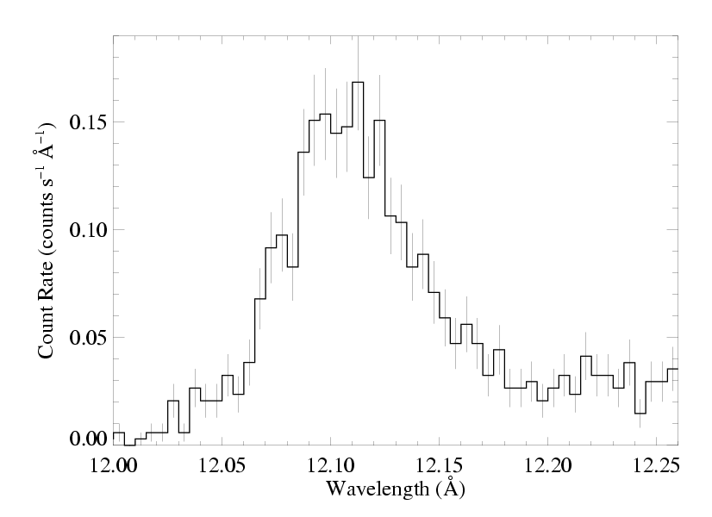
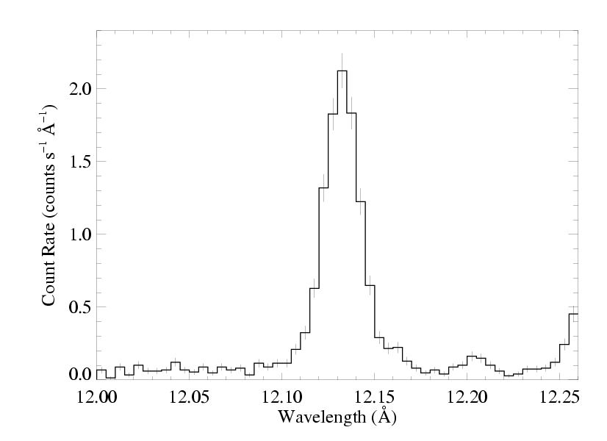
ζ Pup massive
Capella low mass
Notes:
84

Slide 85
The x-ray emission lines are broad: agreement with rad hydro simulations
ζ Pup
But… they’re also blue shifted and asymmetric
Is this predicted by the wind shock scenario?
Notes:
85

