Slide 1
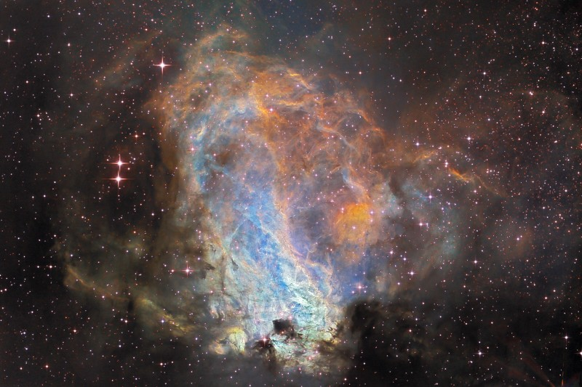
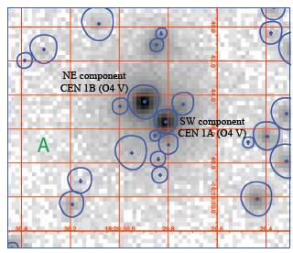
A pair of O stars with hard X-rays in M17
Marc Gagné & David Cohen
optical
Chandra

Slide 2
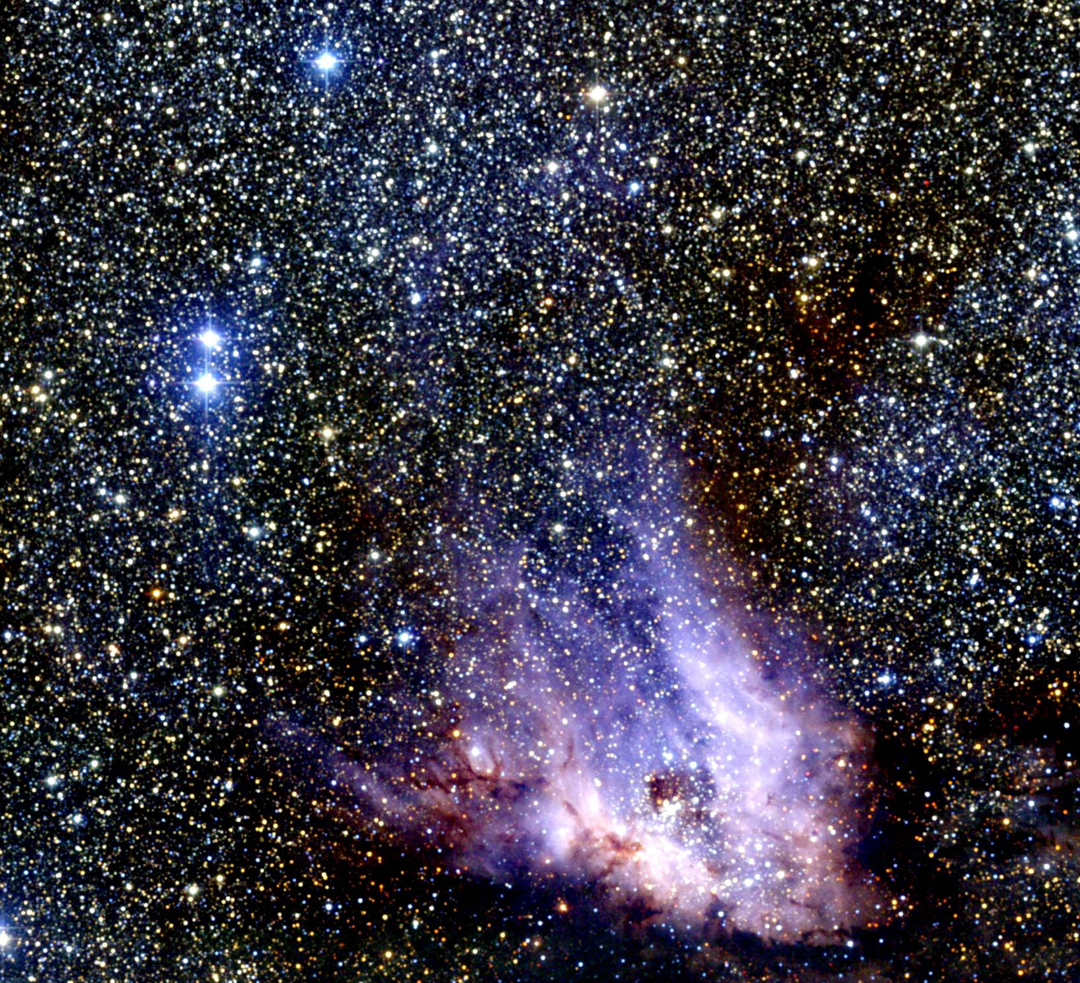
optical
2MASS

Slide 3
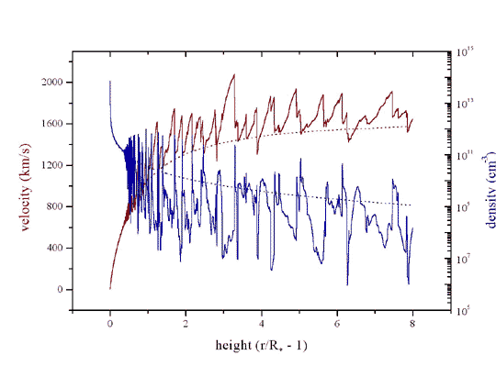
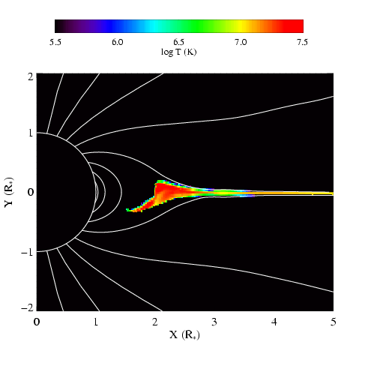
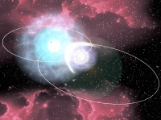
Three models for massive star x-ray emission
1. Instability driven shocks
2. Magnetically channeled wind shocks
3. Wind-wind interaction in close binaries
Notes:
3

Slide 4
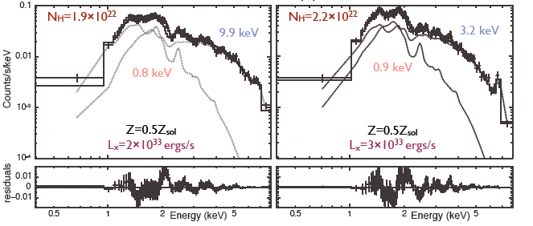
CEN1AB - Kleinmann’s Anonymous Star – is an O4+O4 binary system – with 1.8” separation (2000 AU) – but indications that each component might be binary

Slide 5
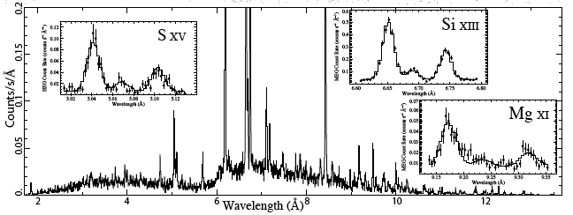
simulated Chandra grating spectrum
Line ratios for location of the X-ray emitting plasma
Line widths for the plasma kinematics

Slide 6
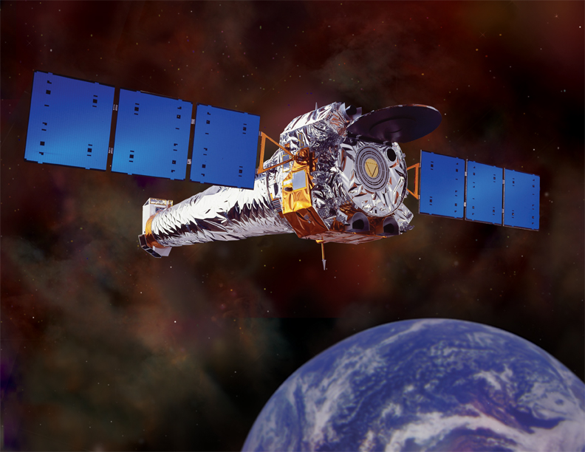
The Chandra X-ray Observatory started taking the data yesterday

Slide 7
Helium-like species’ forbidden-to-intercombination line ratios – f/i or z/(x+y) – provide information about the location of the hot plasma
f
i
i
f
f
i

Slide 8
Helium-like ions (e.g. O⁺⁶, Ne⁺⁸, Mg⁺¹⁰, Si⁺¹², S⁺¹⁴) – schematic energy level diagram
1s2p ¹P
10-20 eV
1s2p ³P
1s2s ³S
resonance (w)
1-2 keV
forbidden (z)
intercombination (x+y)
g.s. 1s² ¹S

Slide 9
Ultraviolet light from the star’s photosphere drives photoexcitation out of the ³S level
1s2p ¹P
UV
1s2p ³P
1s2s ³S
resonance (w)
forbidden (z)
intercombination (x+y)
g.s. 1s² ¹S

Slide 10
Weakening the forbidden line and strengthening the intercombination line
1s2p ¹P
UV
1s2p ³P
1s2s ³S
resonance (w)
forbidden (z)
intercombination (x+y)
g.s. 1s² ¹S

Slide 11
The f/i ratio is thus a diagnostic of the local UV mean intensity…
1s2p ¹P
UV
1s2p ³P
1s2s ³S
resonance (w)
forbidden (z)
intercombination (x+y)
g.s. 1s² ¹S

Slide 12
…and thus the distance of the x-ray emitting plasma from the photosphere
1s2p ¹P
UV
1s2p ³P
1s2s ³S
resonance (w)
forbidden (z)
intercombination (x+y)
g.s. 1s² ¹S

Slide 13
CWB not near periastron should have a high f/i ratio
f
i
i
f
f
i
Notes:
13

Slide 14
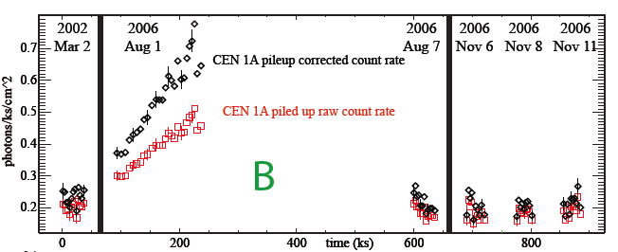
X-ray light curve of CEN 1A: increase over ~1d
evidence for colliding wind binary?
Notes:
14

Slide 15
Notes:
15

Slide 16
Another example of the f/i diagnostic: θ¹ Ori C
Notes:
16

Slide 17
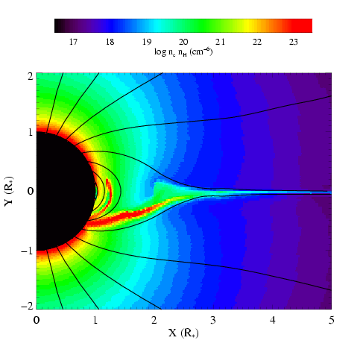
MHD simulation summary
temperature
emission measure
Gagné et al. (2005)
Channeled collision is close to head-on:
Δv > 1000 km s⁻¹ : T > 10⁷ K

Slide 18
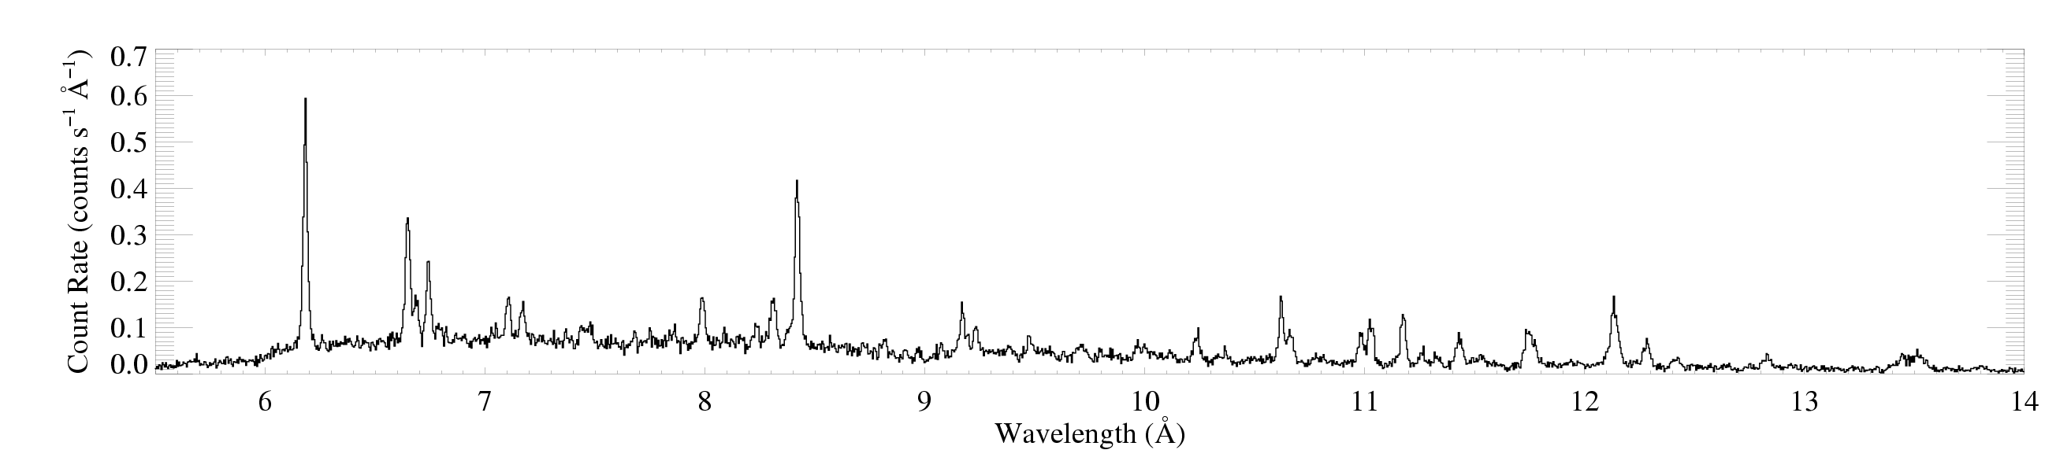
θ¹ Ori C
Mg XI
Notes:
18

Slide 19
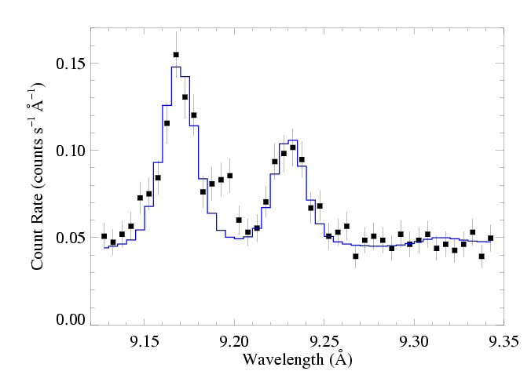
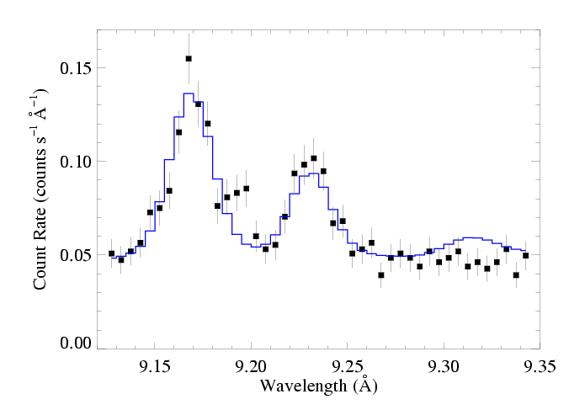
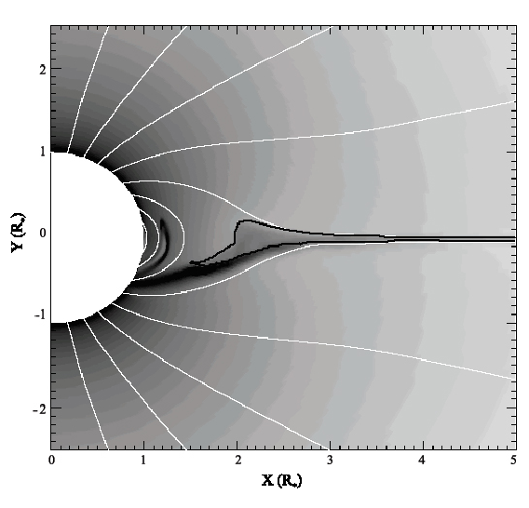
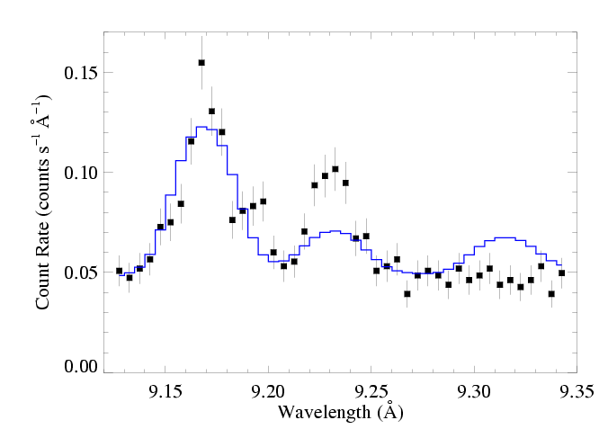
R_{fir}=1.2 R*
R_{fir}=2.1 R*
R_{fir}=4.0 R*

Slide 20
Notes:
20

Slide 21
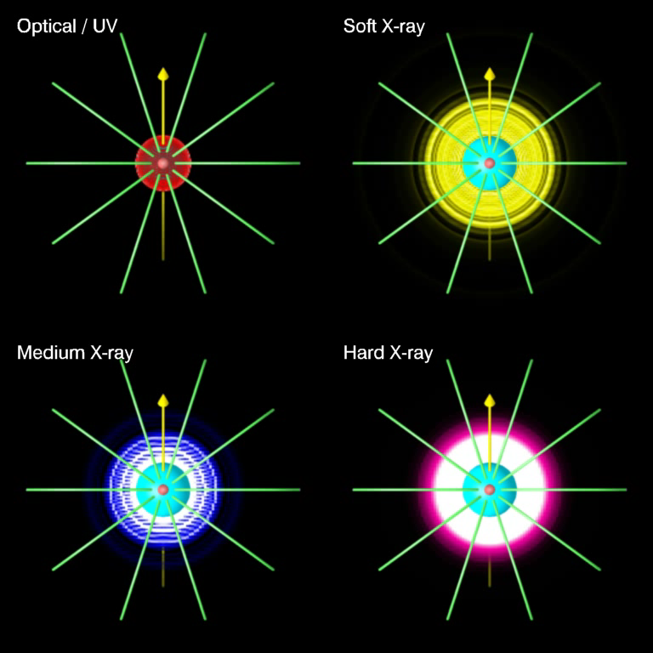
Dynamical models (ud-Doula; Townsend): color scale shows emission measure in different temperature regimes
astro.swarthmore.edu/~cohen/presentations/MiMeS2/zeus-movie.avi
Notes:
21

Slide 22
Notes:
22

Slide 23
Notes:
23

