Slide 1
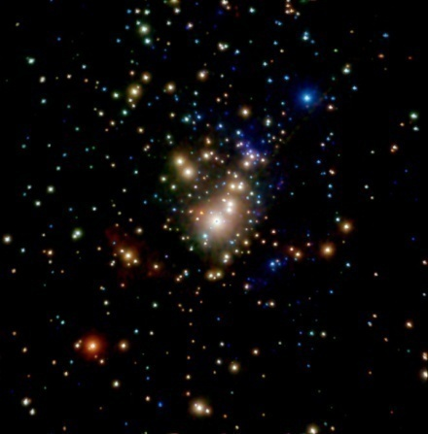
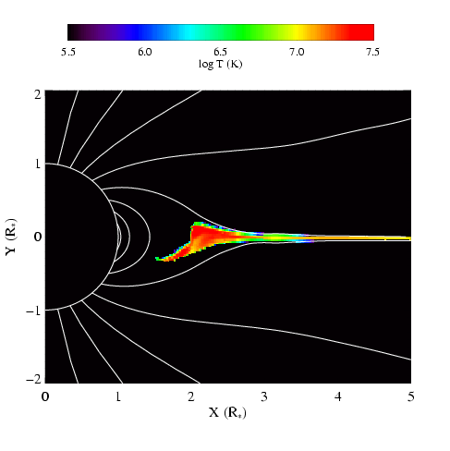
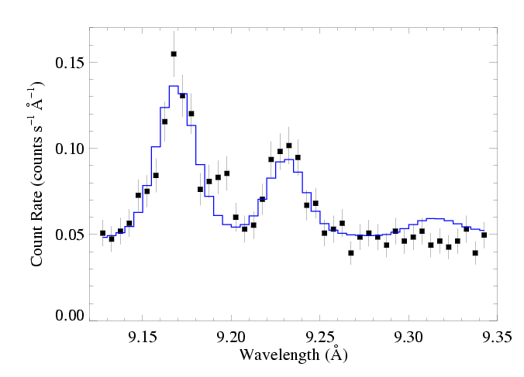
X-ray Diagnostics and Their Relationship to Magnetic Fields
David Cohen Swarthmore College

Slide 2
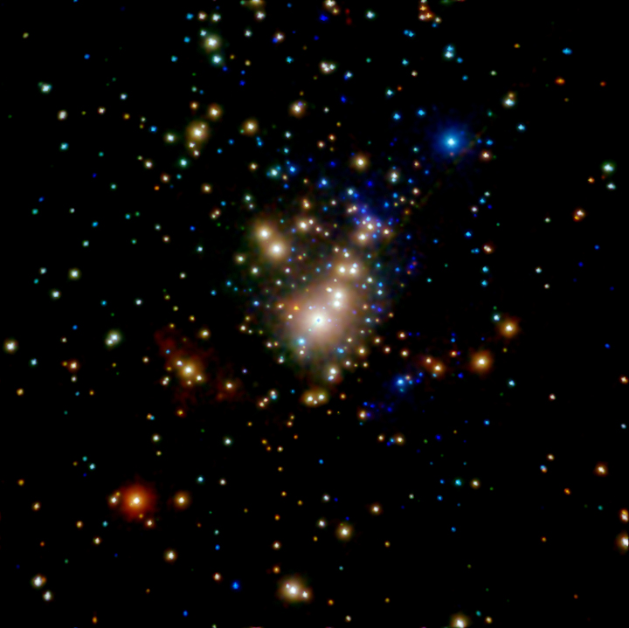
If we understand the physical connection between magnetic fields in massive stars and X-rays, we could use X-ray observations to identify magnetic massive stars.
e.g. Which of the stars in this Chandra X-ray image of the Orion Nebula Cluster are massive magnetic stars?
Notes:
2

Slide 3
But we’re not there yet…
X-ray behavior of known magnetic massive stars is diverse.
We don’t understand enough about the physical mechanisms of X-ray production in them.
Notes:
3

Slide 4
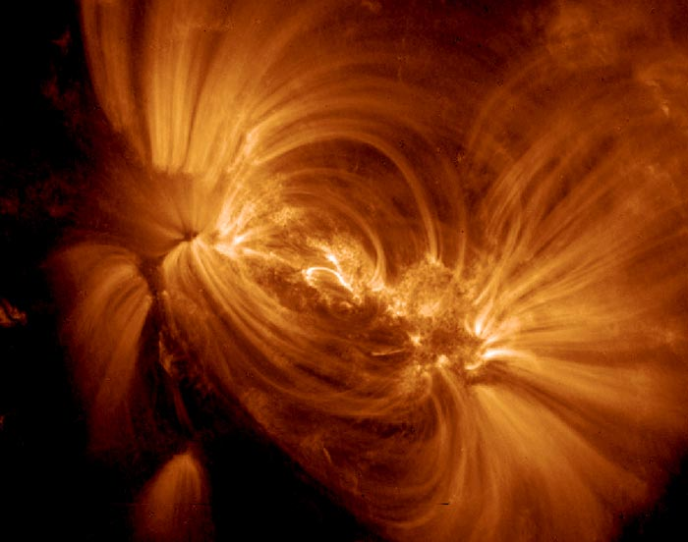
The Sun: X-rays <-> Magnetic Fields
TRACE

Slide 5
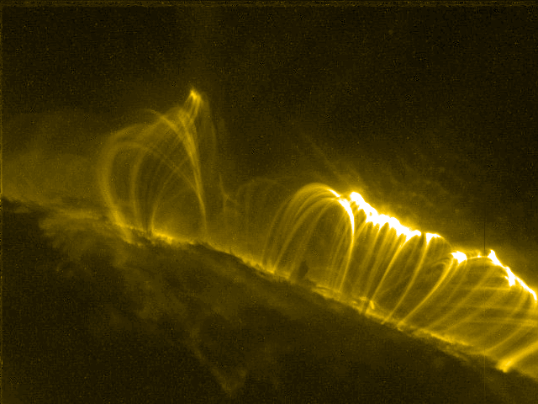
TRACE

Slide 6
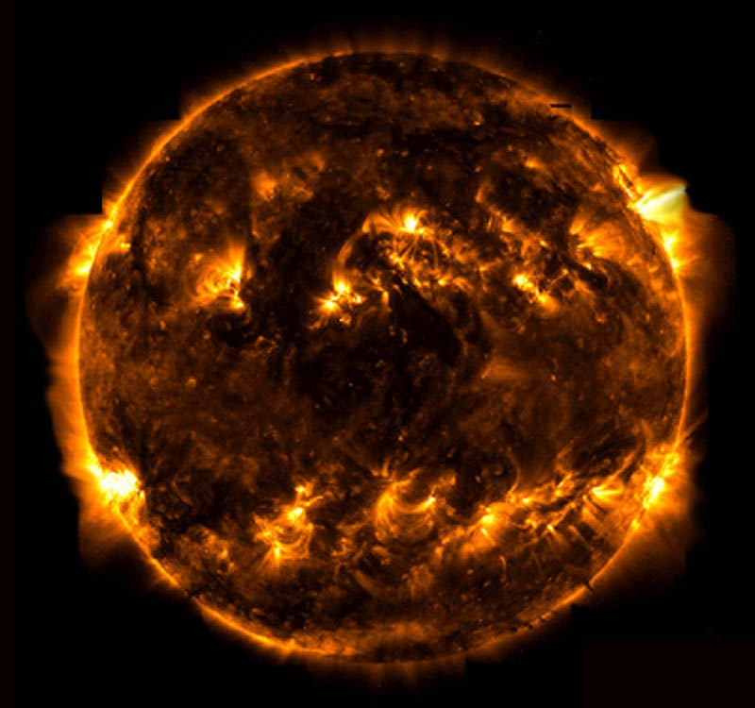
TRACE

Slide 7
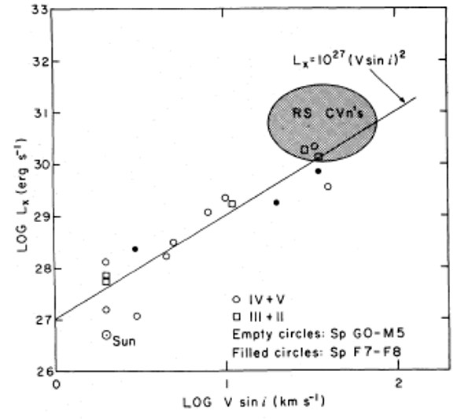
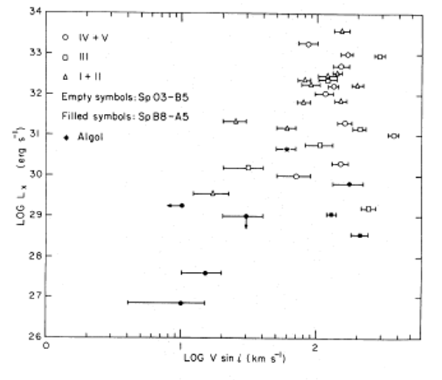
Stellar rotation vs. X-ray luminosity
low-mass stars
high-mass stars
No trend

Slide 8
Massive star X-rays are not coronal
Notes:
8

Slide 9
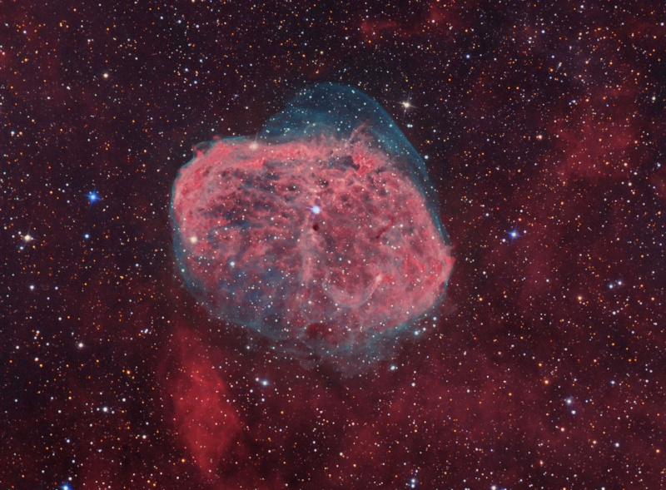
X-rays in massive stars are associated with their radiation-driven winds
Notes:
9

Slide 10
Power in these winds:
erg s⁻¹
while the x-ray luminosity
To account for the x-rays, only one part in 10⁻⁴ of the wind’s mechanical power is needed to heat the wind
Notes:
10

Slide 11
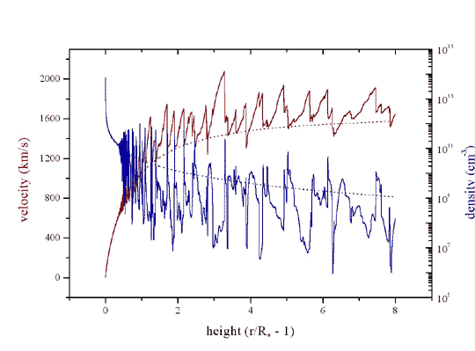
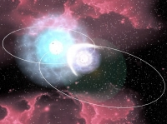
Three models for massive star x-ray emission
1. Instability driven shocks
2. Magnetically channeled wind shocks
3. Wind-wind interaction in close binaries
Notes:
11

Slide 12
Three models for massive star x-ray emission
1. Instability driven shocks
2. Magnetically channeled wind shocks
3. Wind-wind interaction in close binaries
Notes:
12

Slide 13
What are these “X-rays” anyway?
…and what’s the available data like?
Notes:
13

Slide 14
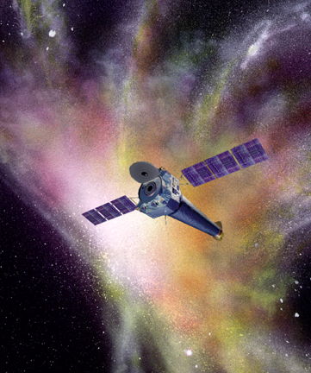
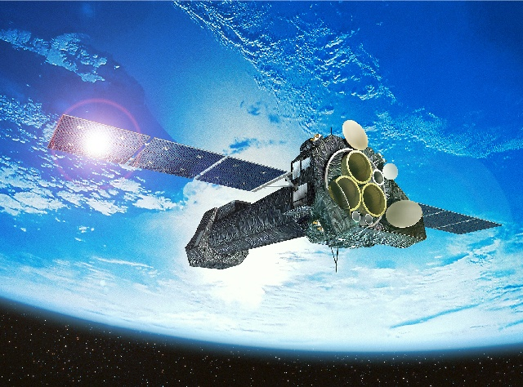
Launched 2000: superior sensitivity, spatial resolution, and spectral resolution
Chandra
XMM-Newton
sub-arcsecond resolution
Notes:
14

Slide 15
XMM-Newton
Both have CCD detectors for imaging spectroscopy:
low spectral resolution: R ~ 20 to 50
Chandra
And both have grating spectrometers: R ~ few 100 to 1000
300 km/s
Notes:
15

Slide 16
XMM-Newton
The gratings have poor sensitivity…
We’ll never get spectra for more than two dozen hot stars
Chandra
Notes:
16

Slide 17
XMM-Newton
The Future:
Astro-H (Japan) – high spectral resolution at high photon energies
…few years from now
Chandra
International X-ray Observatory (IXO)… 2020+
Notes:
17

Slide 18
First, imaging (+ low resolution) spectroscopy with Chandra
Notes:
18

Slide 19
Chandra ACIS Orion Nebula Cluster (COUP)
θ¹ Ori C
Color coded according to photon energy (red: <1keV; green 1 to 2 keV; blue > 2 keV)

Slide 20
Movie from the COUP team: astro.swarthmore.edu/~cohen/presentations/MiMeS2/COUP_optical_xray_m3.mov
Notes:
20

Slide 21
Movie from the COUP team: astro.swarthmore.edu/~cohen/presentations/MiMeS2/COUP_variability_m2.mpg
Notes:
21

Slide 22
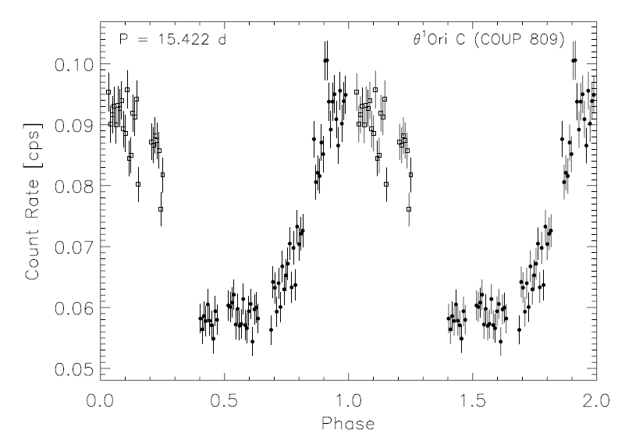
θ¹ Ori C: X-ray lightcurve – periodic variability
Stelzer et al. 2005
not zero
Notes:
22

Slide 23
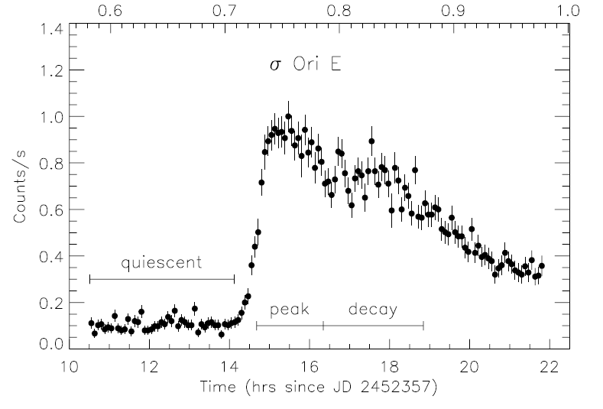
σ Ori E: XMM light curve: flare-like variability
Sanz-Forcada et al. 2004
Centrifugally driven breakout (ud-Doula, Townsend, & Owocki 2006, ApJ, 640, L191) …or low-mass binary companion?
Notes:
23

Slide 24
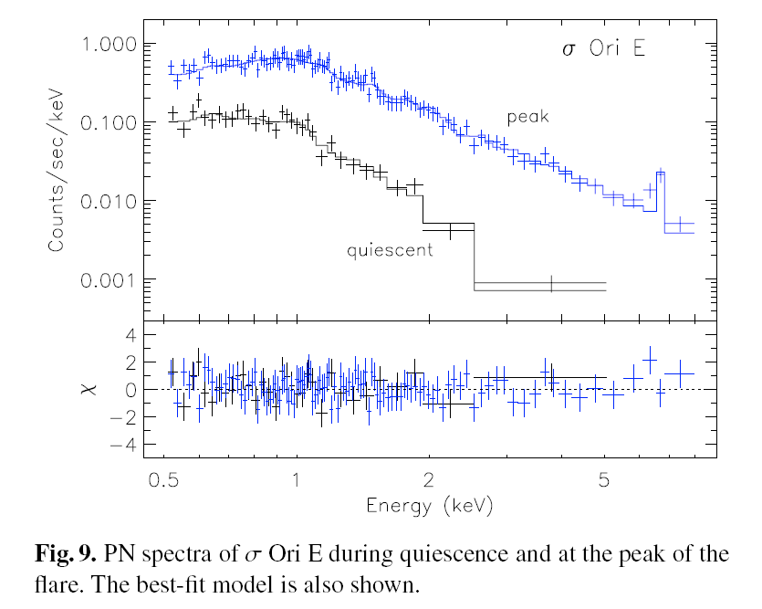
XMM EPIC spectrum of σ Ori E
Sanz-Forcada et al. 2004
Notes:
24

Slide 25
Chandra grating spectra: θ¹ Ori C and a non-magnetic O star
θ¹ Ori C
ζ Pup

Slide 26
thermal emission
“coronal approximation” valid: electrons in ground state, collisions up, spontaneous emission down
optically thin
lines from highly stripped metals, weak bremsstrahlung continuum (continuum stronger for higher temperatures)
Notes:
26

Slide 27
thermal emission
“coronal approximation” valid: electrons in ground state, collisions up, spontaneous emission down
optically thin
lines from highly stripped metals, weak bremsstrahlung continuum (continuum stronger for higher temperatures)
Notes:
27

Slide 28
thermal emission
“coronal approximation” valid: electrons in ground state, collisions up, spontaneous emission down
optically thin
lines from highly stripped metals, weak bremsstrahlung continuum (continuum stronger for higher temperatures)
Notes:
28

Slide 29
thermal emission
“coronal approximation” valid: electrons in ground state, collisions up, spontaneous emission down
optically thin
lines from highly stripped metals, weak bremsstrahlung continuum (continuum stronger for higher temperatures)
Notes:
29

Slide 30
Chandra grating spectra: θ¹ Ori C and a non-magnetic O star
θ¹ Ori C
ζ Pup

Slide 31
Energy Considerations and Scalings
1 keV ~ 12 × 10⁶ K ~ 12 Å
Shock heating: Δv = 300 km/s gives T ~ 10⁶ K (and T ~ v²)
ROSAT 150 eV to 2 keV
Chandra, XMM 350 eV to 10 keV
Notes:
31

Slide 32
Energy Considerations and Scalings
1 keV ~ 12 × 10⁶ K ~ 12 Å
Shock heating: Δv = 1000 km/s gives T ~ 10⁷ K (and T ~ v²)
ROSAT 150 eV to 2 keV
Chandra, XMM 350 eV to 10 keV
Notes:
32

Slide 33
H-like/He-like ratio is temperature sensitive
θ¹ Ori C
Mg XII
Mg XI
Si XIV
Si XIII
ζ Pup

Slide 34
θ¹ Ori C – is hotter
θ¹ Ori C
Mg XII
Mg XI
Si XIV
Si XIII
ζ Pup
H/He > 1 in θ¹ Ori C

Slide 35
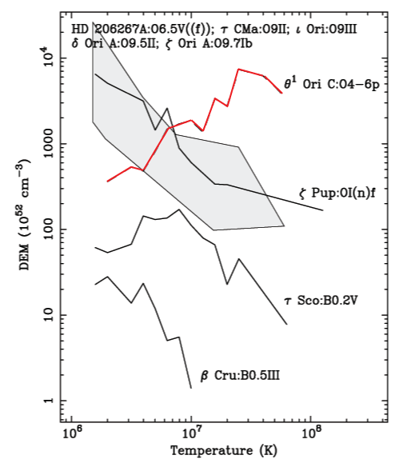
Differential Emission Measure (temperature distribution)
θ¹ Ori C is much hotter
Wojdowski & Schulz (2005)

Slide 36
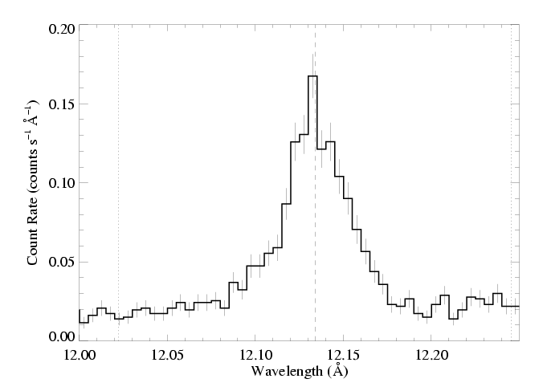
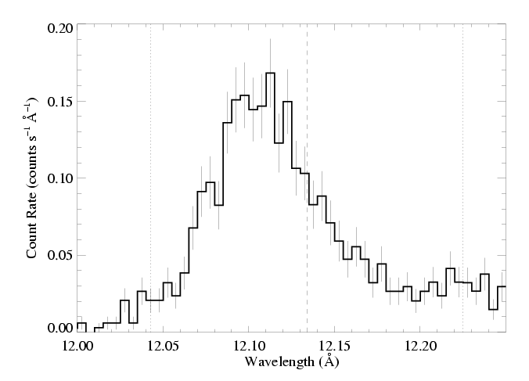
θ¹ Ori C (O7 V)
Emission lines are significantly narrower, too
1000 km s⁻¹
ζ Pup (O4 If)

Slide 37
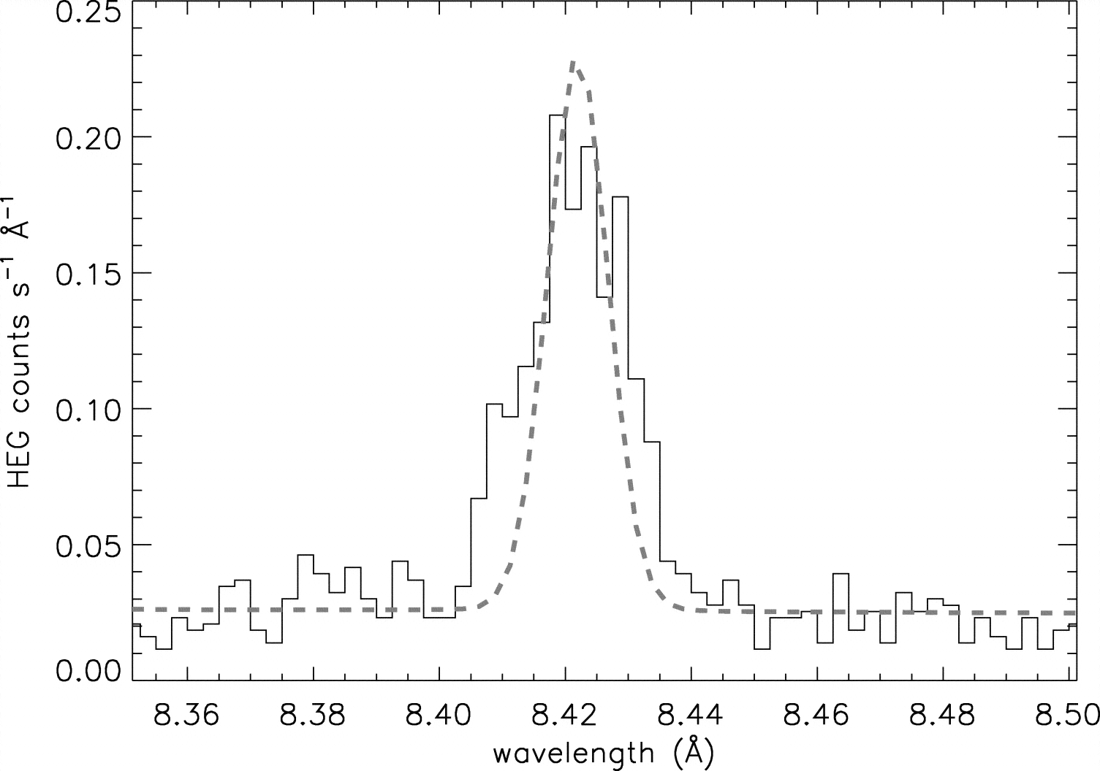
Mg XII Ly-α in θ¹ Ori C compared to instrumental profile
Notes:
37

Slide 38
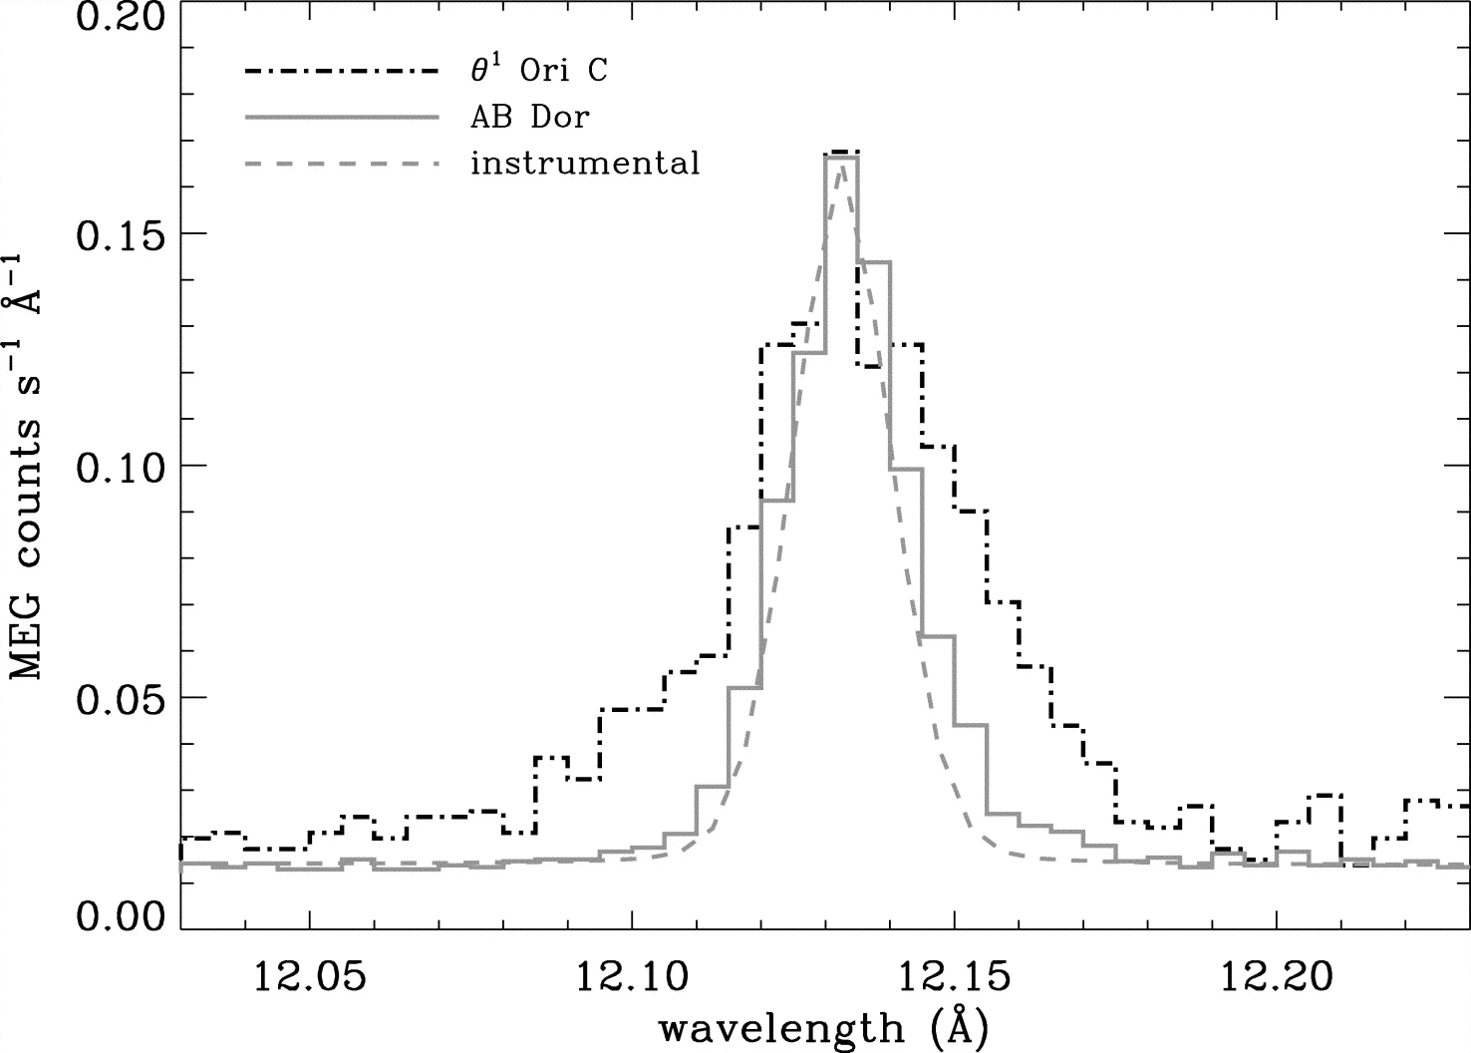
Ne X Ly-α in θ¹ Ori C : cooler plasma, broader – some contribution from “standard” instability wind shocks
Notes:
38

Slide 39
The X-ray properties of θ¹ Ori C can be understood in the context of its magnetic field and the magnetically channeled wind shock (MCWS) mechanism
Notes:
39

Slide 40
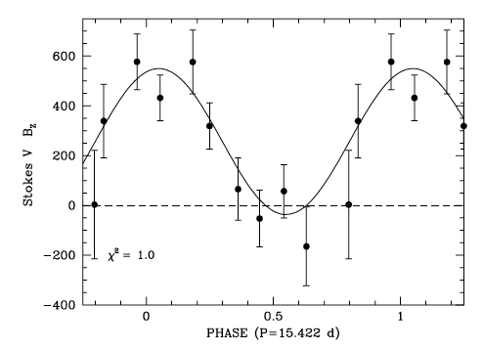
Dipole magnetic field
Wade et al. 2008
Notes:
40

Slide 41
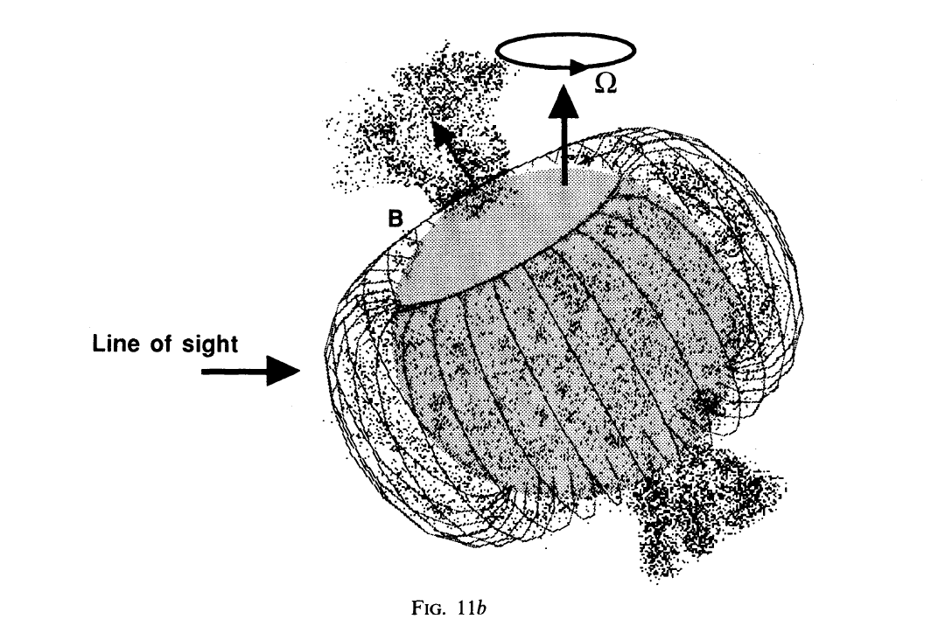
Shore & Brown, 1990
Notes:
41

Slide 42
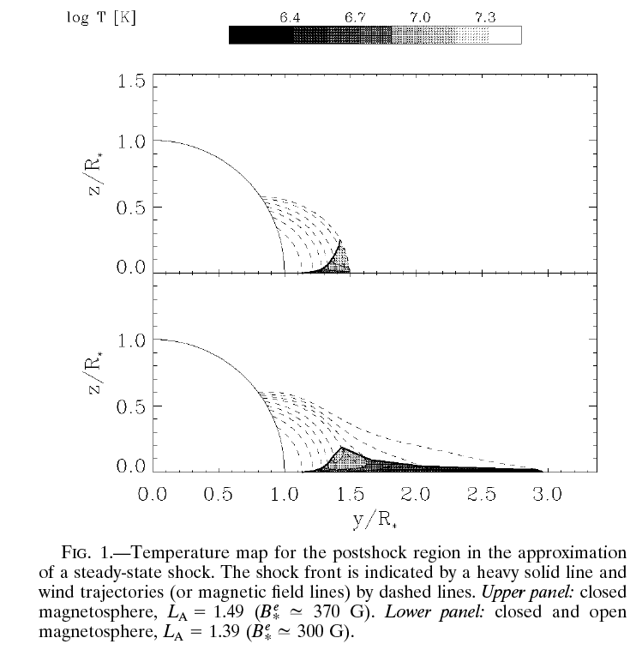
MCWS: Babel & Montmerle 1997
Notes:
42

Slide 43
Dynamical models (ud-Doula; Townsend): color scale shows emission measure in different temperature regimes
astro.swarthmore.edu/~cohen/presentations/MiMeS2/zeus-movie.avi
Notes:
43

Slide 44
Looking at individual physical variables:
Note that the hot, post-shock plasma:
has relatively low density,
is concentrated near the tops of the largest closed-loop regions (~2R_{star}),
and is very slow moving (due to confinement)
Notes:
44

Slide 45
Simulation/visualization courtesy A. ud-Doula Movie available at astro.swarthmore.edu/~cohen/presentations/apip09/t1oc-lowvinf-logd.avi
Notes:
45

Slide 46
Simulation/visualization courtesy A. ud-Doula Movie available at astro.swarthmore.edu/~cohen/presentations/apip09/t1oc-lowvinf-logT.avi
Notes:
46

Slide 47
Simulation/visualization courtesy A. ud-Doula Movie available at astro.swarthmore.edu/~cohen/presentations/apip09/t1oc-lowvinf-speed.avi
Notes:
47

Slide 48
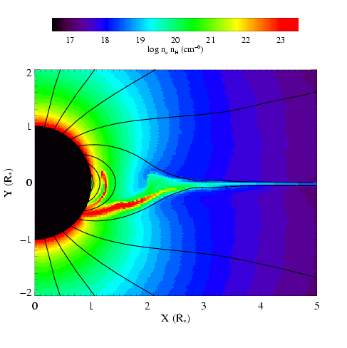
MHD simulation summary
temperature
emission measure
Gagné et al. (2005)
Channeled collision is close to head-on: Δv > 1000 km s⁻¹ : T > 10⁷ K

Slide 49
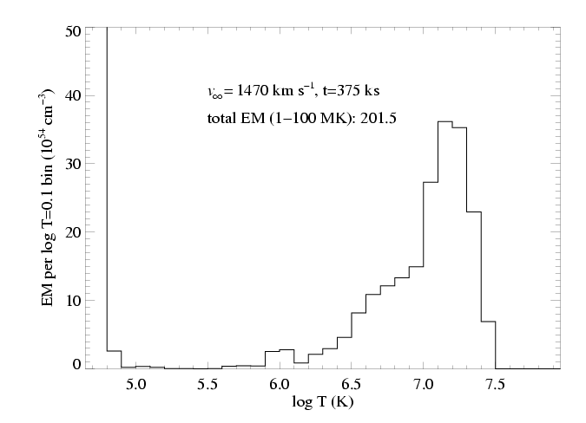
Differential emission measure (temperature distribution)
MHD simulation of θ¹ Ori C reproduces the observed differential emission measure
Wojdowski & Schulz (2005)

Slide 50
There are Chandra observations at many different phases
Notes:
50

Slide 51
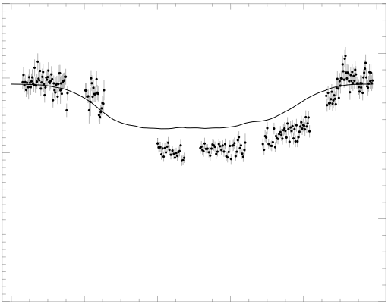
Chandra broadband count rate vs. rotational phase
0.4
1.5
0.3
1.0
0.2
Simulation EM (10⁵⁶ cm⁻³)
θ¹ Ori C ACIS-I count rate (s⁻¹)
0.1
0.5
0.0
0.0
0.0 0.2 0.4 0.6 0.8 1.0
Rotational phase (P=15.422 days)
Model from MHD simulation

Slide 52
The star itself occults the hot plasma in the magnetosphere
0.4
1.5
0.3
The closer the hot plasma is to the star, the deeper the dip in the x-ray light curve
1.0
0.2
Simulation EM (10⁵⁶ cm⁻³)
θ¹ Ori C ACIS-I count rate (s⁻¹)
0.1
0.5
0.0
0.0
0.0 0.2 0.4 0.6 0.8 1.0
Rotational phase (P=15.422 days)

Slide 53
The star itself occults the hot plasma in the magnetosphere
0.4
1.5
0.3
hot plasma is too far from the star in the simulation – the dip is not deep enough
1.0
0.2
Simulation EM (10⁵⁶ cm⁻³)
θ¹ Ori C ACIS-I count rate (s⁻¹)
0.1
0.5
0.0
0.0
0.0 0.2 0.4 0.6 0.8 1.0
Rotational phase (P=15.422 days)

Slide 54
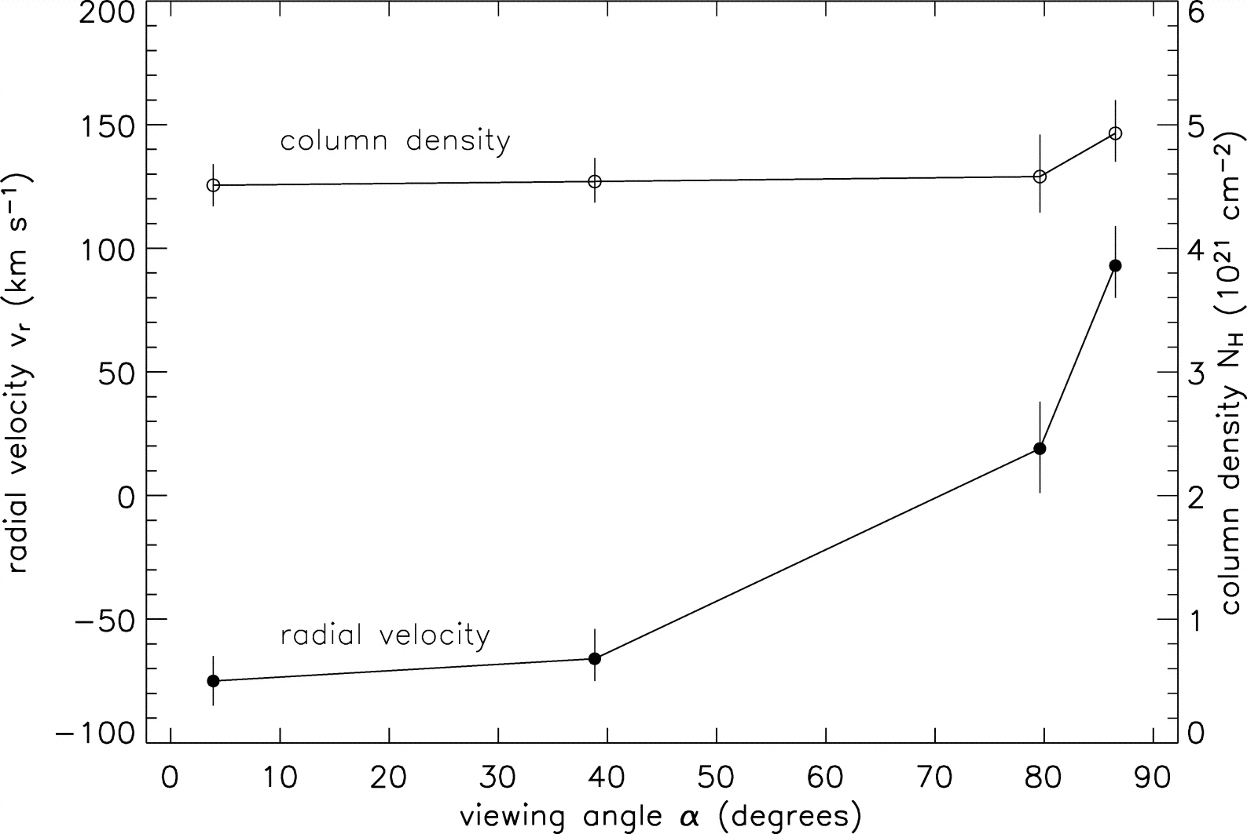
θ¹ Ori C column density (from x-ray absorption) vs. phase
pole-on
equator-on
Notes:
54

Slide 55
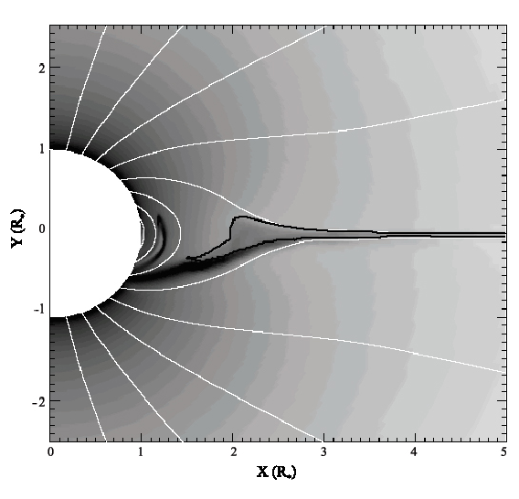
Emission measure
contour encloses T > 10⁶ K

Slide 56
Helium-like species’ forbidden-to-intercombination line ratios – f/i or z/(x+y) – provide information about the location of the hot plasma

Slide 57
Helium-like ions (e.g. O⁺⁶, Ne⁺⁸, Mg⁺¹⁰, Si⁺¹², S⁺¹⁴) – schematic energy level diagram
1s2p ¹P
10-20 eV
1s2p ³P
1s2s ³S
resonance (w)
1-2 keV
forbidden (z)
intercombination (x+y)
g.s. 1s² ¹S

Slide 58
Ultraviolet light from the star’s photosphere drives photoexcitation out of the ³S level
1s2p ¹P
UV
1s2p ³P
1s2s ³S
resonance (w)
forbidden (z)
intercombination (x+y)
g.s. 1s² ¹S

Slide 59
Weakening the forbidden line and strengthening the intercombination line
1s2p ¹P
UV
1s2p ³P
1s2s ³S
resonance (w)
forbidden (z)
intercombination (x+y)
g.s. 1s² ¹S

Slide 60
The f/i ratio is thus a diagnostic of the local UV mean intensity…
1s2p ¹P
UV
1s2p ³P
1s2s ³S
resonance (w)
forbidden (z)
intercombination (x+y)
g.s. 1s² ¹S

Slide 61
…and thus the distance of the x-ray emitting plasma from the photosphere
1s2p ¹P
UV
1s2p ³P
1s2s ³S
resonance (w)
forbidden (z)
intercombination (x+y)
g.s. 1s² ¹S

Slide 62
θ¹ Ori C
Mg XI
Notes:
62

Slide 63
R_{fir}=1.2 R*
R_{fir}=2.1 R*
R_{fir}=4.0 R*

Slide 64
He-like f/i ratios and the x-ray light curve both indicate that the hot plasma is somewhat closer to the photosphere of θ¹ Ori C than the MHD models predict.

Slide 65
So, in θ¹ Ori C, the X-rays tell us about the magnetospheric conditions in several ways:
High X-ray luminosity
X-ray hardness (high plasma temperatures)
Periodic variability (rotation and occultation)
Narrow emission lines (confinement)
f/i ratios quantify location
Notes:
65

Slide 66
What about other magnetic massive stars?
Notes:
66

Slide 67
What about confinement?
Recall:
θ¹ Ori C: η* ~ 20 : decent confinement
Notes:
67

Slide 68
What about confinement?
Recall:
ζ Ori: η* ~ 0.1 : poor confinement
θ¹ Ori C: η* ~ 20 : decent confinement
σ Ori E: η* ~ 10⁷ : excellent confinement
Notes:
68

Slide 69
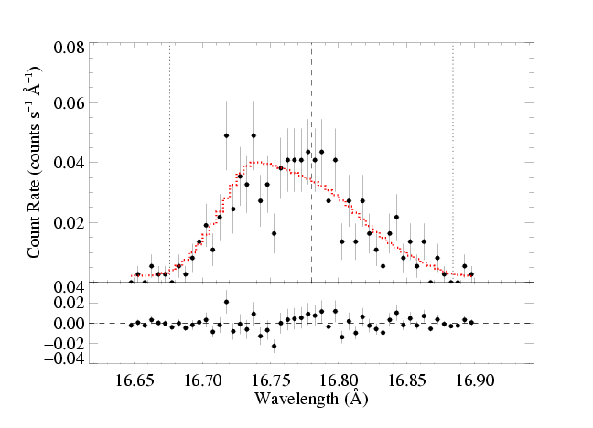
θ¹ Ori C has a hard X-ray spectrum with narrow lines
…HD191612 and ζ Ori have soft X-ray spectra with broad lines
-v_{inf}
λ_{o}
+v_{inf}
Fe XVII in ζ Ori
Notes:
69

Slide 70
ζ Ori
θ¹ Ori C
Notes:
70

Slide 71
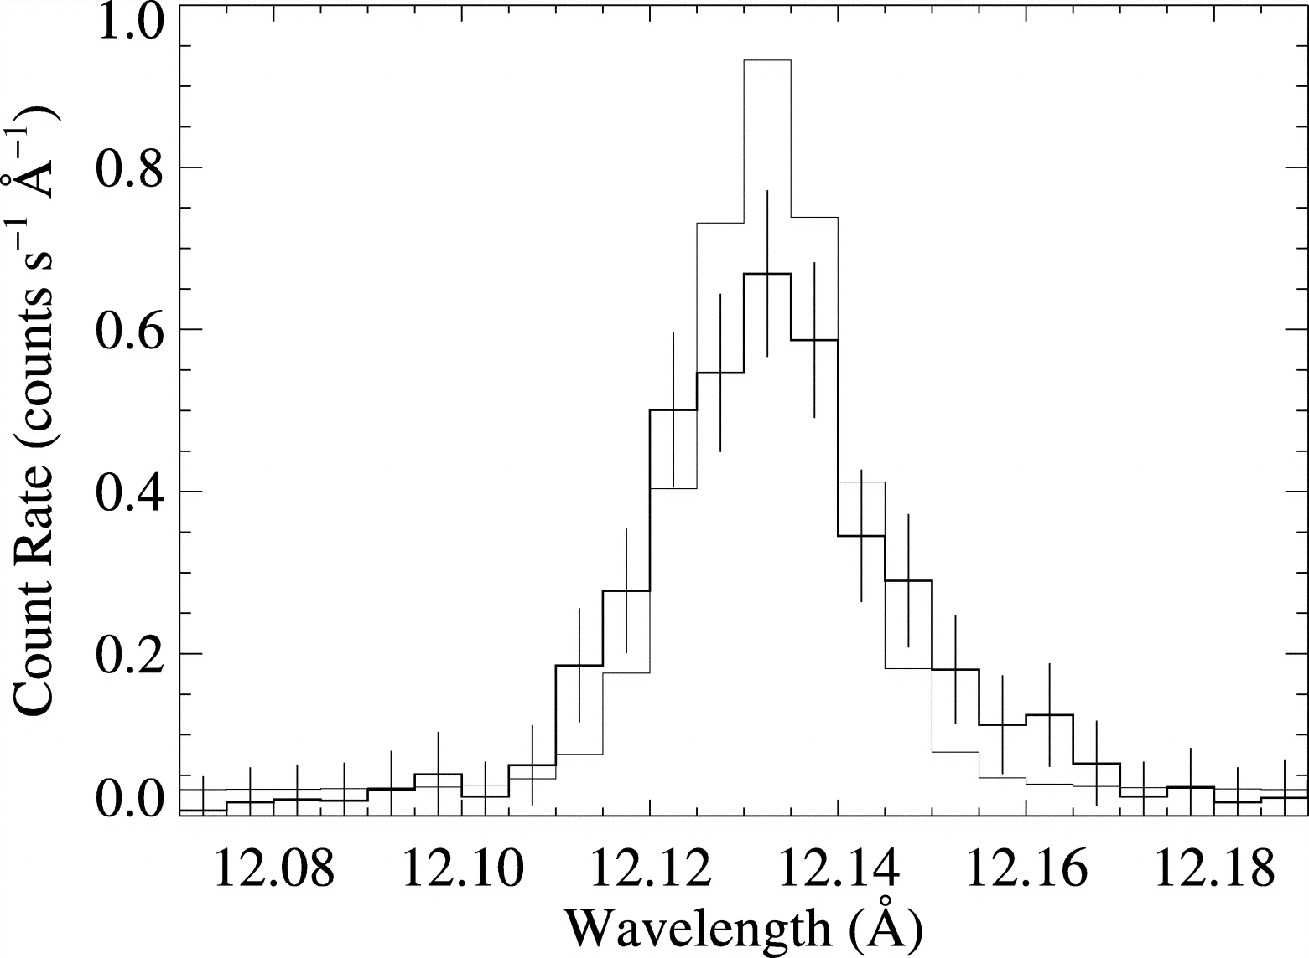
τ Sco does have a hard spectrum and narrow lines
Ne Lyα compared to instrumental response: narrow
Notes:
71

Slide 72
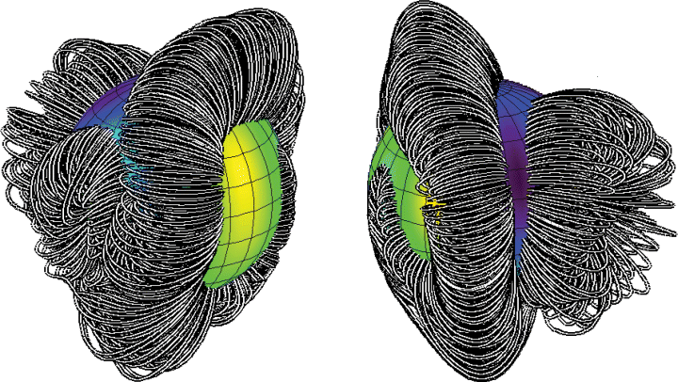
τ Sco: closed loop region is near the star…
Notes:
72

Slide 73
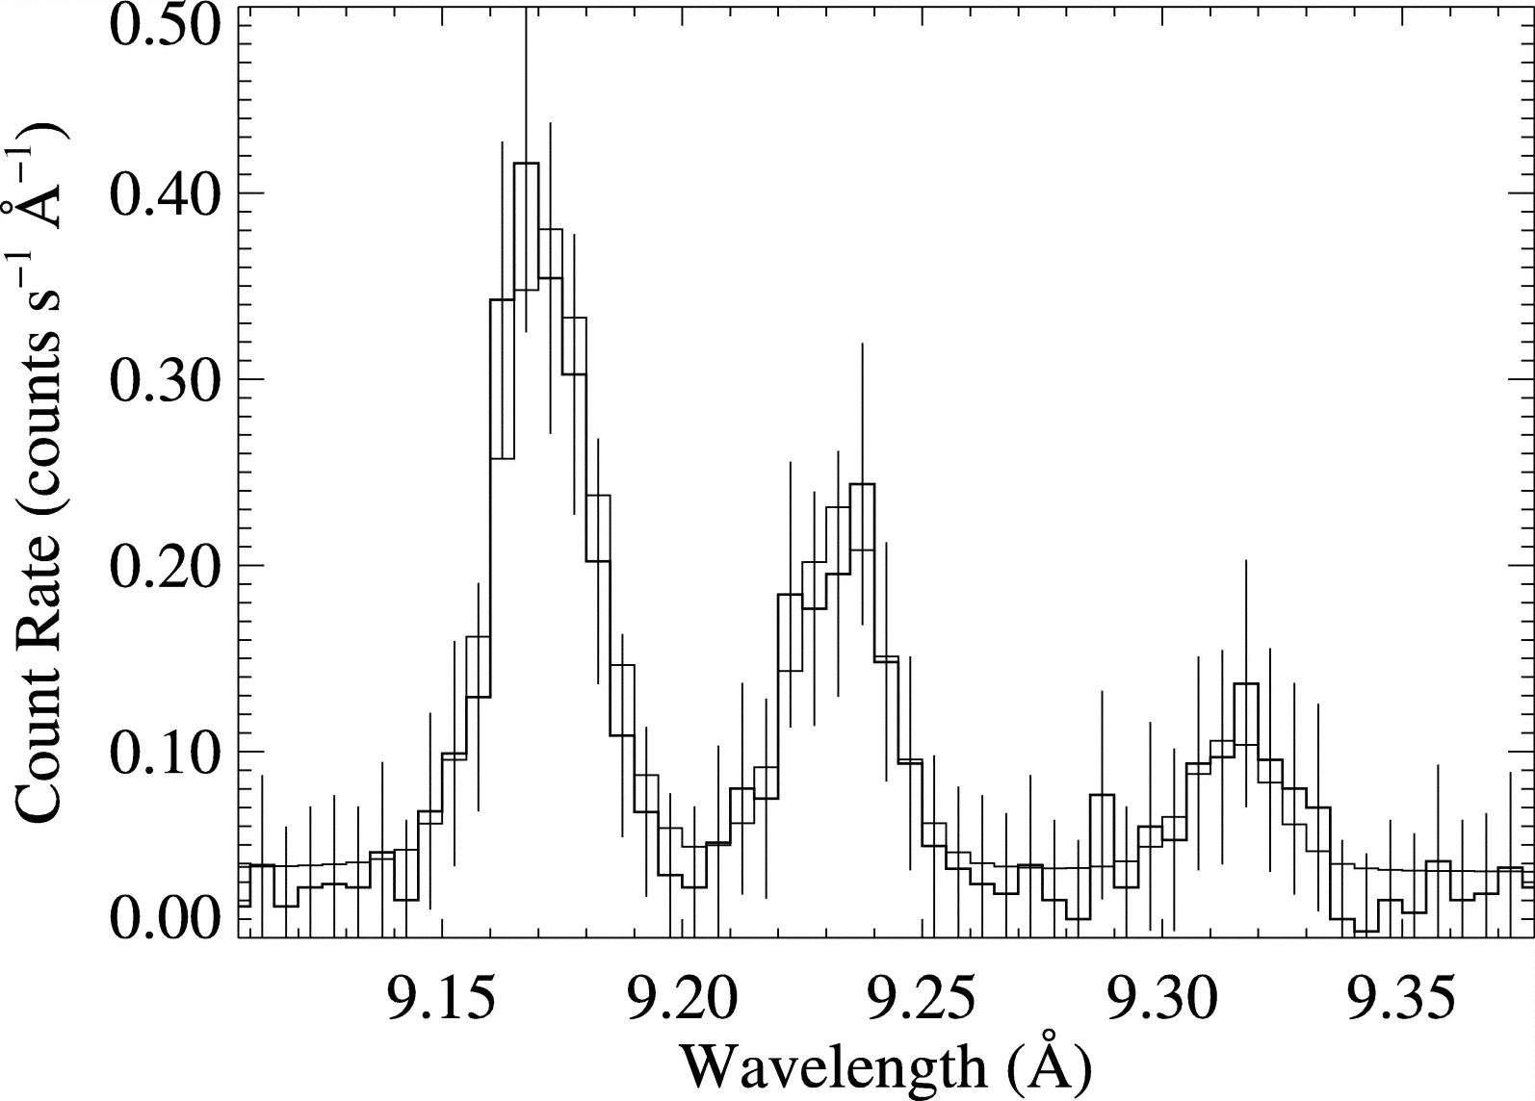
τ Sco: closed loop region is near the star…
…f/i ratios tell us X-rays are far from the star (~3R_{star})
i
f
Notes:
73

Slide 74
Do He-like f/i ratios provide evidence of hot plasma near the photospheres of O stars?
Notes:
74

Slide 75
Do He-like f/i ratios provide evidence of hot plasma near the photospheres of O stars?
No, I’m afraid they do not.
Notes:
75

Slide 76
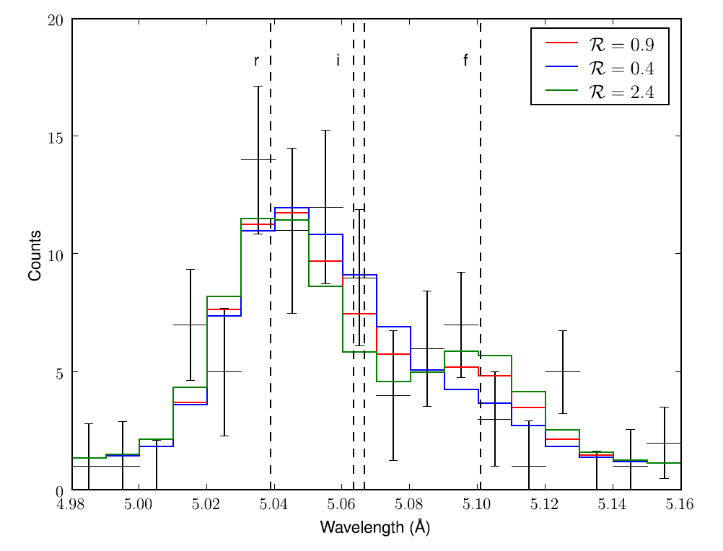
Features are very blended in most O stars: here, the three models are statistically indistinguishable
locations span 1.1 R_{star} to infinity
ζ Pup S XV Chandra MEG
Notes:
76

Slide 77
σ Ori E (η* ~ 10⁷: RRM+RFHD)
Notes:
77

Slide 78
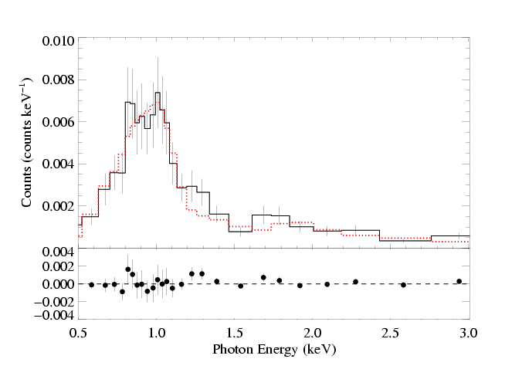
Chandra ACIS (low-resolution, CCD) spectrum
Notes:
78

Slide 79
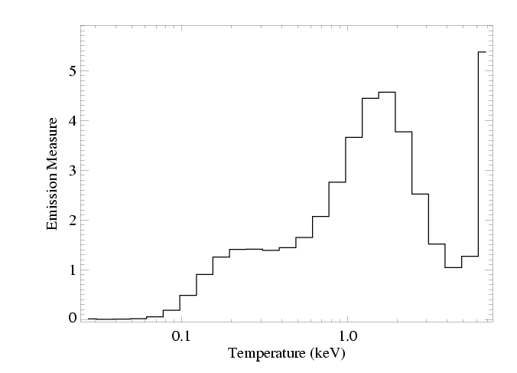
DEM derived from Chandra ACIS spectrum
Notes:
79

Slide 80
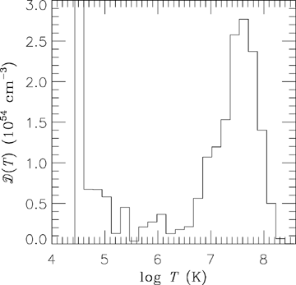
DEM from RFHD modeling
Notes:
80

Slide 81
Observed & theoretical DEMs agree well
Notes:
81

Slide 82
RFHD (Townsend, Owocki, & ud-Doula 2007, MNRAS, 382, 139 )
astro.swarthmore.edu/~cohen/presentations/MiMeS2/hav-rfhd-4p.avi
Notes:
82

Slide 83
Conclusions
MCWS dynamical scenario explains θ¹ Ori C well…but, in detail, MHD models do not reproduce all the observational properties
Most other magnetic massive stars have X-ray emission that is different from θ¹ Ori C
Some have soft X-ray spectra with broad lines
Closed field regions may not always be associated with the X-rays (τ Sco)
f/i ratios, hard X-rays, variability in massive stars…not unique to magnetic field wind interaction

