Slide 1
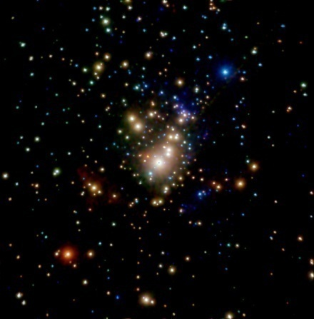
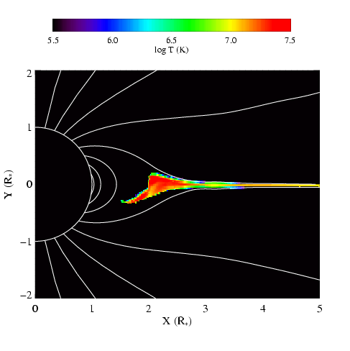
X-ray Diagnostics and Their Relationship to Magnetic Fields
David Cohen Swarthmore College

Slide 2
Notes:
2

Slide 3
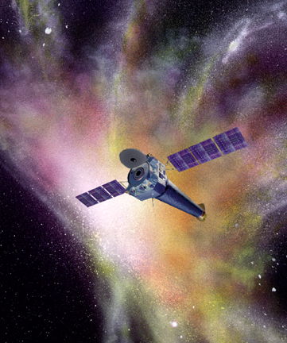
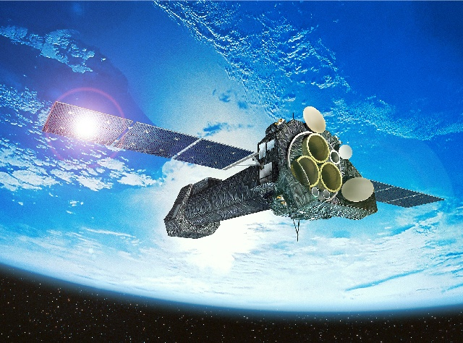
Launched 2000: superior sensitivity, spatial resolution, and spectral resolution
Chandra
XMM-Newton
Sub-arcsecond resolution
Notes:
3

Slide 4
XMM-Newton
Both have CCD detectors for imaging spectroscopy (at low spectral resolution: R~20 to 50)
And – with lower sensitivity – both have grating spectrometers with resolutions of a few 100 to ~1000
Chandra
Notes:
4

Slide 5
Notes:
5

Slide 6
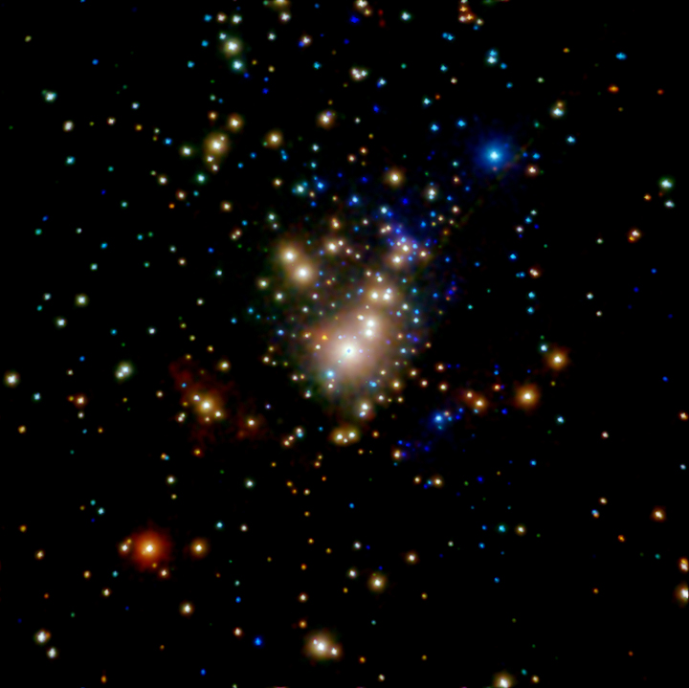
Chandra ACIS Orion Nebula Cluster (COUP)
θ¹ Ori C
Color coded according to photon energy (red: <1keV; green 1 to 2 keV; blue > 2 keV)

Slide 7
Notes:
7

Slide 8
Notes:
8

Slide 9
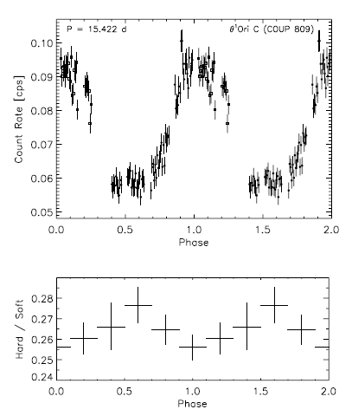
θ¹ Ori C: X-ray lightcurve
Stelzer et al. 2005
Notes:
9

Slide 10
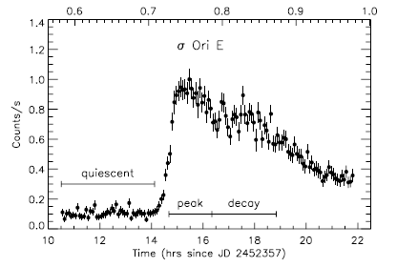
σ Ori E: XMM light curve
Sanz-Forcada et al. 2004
Notes:
10

Slide 11
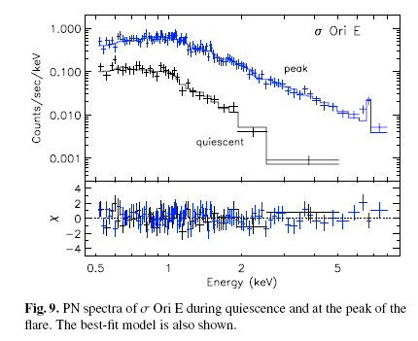
XMM EPIC spectrum of σ Ori E
Sanz-Forcada et al. 2004
Notes:
11

Slide 12
Differences between θ¹ Ori C and a normal O star
θ¹ Ori C
Mg XII
Mg XI
Si XIV
Si XIII
ζ Pup

Slide 13
Hot plasma emitting thermal x-rays
1 keV ~ 12 × 10⁶ K ~ 12 Å
Shock heating: Δv = 300 km gives T ~ 10⁶ K (and T ~ v²)
ROSAT 150 eV to 2 keV
Chandra, XMM 500 eV to 10 keV
Notes:
13

Slide 14
Notes:
14

Slide 15
Chandra grating spectra
θ¹ Ori C
θ¹ Ori C: hotter plasma, narrower emission lines
ζ Pup
ζ Pup: cooler plasma, broad emission lines

Slide 16
H-like/He-like ratio is temperature sensitive
θ¹ Ori C
Mg XII
Mg XI
Si XIV
Si XIII
ζ Pup

Slide 17
The magnetic O star – θ¹ Ori C – is hotter
θ¹ Ori C
Mg XII
Mg XI
Si XIV
Si XIII
ζ Pup

Slide 18
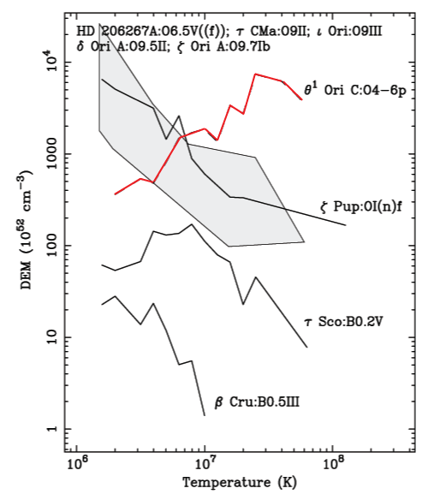
Differential Emission Measure (temperature distribution)
Wojdowski & Schulz (2005)

Slide 19
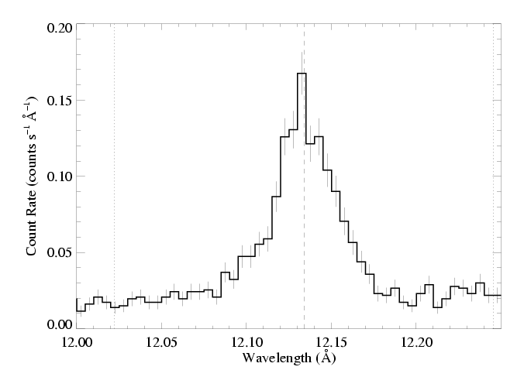
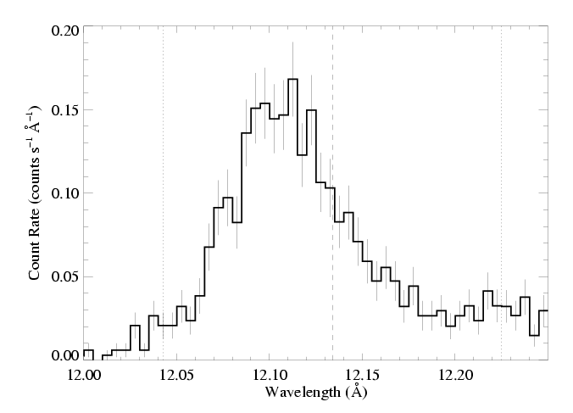
θ¹ Ori C (O7 V)
Emission lines are significantly narrower, too
1000 km s⁻¹
ζ Pup (O4 If)

Slide 20
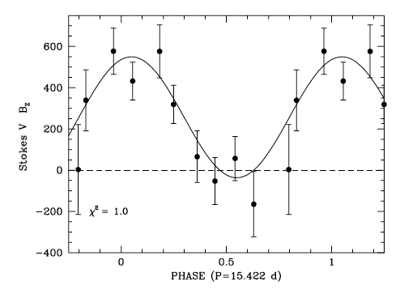
Dipole magnetic field
Wade et al. 2008
Notes:
20

Slide 21
Recently discovered dipole magnetic field of > 1 kG : Zeeman Doppler spectroscopy (Wade et al. 2006)
Simulation/visualization courtesy R. Townsend Movie available at astro.swarthmore.edu/~cohen/presentations/apip09/rrm-o25-i75-b60-redt.avi

Slide 22
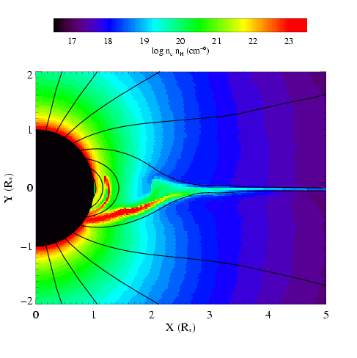
MHD simulations of magnetically channeled wind
temperature
emission measure
simulations by A. ud-Doula; Gagné et al. (2005)
Channeled collision is close to head-on – >1000 km s⁻¹ : T > 10⁷ K

Slide 23
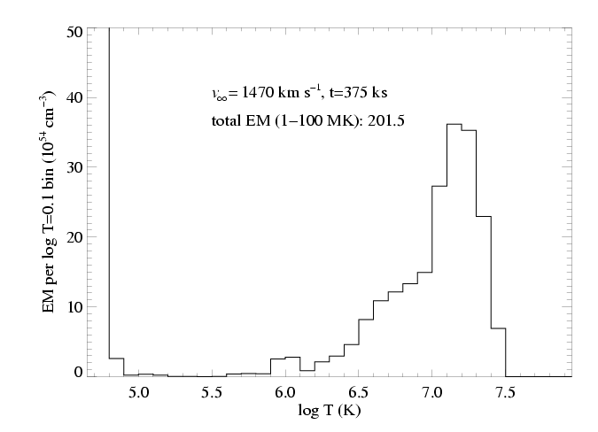
Differential emission measure (temperature distribution)
MHD simulation of θ¹ Ori C reproduces the observed differential emission measure
Wojdowski & Schulz (2005)

Slide 24
Notes:
24

Slide 25
Notes:
25

Slide 26
Notes:
26

Slide 27
Notes:
27

Slide 28
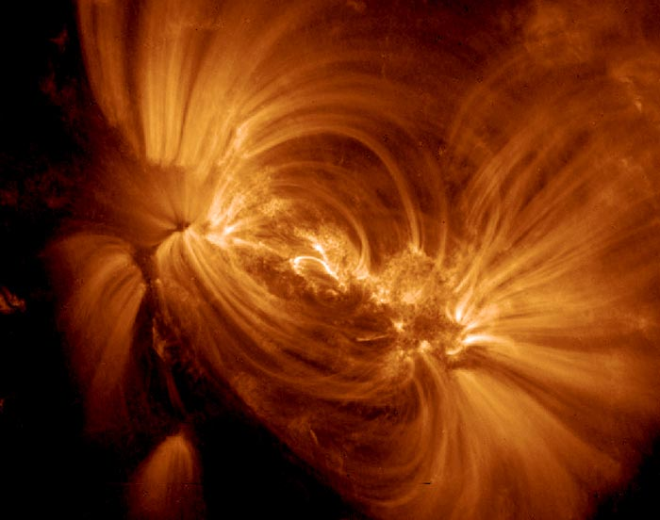

Slide 29
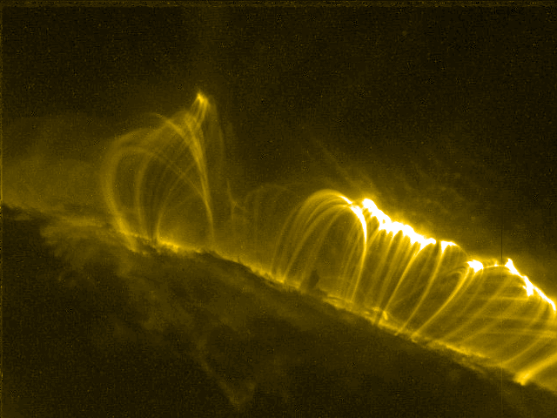

Slide 30
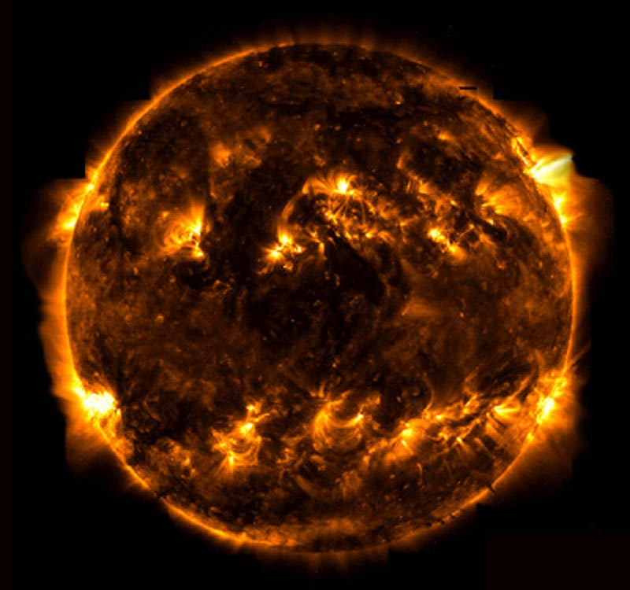
TRACE

Slide 31
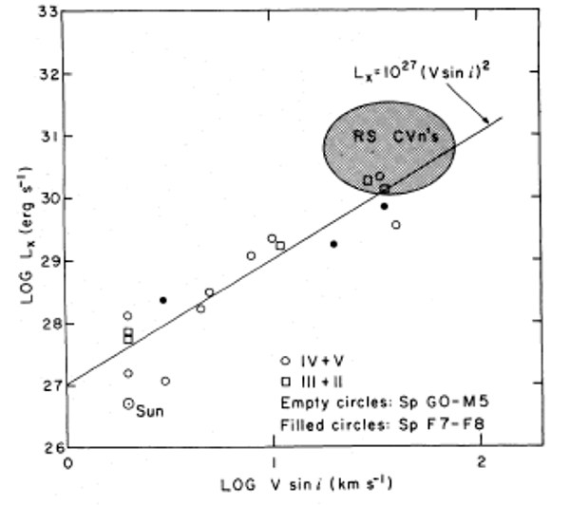
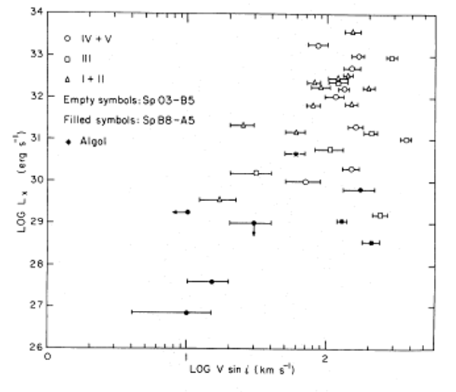
Stellar rotation vs. X-ray luminosity
low-mass stars
high-mass stars
No trend

Slide 32
Notes:
32

Slide 33
High Temperatures – signs of magnetically channeled wind shocks
Notes:
33

Slide 34
Notes:
34

Slide 35
But what about magnetic stars with soft X-rays?
Notes:
35

Slide 36
Notes:
36

Slide 37
Chandra HETGS/MEG spectrum (R ~ 1000 ~ 300 km s⁻¹)
ζ Pup
Si
Mg
Ne
Fe
O
H-like
He-like
Notes:
37

Slide 38
Notes:
38

Slide 39
What about zeta Ori?
Notes:
39

Slide 40
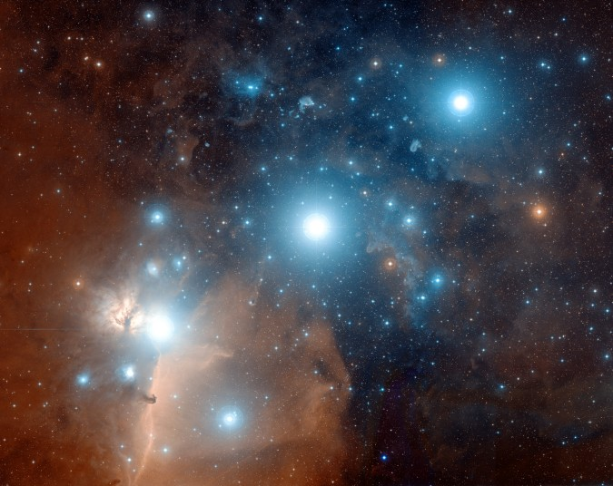
ζ Ori: O9.5

Slide 41
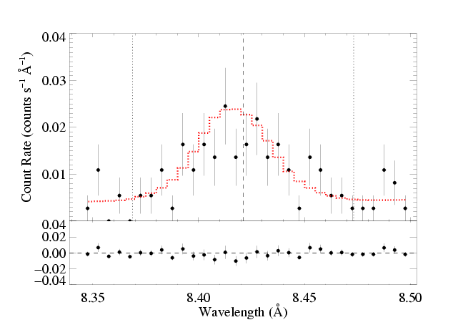
ζ Ori: O9.5 - less massive
Mg XII Lyman-α: τ* = 0.1

Slide 42
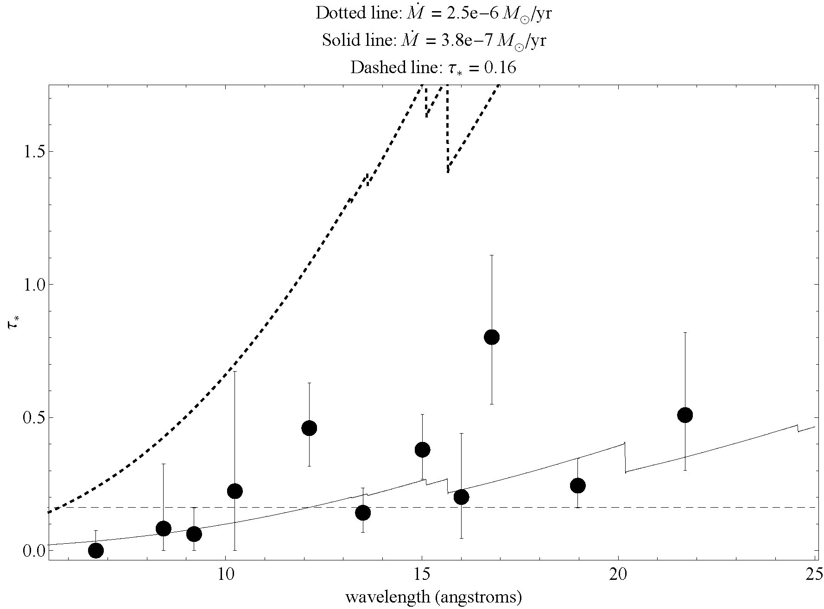

Slide 43
Notes:
43

Slide 44
What about late O and early B stars with big filling factors and narrow lines?
Notes:
44

Slide 45
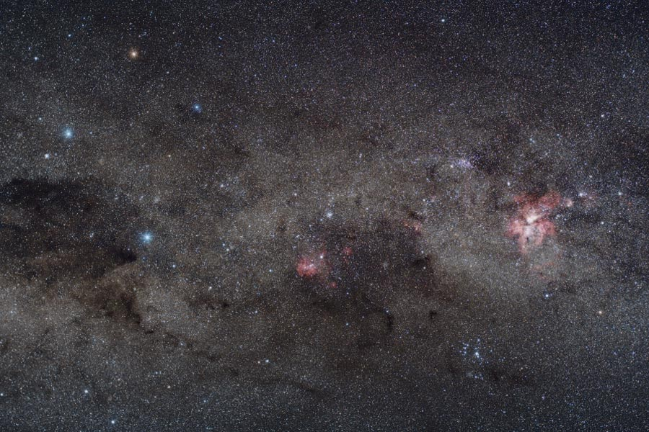
Yuri Beletsky (ESO)
Notes:
45

Slide 46
Notes:
46

Slide 47
Notes:
47

Slide 48
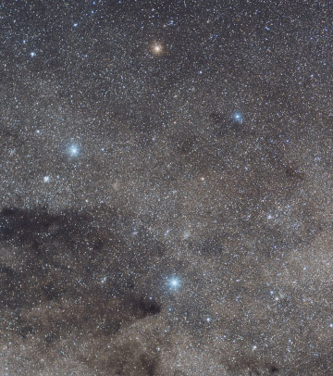
Crucis
aliases:
Mimosa
HD 111123
a massive (16 M_{sun}), luminous (34,000 L_{sun}), hot (30,000 K) star
…but not quite as hot, massive, and luminous as an O star: a B0.5 III star
Notes:
48

Slide 49
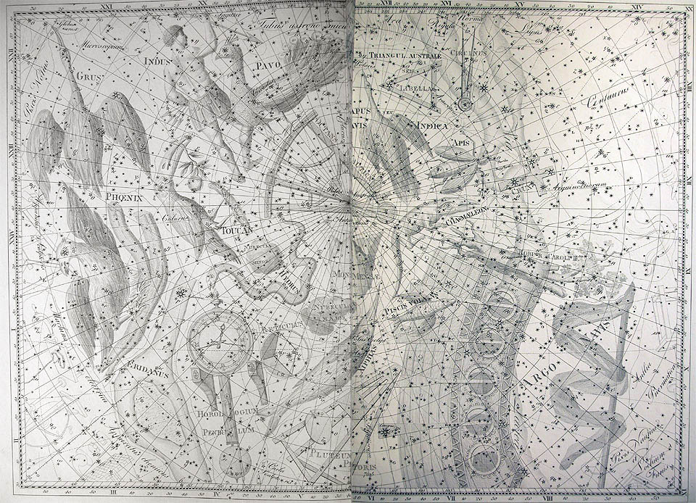
Notes:
49

Slide 50
Notes:
50

Slide 51
Notes:
51

Slide 52
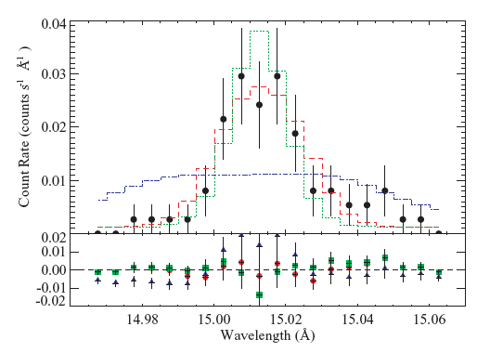
β Crucis (B0.5 V): lines are narrow!
unresolved
wind-broadened
best-fit
Fe XVII line
Notes:
52

Slide 53
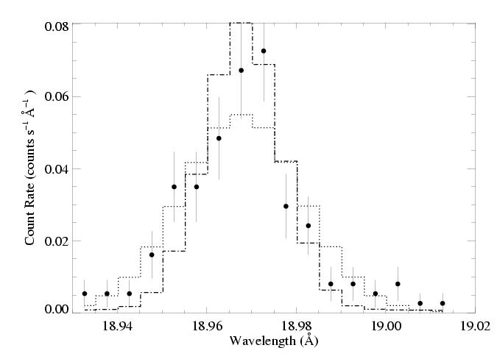
β Cru: O VIII Ly-α line
Notes:
53

Slide 54
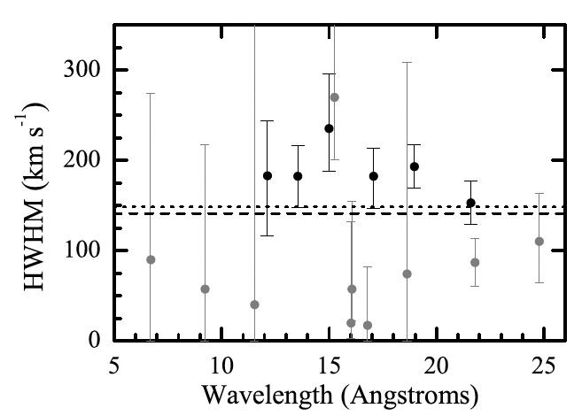
Notes:
54

Slide 55
Later-type massive stars with weaker winds… X-ray production is hard to explain…
Notes:
55

Slide 56
Notes:
56

Slide 57
Part 2: Magnetically Channeled Winds
Notes:
57

Slide 58
Predictions:
Shocks are strong – head-on – and so plasma is hotter;
Hot plasma is moving much slower (confinement);
Rotational modulation of X-ray flux;
Hot plasma is ~1 R* above the surface.
Notes:
58

Slide 59
Chandra grating spectra
θ¹ Ori C
θ¹ Ori C: hotter plasma, narrower emission lines
ζ Pup
ζ Pup: cooler plasma, broad emission lines

Slide 60
H-like/He-like ratio is temperature sensitive
θ¹ Ori C
Mg XII
Mg XI
Si XIV
Si XIII
ζ Pup

Slide 61
The magnetic O star – θ¹ Ori C – is hotter
θ¹ Ori C
Mg XII
Mg XI
Si XIV
Si XIII
ζ Pup

Slide 62
Differential emission measure (temperature distribution)
MHD simulation of θ¹ Ori C reproduces the observed differential emission measure
Wojdowski & Schulz (2005)

Slide 63
θ¹ Ori C (O7 V)
Emission lines are significantly narrower in the magnetic massive star’s x-ray spectrum
1000 km s⁻¹
ζ Pup (O4 If)

Slide 64
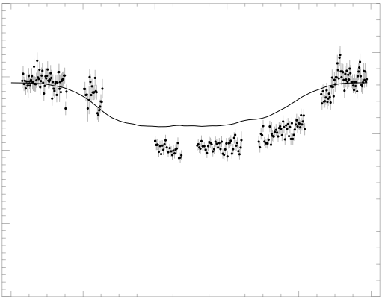
Chandra broadband count rate vs. rotational phase
0.4
1.5
0.3
1.0
0.2
Simulation EM (10⁵⁶ cm⁻³)
θ¹ Ori C ACIS-I count rate (s⁻¹)
0.1
0.5
0.0
0.0
0.0 0.2 0.4 0.6 0.8 1.0
Rotational phase (P=15.422 days)
Model from MHD simulation

Slide 65
The star itself occults the hot plasma torus
0.4
1.5
0.3
The closer the hot plasma is to the star, the deeper the dip in the x-ray light curve
1.0
0.2
Simulation EM (10⁵⁶ cm⁻³)
θ¹ Ori C ACIS-I count rate (s⁻¹)
0.1
0.5
0.0
0.0
0.0 0.2 0.4 0.6 0.8 1.0
Rotational phase (P=15.422 days)

Slide 66
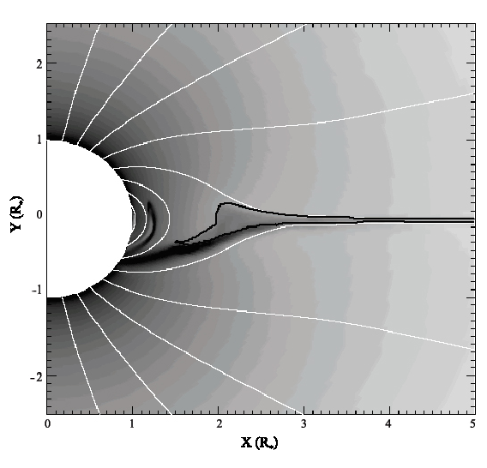
Emission measure
contour encloses T > 10⁶ K

Slide 67
Helium-like species’ forbidden-to-intercombination line ratios – z/(x+y) – provide information about the location of the hot plasma
…not the density, as is usually the case.

Slide 68
Helium-like ions (e.g. O⁺⁶, Ne⁺⁸, Mg⁺¹⁰, Si⁺¹², S⁺¹⁴) – schematic energy level diagram
1s2p ¹P
10-20 eV
1s2p ³P
1s2s ³S
resonance (w)
1-2 keV
forbidden (z)
intercombination (x+y)
g.s. 1s² ¹S

Slide 69
Ultraviolet light from the star’s photosphere drives photoexcitation out of the ³S level
1s2p ¹P
UV
1s2p ³P
1s2s ³S
resonance (w)
forbidden (z)
intercombination (x+y)
g.s. 1s² ¹S

Slide 70
The f/i ratio is thus a diagnostic of the local UV mean intensity…
1s2p ¹P
UV
1s2p ³P
1s2s ³S
resonance (w)
forbidden (z)
intercombination (x+y)
g.s. 1s² ¹S

Slide 71
…and thus the distance of the x-ray emitting plasma from the photosphere
1s2p ¹P
UV
1s2p ³P
1s2s ³S
resonance (w)
forbidden (z)
intercombination (x+y)
g.s. 1s² ¹S

Slide 72
R_{fir}=1.2 R*
R_{fir}=2.1 R*
R_{fir}=4.0 R*

Slide 73
He-like f/i ratios and the x-ray light curve both indicate that the hot plasma is somewhat closer to the photosphere than the MHD models predict.

Slide 74
Conclusions
Normal massive stars have x-ray line profiles consistent with the predictions of the wind instability model.
Photoelectric absorption’s effect on the profile shapes can be used as a mass-loss rate diagnostic: mass-loss rates are lower than previously thought.
Later-type massive stars have X-rays that are harder to understand, though…

Slide 75
Conclusions, pt. 2
Magnetic massive stars have harder spectra with narrower lines and rotationally modulated variability, in general agreement with MHD simulations.
Line ratio diagnostics are useful for localizing the hot plasma, and indicate that the MHD simulations predict a location that is too far from the photosphere.

Slide 76
Notes:
76

Slide 77
Massive star X-rays vs. Solar-type X-rays

Slide 78
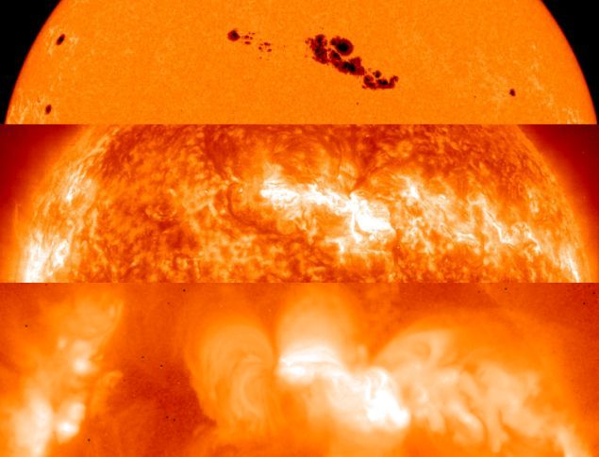
The Sun at different wavelengths
Optical 5800 K
SOHO EUV few 10⁵ K
YOKOH x-ray few 10⁶ K

Slide 79
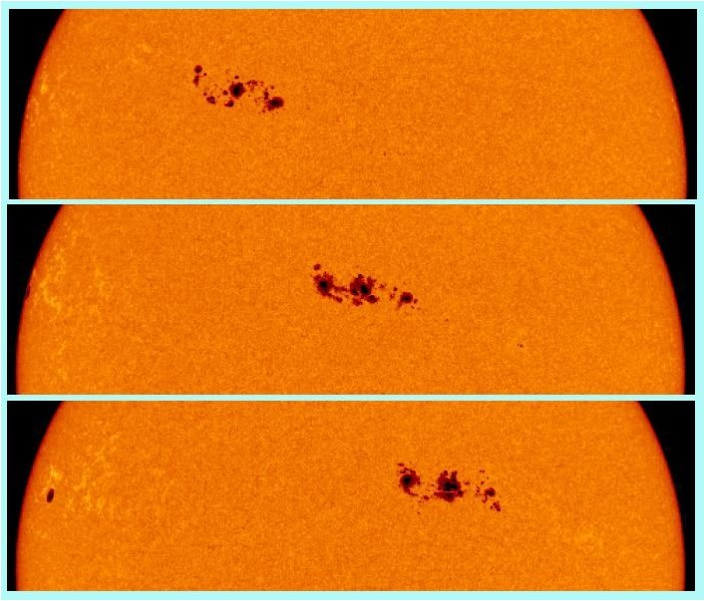
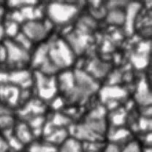
rotation
convection

Slide 80
Notes:
80

Slide 81
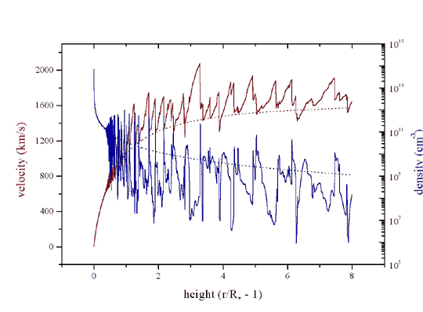
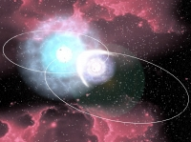
Three models for massive star x-ray emission
1. Instability driven shocks
2. Magnetically channeled wind shocks
3. Wind-wind interaction in close binaries
Notes:
81

Slide 82
Notes:
82

Slide 83
Orion’s belt stars
De Martin/Digitized Sky Survey
Notes:
83

Slide 84
Notes:
84

Slide 85
Notes:
85

Slide 86
Chandra HETGS/MEG spectrum (R ~ 1000 ~ 300 km s⁻¹)
θ¹ Ori C
Si
Mg
Fe
Ne
H-like
He-like
Notes:
86

Slide 87
Notes:
87

Slide 88
ζ Pup
Low-mass star (Capella) for comparison
Notes:
88

Slide 89
ζ Pup
Ne X
Ne IX
Fe XVII
Capella
Notes:
89

Slide 90
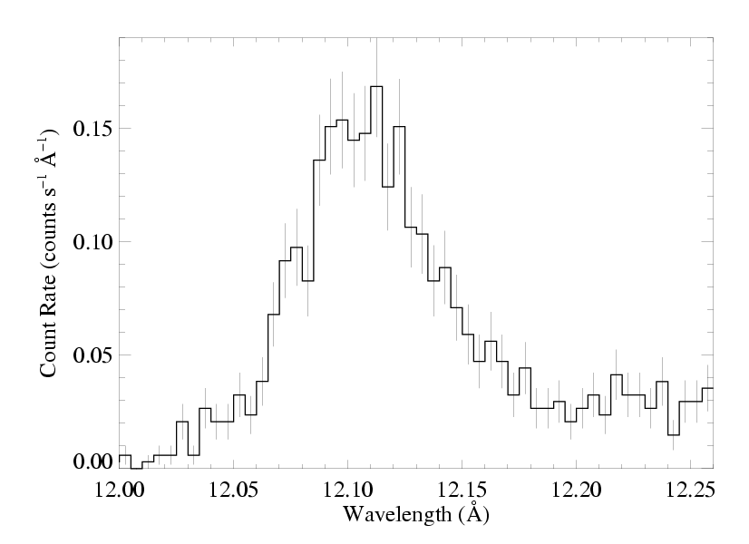
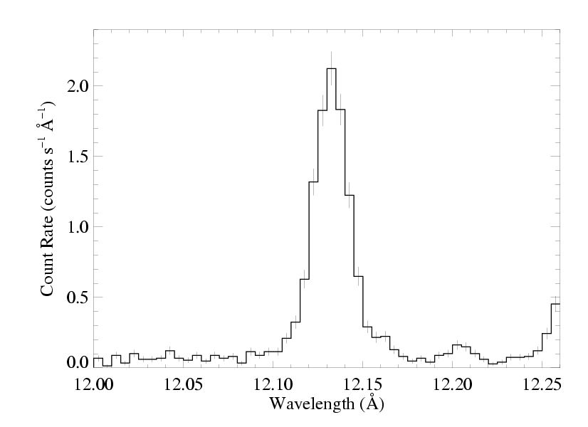
ζ Pup massive
Capella low mass
Notes:
90

Slide 91
The x-ray emission lines are broad: agreement with rad hydro simulations
ζ Pup
But… they’re also blue shifted and asymmetric
Is this predicted by the wind shock scenario?
Notes:
91

