Slide 1
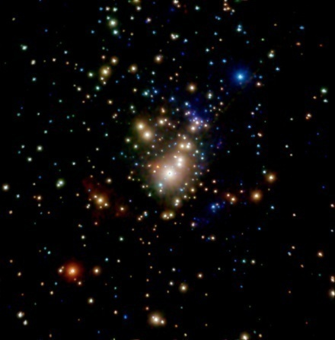
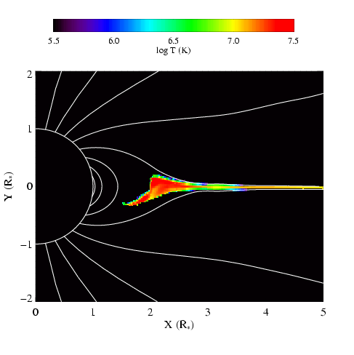
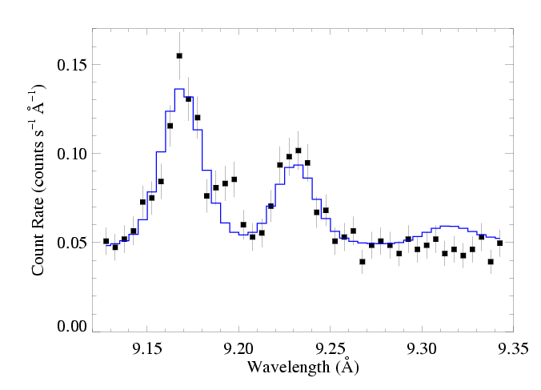
X-ray Diagnostics and Their Relationship to Magnetic Fields
David Cohen Swarthmore College

Slide 2
Notes:
2

Slide 3
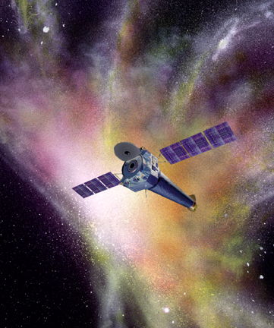
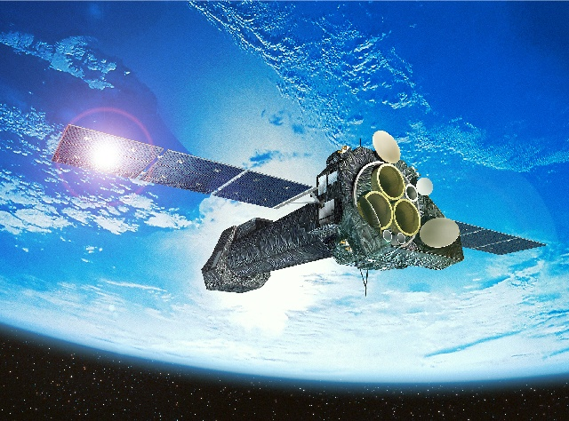
Launched 2000: superior sensitivity, spatial resolution, and spectral resolution
Chandra
XMM-Newton
sub-arcsecond resolution
Notes:
3

Slide 4
XMM-Newton
Both have CCD detectors for imaging spectroscopy:
low spectral resolution: R ~ 20 to 50
Chandra
And both have grating spectrometers: R ~ few 100 to 1000
Notes:
4

Slide 5
Notes:
5

Slide 6
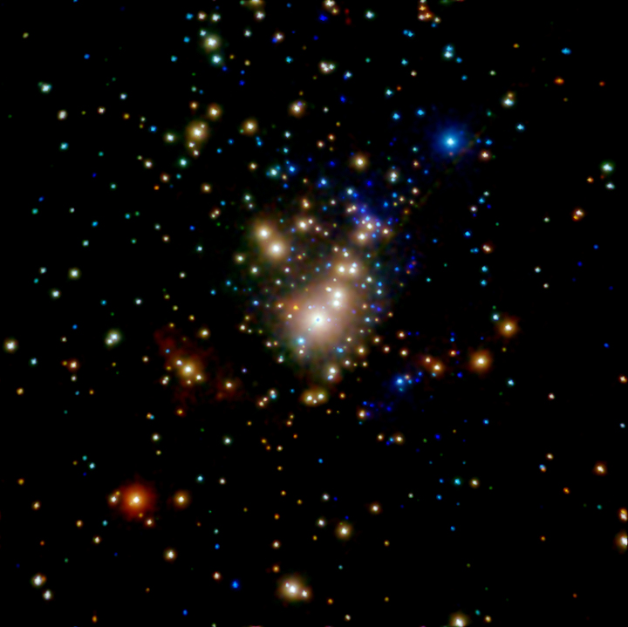
Chandra ACIS Orion Nebula Cluster (COUP)
θ¹ Ori C
Color coded according to photon energy (red: <1keV; green 1 to 2 keV; blue > 2 keV)

Slide 7
Notes:
7

Slide 8
Notes:
8

Slide 9
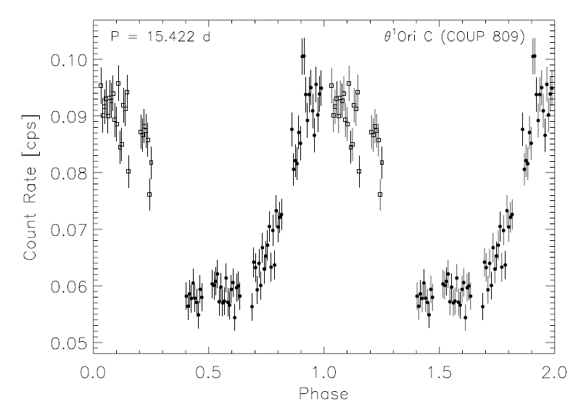
θ¹ Ori C: X-ray lightcurve
Stelzer et al. 2005
Notes:
9

Slide 10
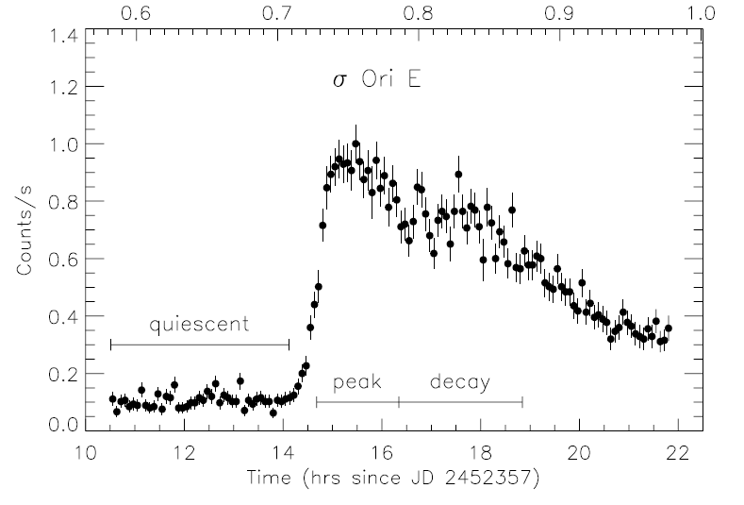
σ Ori E: XMM light curve
Sanz-Forcada et al. 2004
Notes:
10

Slide 11
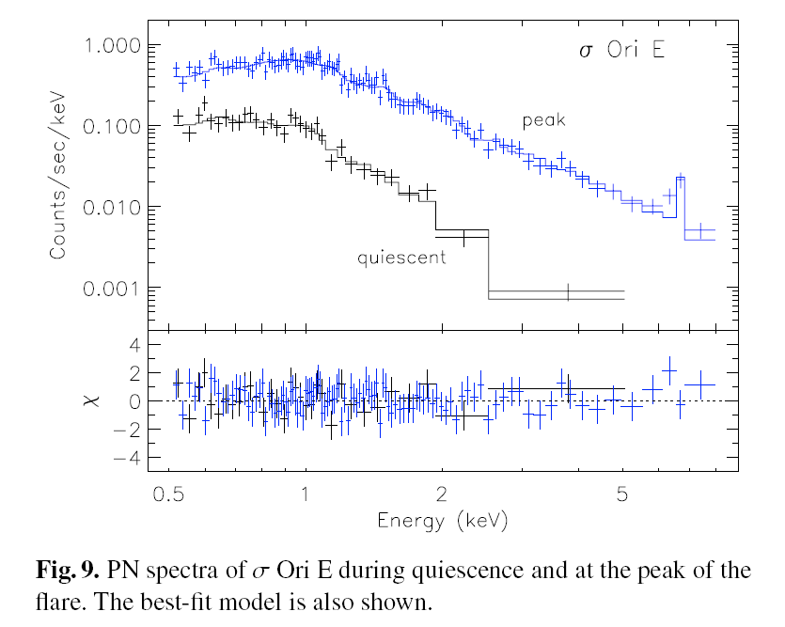
XMM EPIC spectrum of σ Ori E
Sanz-Forcada et al. 2004
Notes:
11

Slide 12
Chandra grating specra: θ¹ Ori C and a non-magnetic O star
θ¹ Ori C
ζ Pup

Slide 13
Hot plasma emitting thermal x-rays
1 keV ~ 12 × 10⁶ K ~ 12 Å
Shock heating: Δv = 300 km gives T ~ 10⁶ K (and T ~ v²)
ROSAT 150 eV to 2 keV
Chandra, XMM 350 eV to 10 keV
Notes:
13

Slide 14
Hot plasma emitting thermal x-rays
1 keV ~ 12 × 10⁶ K ~ 12 Å
Shock heating: Δv = 1000 km gives T ~ 10⁷ K (and T ~ v²)
ROSAT 150 eV to 2 keV
Chandra, XMM 350 eV to 10 keV
Notes:
14

Slide 15
Notes:
15

Slide 16
H-like/He-like ratio is temperature sensitive
θ¹ Ori C
Mg XII
Mg XI
Si XIV
Si XIII
ζ Pup

Slide 17
The magnetic O star – θ¹ Ori C – is hotter
θ¹ Ori C
Mg XII
Mg XI
Si XIV
Si XIII
ζ Pup

Slide 18
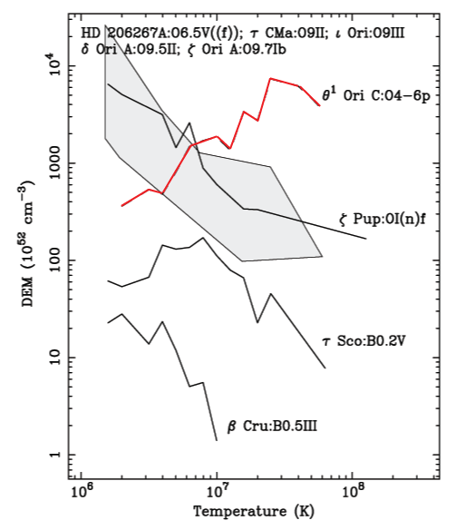
Differential Emission Measure (temperature distribution)
θ¹ Ori C is much hotter
Wojdowski & Schulz (2005)

Slide 19
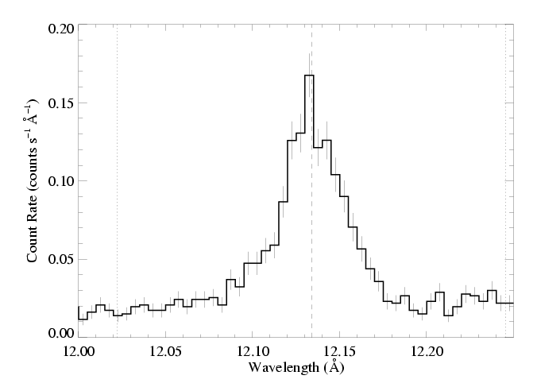
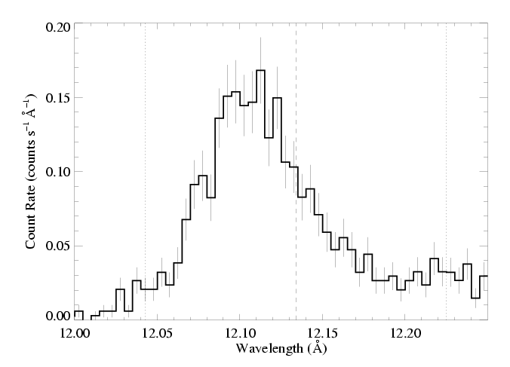
θ¹ Ori C (O7 V)
Emission lines are significantly narrower, too
1000 km s⁻¹
ζ Pup (O4 If)

Slide 20
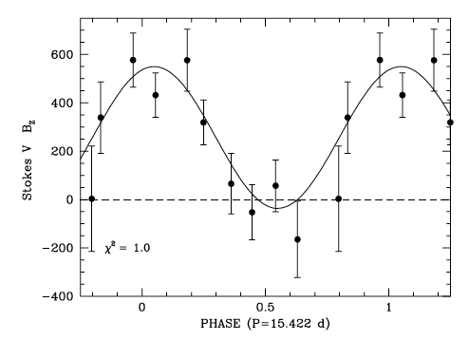
Dipole magnetic field
Wade et al. 2008
Notes:
20

Slide 21
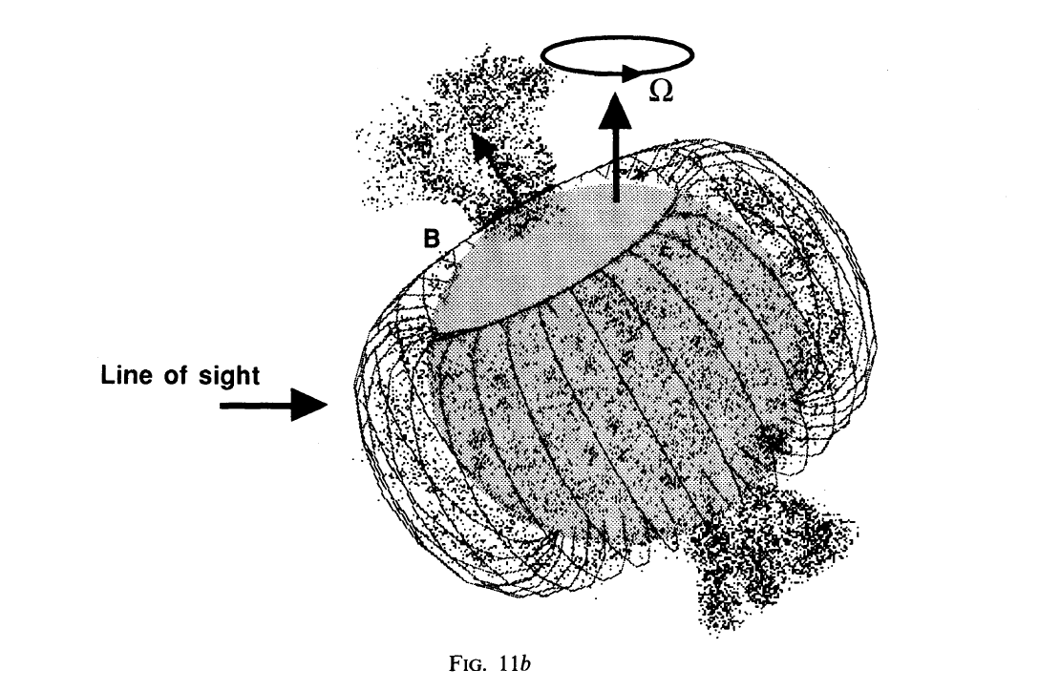
Shore & Brown, 1990
Notes:
21

Slide 22
Rotating tilted dipole
Simulation/visualization courtesy R. Townsend

Slide 23
Notes:
23

Slide 24
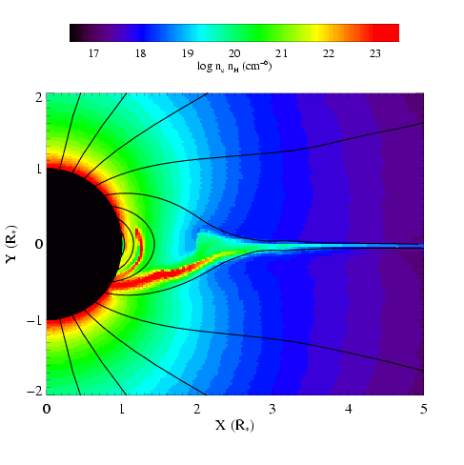
MHD simulations of magnetically channeled wind
temperature
emission measure
simulations by A. ud-Doula; Gagné et al. (2005)
Channeled collision is close to head-on: Δv > 1000 km s⁻¹ : T > 10⁷ K

Slide 25
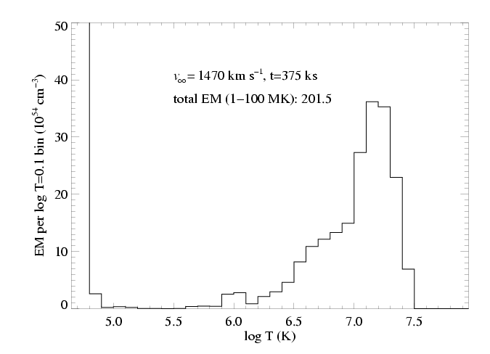
Differential emission measure (temperature distribution)
MHD simulation of θ¹ Ori C reproduces the observed differential emission measure
Wojdowski & Schulz (2005)

Slide 26
Notes:
26

Slide 27
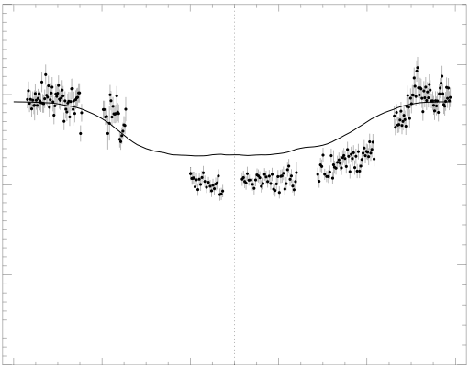
Chandra broadband count rate vs. rotational phase
0.4
1.5
0.3
1.0
0.2
Simulation EM (10⁵⁶ cm⁻³)
θ¹ Ori C ACIS-I count rate (s⁻¹)
0.1
0.5
0.0
0.0
0.0 0.2 0.4 0.6 0.8 1.0
Rotational phase (P=15.422 days)
Model from MHD simulation

Slide 28
The star itself occults the hot plasma torus
0.4
1.5
0.3
The closer the hot plasma is to the star, the deeper the dip in the x-ray light curve
1.0
0.2
Simulation EM (10⁵⁶ cm⁻³)
θ¹ Ori C ACIS-I count rate (s⁻¹)
0.1
0.5
0.0
0.0
0.0 0.2 0.4 0.6 0.8 1.0
Rotational phase (P=15.422 days)

Slide 29
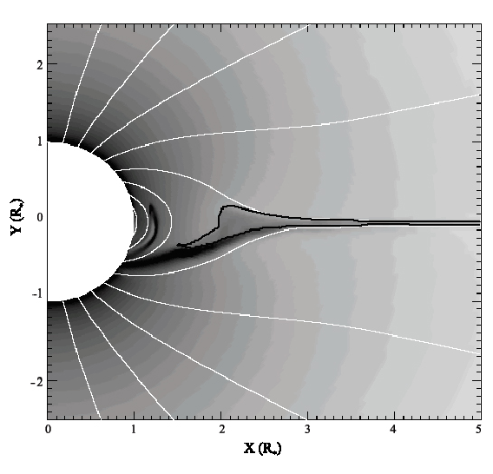
Emission measure
contour encloses T > 10⁶ K

Slide 30
Helium-like species’ forbidden-to-intercombination line ratios – f/i or z/(x+y) – provide information about the location of the hot plasma
…not the density, as is usually the case.

Slide 31
Helium-like ions (e.g. O⁺⁶, Ne⁺⁸, Mg⁺¹⁰, Si⁺¹², S⁺¹⁴) – schematic energy level diagram
1s2p ¹P
10-20 eV
1s2p ³P
1s2s ³S
resonance (w)
1-2 keV
forbidden (z)
intercombination (x+y)
g.s. 1s² ¹S

Slide 32
Ultraviolet light from the star’s photosphere drives photoexcitation out of the ³S level
1s2p ¹P
UV
1s2p ³P
1s2s ³S
resonance (w)
forbidden (z)
intercombination (x+y)
g.s. 1s² ¹S

Slide 33
The f/i ratio is thus a diagnostic of the local UV mean intensity…
1s2p ¹P
UV
1s2p ³P
1s2s ³S
resonance (w)
forbidden (z)
intercombination (x+y)
g.s. 1s² ¹S

Slide 34
…and thus the distance of the x-ray emitting plasma from the photosphere
1s2p ¹P
UV
1s2p ³P
1s2s ³S
resonance (w)
forbidden (z)
intercombination (x+y)
g.s. 1s² ¹S

Slide 35
R_{fir}=1.2 R*
R_{fir}=2.1 R*
R_{fir}=4.0 R*

Slide 36
He-like f/i ratios and the x-ray light curve both indicate that the hot plasma is somewhat closer to the photosphere of θ¹ Ori C than the MHD models predict.

Slide 37
Some slides showing f/i ratios in zeta Ori, tau Sco… main point: there is NO evidence for a “near star high ion problem”
Notes:
37

Slide 38
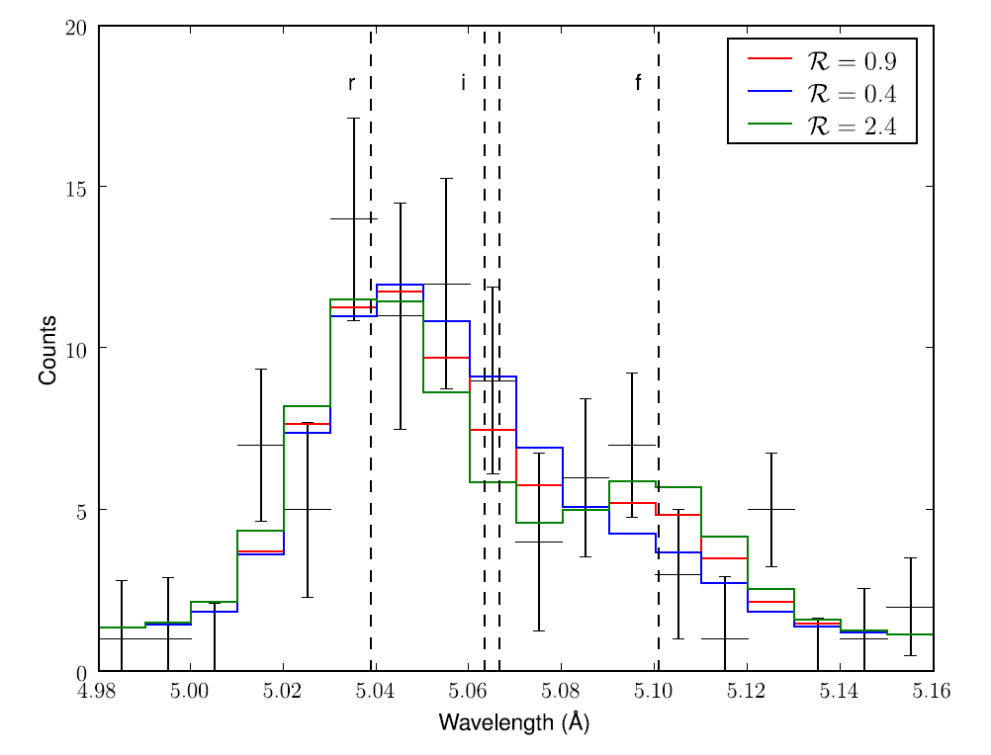
ζ Pup S XV Chandra MEG
Notes:
38

Slide 39
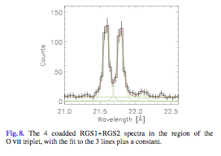
Notes:
39

Slide 40
More possible topics:
Zeta Ori, HD191612 – magnetic but X-rays look “normal”
Tau Sco – narrow lines but f/i ratios imply plasma far from the photosphere
Sigma Ori E – X-ray DEM well reproduced by Rich’s RFHD modeling; flaring too (centrifugal breakout)
Early B stars are mysterious – large x-ray luminosities, soft spectra, narrow lines but no evidence for magnetic fields (theta Car, beta Cru)
Notes:
40

Slide 41
Conclusions
Some conclusions…

