Slide 1
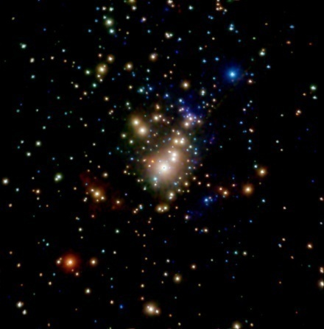
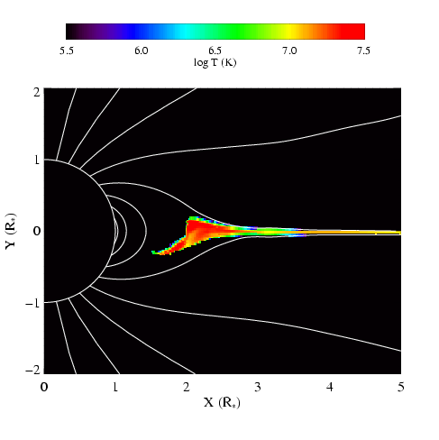
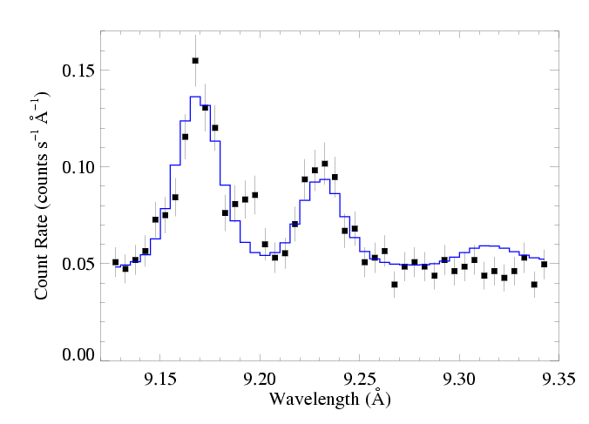
X-ray Diagnostics and Their Relationship to Magnetic Fields
David Cohen Swarthmore College

Slide 2
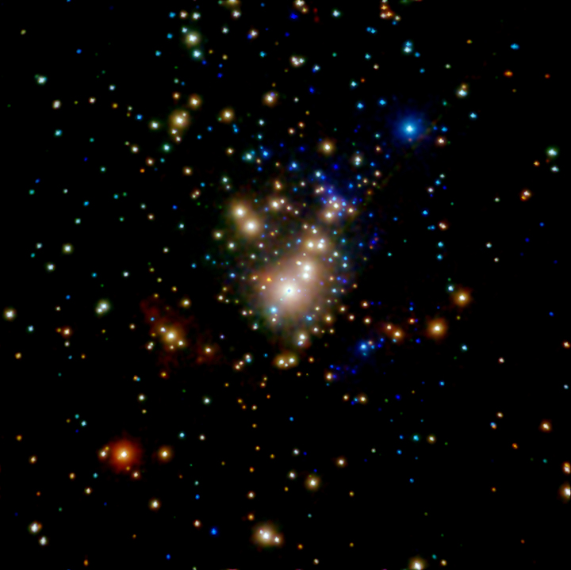
If we understand the physical connection between magnetic fields in massive stars and X-rays, we could use X-ray observations to identify magnetic massive stars.
e.g. Which of the stars in this Chandra X-ray image of the Orion Nebula Cluster are massive magnetic stars?
Notes:
2

Slide 3
But we’re not there yet…
X-ray behavior of known magnetic massive stars is diverse.
We don’t understand enough about the physical mechanisms of X-ray production in them.
Notes:
3

Slide 4
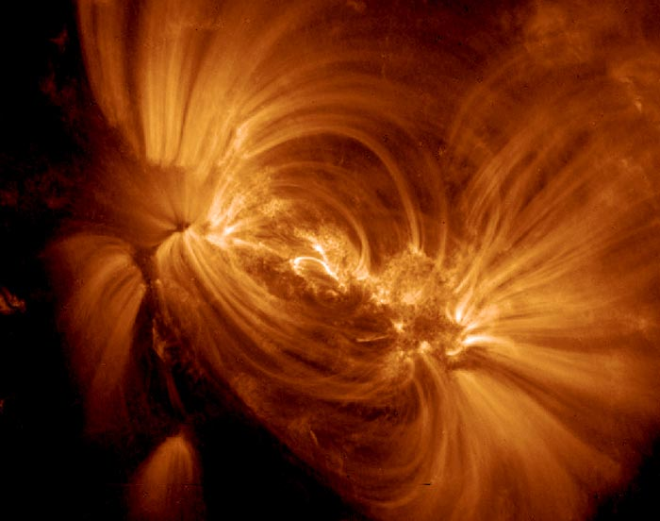
The Sun: X-rays <-> Magnetic Fields

Slide 5
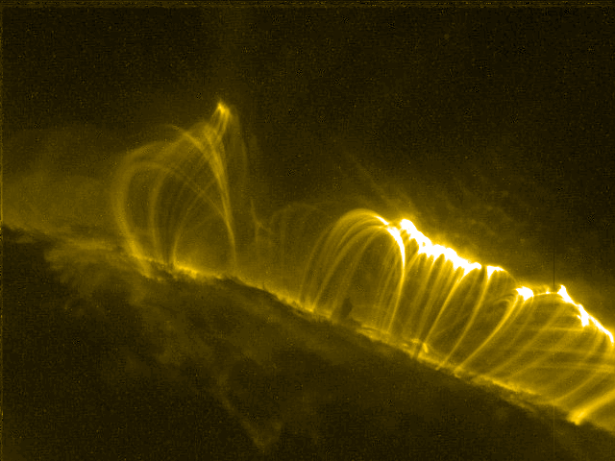

Slide 6
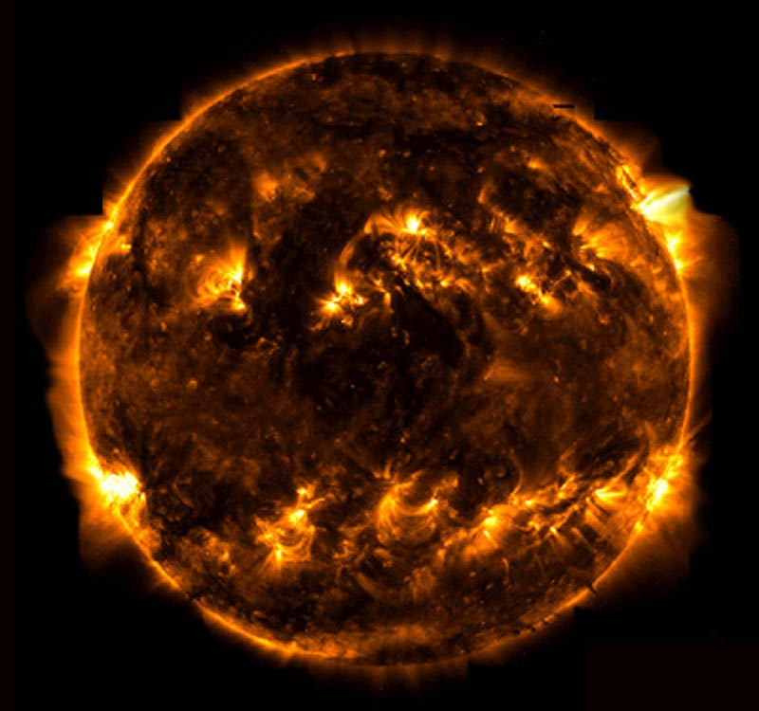
TRACE

Slide 7
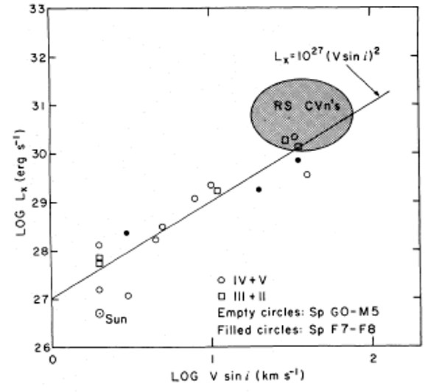
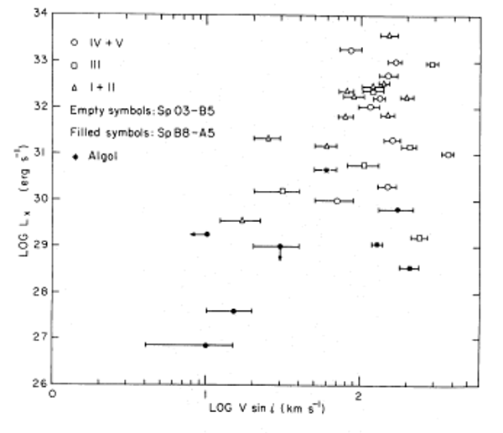
Stellar rotation vs. X-ray luminosity
low-mass stars
high-mass stars
No trend

Slide 8
Massive star X-rays are not coronal
Notes:
8

Slide 9
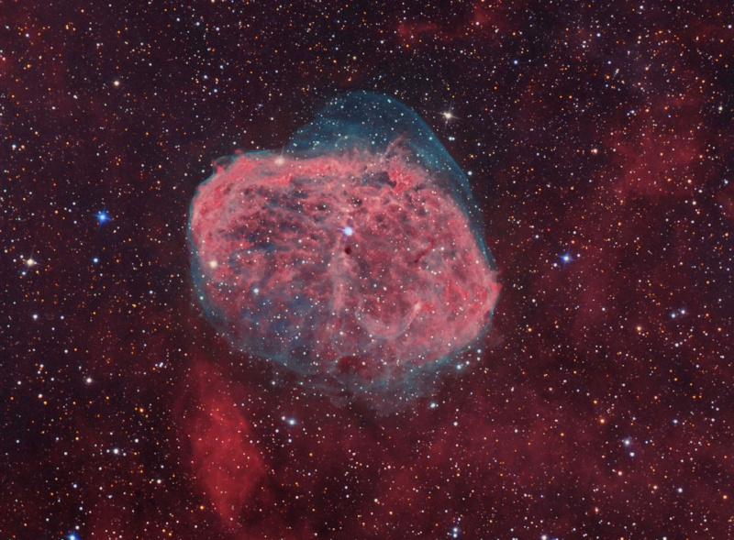
X-rays in massive stars are associated with their radiation-driven winds
Notes:
9

Slide 10
Power in these winds:
erg s⁻¹
while the x-ray luminosity
To account for the x-rays, only one part in 10⁻⁴ of the wind’s mechanical power is needed to heat the wind
Notes:
10

Slide 11
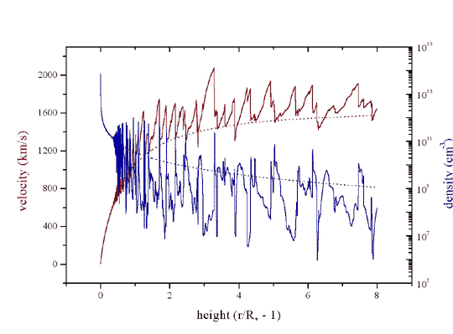
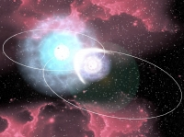
Three models for massive star x-ray emission
1. Instability driven shocks
2. Magnetically channeled wind shocks
3. Wind-wind interaction in close binaries
Notes:
11

Slide 12
Three models for massive star x-ray emission
1. Instability driven shocks
2. Magnetically channeled wind shocks
3. Wind-wind interaction in close binaries
Notes:
12

Slide 13
What are these “X-rays” anyway?
…and what’s the available data like?
Notes:
13

Slide 14
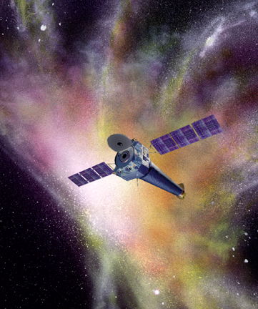
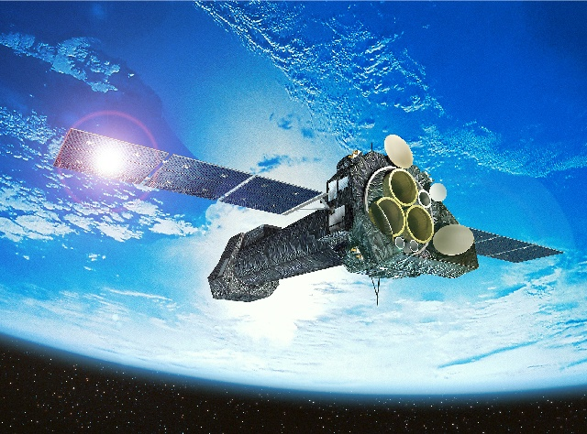
Launched 2000: superior sensitivity, spatial resolution, and spectral resolution
Chandra
XMM-Newton
sub-arcsecond resolution
Notes:
14

Slide 15
XMM-Newton
Both have CCD detectors for imaging spectroscopy:
low spectral resolution: R ~ 20 to 50
Chandra
And both have grating spectrometers: R ~ few 100 to 1000
300 km/s
Notes:
15

Slide 16
XMM-Newton
The gratings have poor sensitivity…
We’ll never get spectra for more than two dozen hot stars
Chandra
Notes:
16

Slide 17
XMM-Newton
The Future:
Astro-H (Japan) – high spectral resolution at high photon energies
…few years from now
Chandra
International X-ray Observatory (IXO)… 2020+
Notes:
17

Slide 18
First, imaging (+ low resolution) spectroscopy with Chandra
Notes:
18

Slide 19
Chandra ACIS Orion Nebula Cluster (COUP)
θ¹ Ori C
Color coded according to photon energy (red: <1keV; green 1 to 2 keV; blue > 2 keV)

Slide 20
Notes:
20

Slide 21
Notes:
21

Slide 22
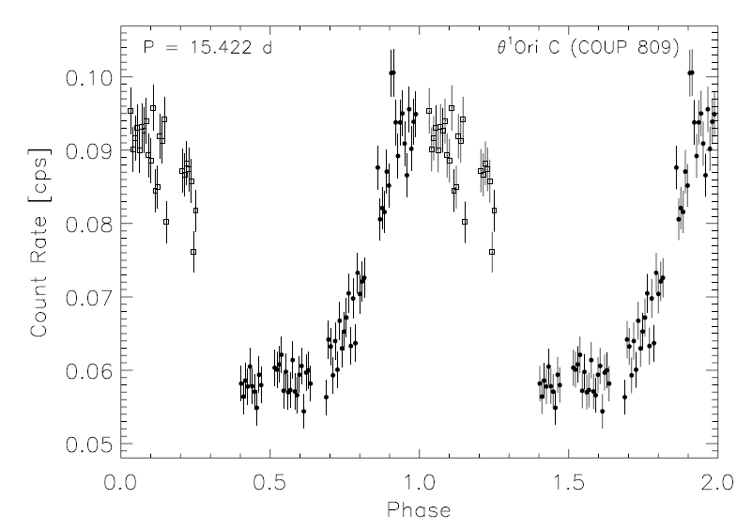
θ¹ Ori C: X-ray lightcurve
Stelzer et al. 2005
not zero
Notes:
22

Slide 23
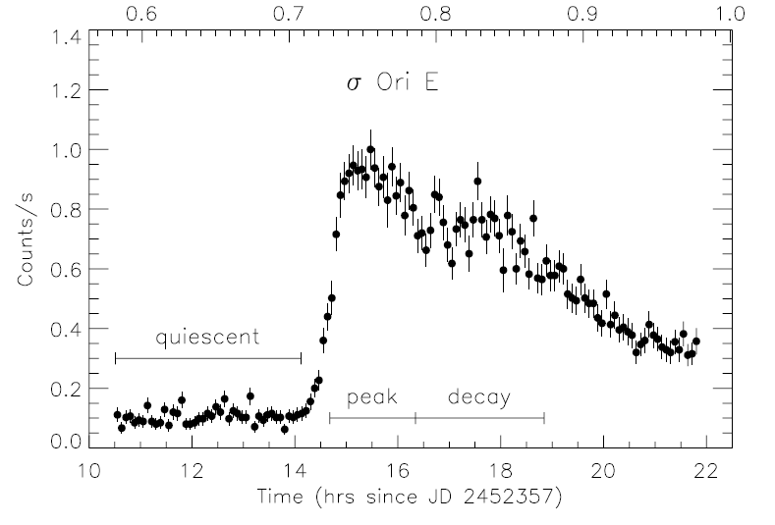
σ Ori E: XMM light curve
Sanz-Forcada et al. 2004
Notes:
23

Slide 24
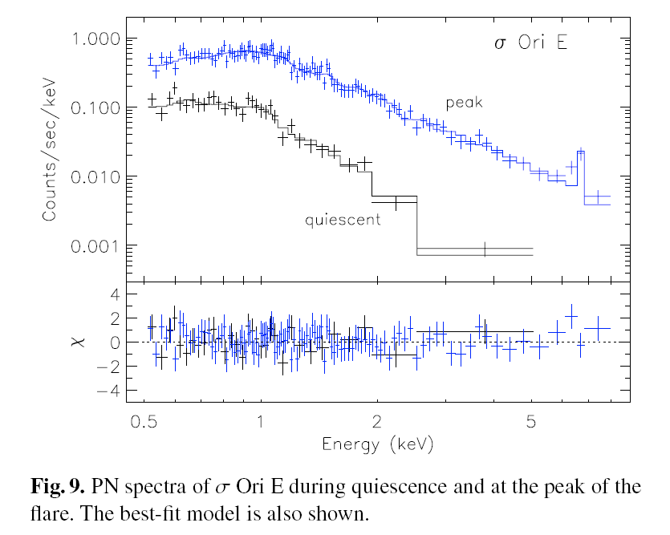
XMM EPIC spectrum of σ Ori E
Sanz-Forcada et al. 2004
Notes:
24

Slide 25
Chandra grating spectra: θ¹ Ori C and a non-magnetic O star
θ¹ Ori C
ζ Pup

Slide 26
thermal emission
“coronal approximation” valid: electrons in ground state, collisions up, spontaneous emission down
optically thin
lines from highly stripped metals, weak bremsstrahlung continuum (continuum stronger for higher temperatures)
Notes:
26

Slide 27
thermal emission
“coronal approximation” valid: electrons in ground state, collisions up, spontaneous emission down
optically thin
lines from highly stripped metals, weak bremsstrahlung continuum (continuum stronger for higher temperatures)
Notes:
27

Slide 28
thermal emission
“coronal approximation” valid: electrons in ground state, collisions up, spontaneous emission down
optically thin
lines from highly stripped metals, weak bremsstrahlung continuum (continuum stronger for higher temperatures)
Notes:
28

Slide 29
thermal emission
“coronal approximation” valid: electrons in ground state, collisions up, spontaneous emission down
optically thin
lines from highly stripped metals, weak bremsstrahlung continuum (continuum stronger for higher temperatures)
Notes:
29

Slide 30
Chandra grating spectra: θ¹ Ori C and a non-magnetic O star
θ¹ Ori C
ζ Pup

Slide 31
Energy Considerations and Scalings
1 keV ~ 12 × 10⁶ K ~ 12 Å
Shock heating: Δv = 300 km gives T ~ 10⁶ K (and T ~ v²)
ROSAT 150 eV to 2 keV
Chandra, XMM 350 eV to 10 keV
Notes:
31

Slide 32
Energy Considerations and Scalings
1 keV ~ 12 × 10⁶ K ~ 12 Å
Shock heating: Δv = 1000 km gives T ~ 10⁷ K (and T ~ v²)
ROSAT 150 eV to 2 keV
Chandra, XMM 350 eV to 10 keV
Notes:
32

Slide 33
H-like/He-like ratio is temperature sensitive
θ¹ Ori C
Mg XII
Mg XI
Si XIV
Si XIII
ζ Pup

Slide 34
θ¹ Ori C – is hotter
θ¹ Ori C
Mg XII
Mg XI
Si XIV
Si XIII
ζ Pup
H/He > 1 in θ¹ Ori C

Slide 35
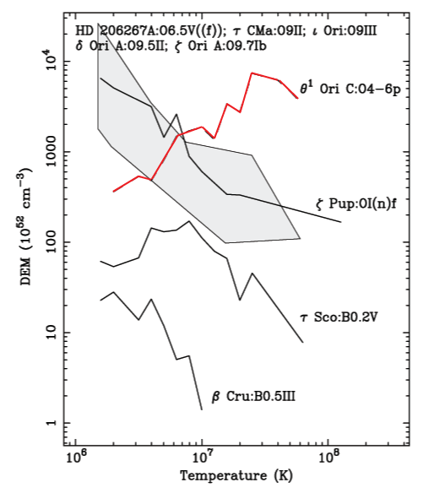
Differential Emission Measure (temperature distribution)
θ¹ Ori C is much hotter
Wojdowski & Schulz (2005)

Slide 36
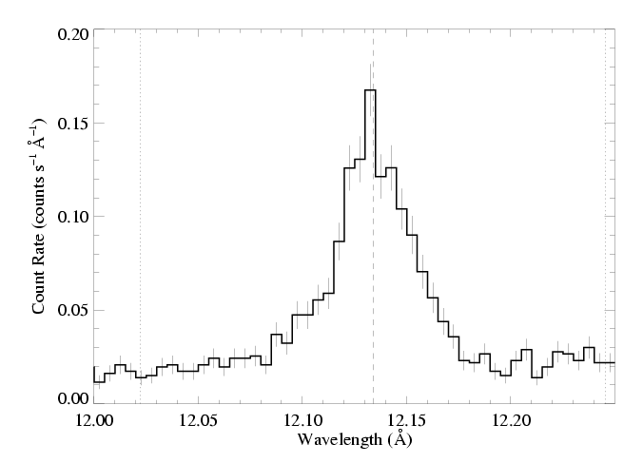
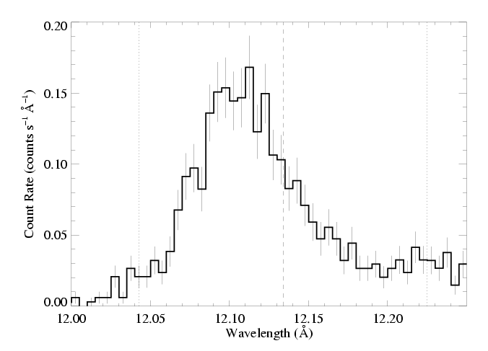
θ¹ Ori C (O7 V)
Emission lines are significantly narrower, too
1000 km s⁻¹
ζ Pup (O4 If)

Slide 37
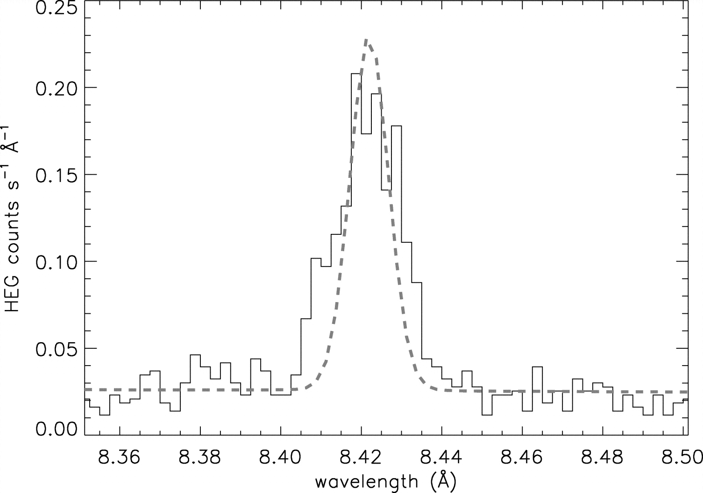
Mg XII Ly-α in θ¹ Ori C compared to instrumental profile
Notes:
37

Slide 38
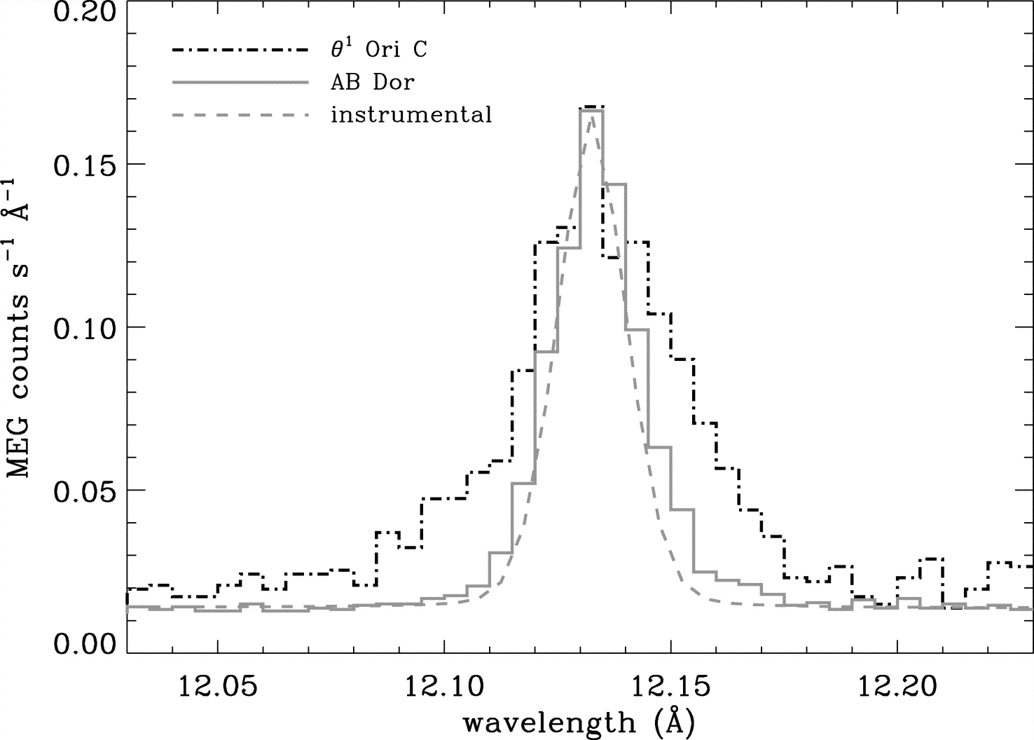
Ne X Ly-α in θ¹ Ori C : cooler plasma, broader – some contribution from “standard” instability wind shocks
Notes:
38

Slide 39
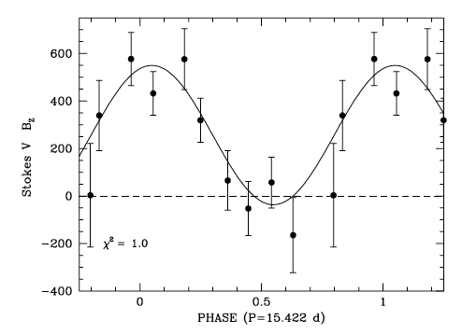
Dipole magnetic field
Wade et al. 2008
Notes:
39

Slide 40
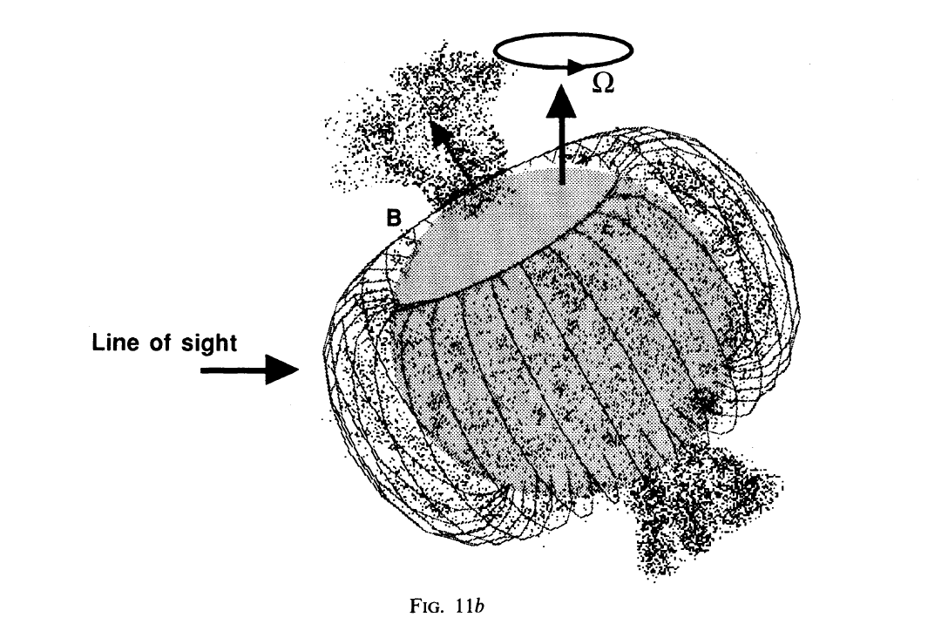
Shore & Brown, 1990
Notes:
40

Slide 41
Notes:
41

Slide 42
There are Chandra observations at many different phases
Notes:
42

Slide 43
What about confinement?
Recall:
θ¹ Ori C: η* ~ 20 : decent confinement
Notes:
43

Slide 44
What about confinement?
Recall:
ζ Ori: η* ~ 0.1 : poor confinement
θ¹ Ori C: η* ~ 20 : decent confinement
σ Ori E: η* ~ 10⁷ : excellent confinement
Notes:
44

Slide 45
Simulation/visualization courtesy A. ud-Doula Movie available at astro.swarthmore.edu/~cohen/presentations/apip09/t1oc-lowvinf-logd.avi
Notes:
45

Slide 46
Simulation/visualization courtesy A. ud-Doula Movie available at astro.swarthmore.edu/~cohen/presentations/apip09/t1oc-lowvinf-logT.avi
Notes:
46

Slide 47
Simulation/visualization courtesy A. ud-Doula Movie available at astro.swarthmore.edu/~cohen/presentations/apip09/t1oc-lowvinf-speed.avi
Notes:
47

Slide 48
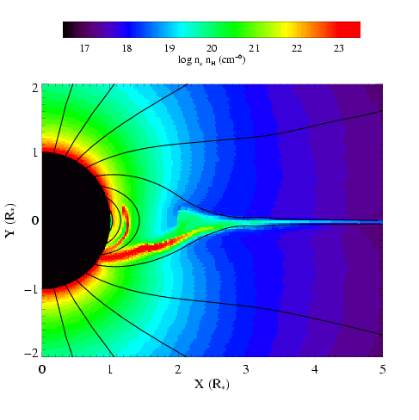
MHD simulations of magnetically channeled wind
temperature
emission measure
simulations by A. ud-Doula; Gagné et al. (2005)
Channeled collision is close to head-on: Δv > 1000 km s⁻¹ : T > 10⁷ K

Slide 49
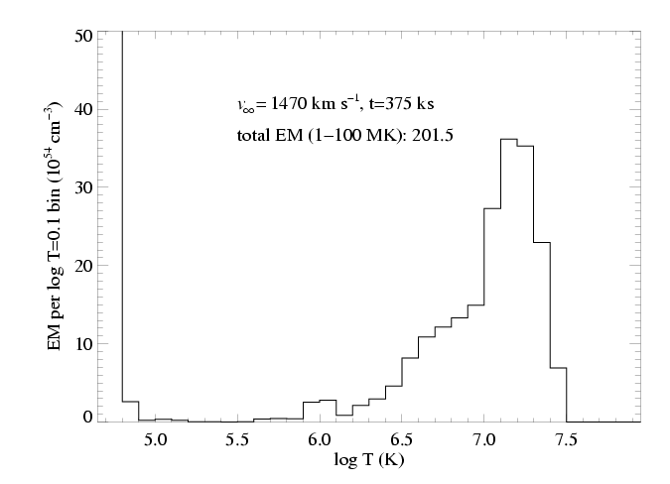
Differential emission measure (temperature distribution)
MHD simulation of θ¹ Ori C reproduces the observed differential emission measure
Wojdowski & Schulz (2005)

Slide 50
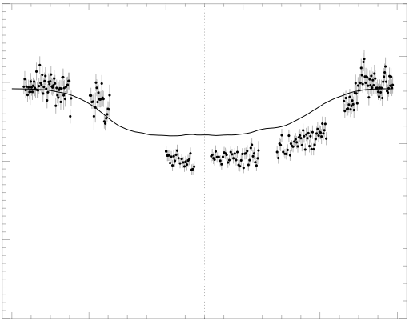
Chandra broadband count rate vs. rotational phase
0.4
1.5
0.3
1.0
0.2
Simulation EM (10⁵⁶ cm⁻³)
θ¹ Ori C ACIS-I count rate (s⁻¹)
0.1
0.5
0.0
0.0
0.0 0.2 0.4 0.6 0.8 1.0
Rotational phase (P=15.422 days)
Model from MHD simulation

Slide 51
The star itself occults the hot plasma torus
0.4
1.5
0.3
The closer the hot plasma is to the star, the deeper the dip in the x-ray light curve
1.0
0.2
Simulation EM (10⁵⁶ cm⁻³)
θ¹ Ori C ACIS-I count rate (s⁻¹)
0.1
0.5
0.0
0.0
0.0 0.2 0.4 0.6 0.8 1.0
Rotational phase (P=15.422 days)

Slide 52
The star itself occults the hot plasma torus
0.4
1.5
0.3
hot plasma is too far from the star in the simulation – the dip is not deep enough
1.0
0.2
Simulation EM (10⁵⁶ cm⁻³)
θ¹ Ori C ACIS-I count rate (s⁻¹)
0.1
0.5
0.0
0.0
0.0 0.2 0.4 0.6 0.8 1.0
Rotational phase (P=15.422 days)

Slide 53
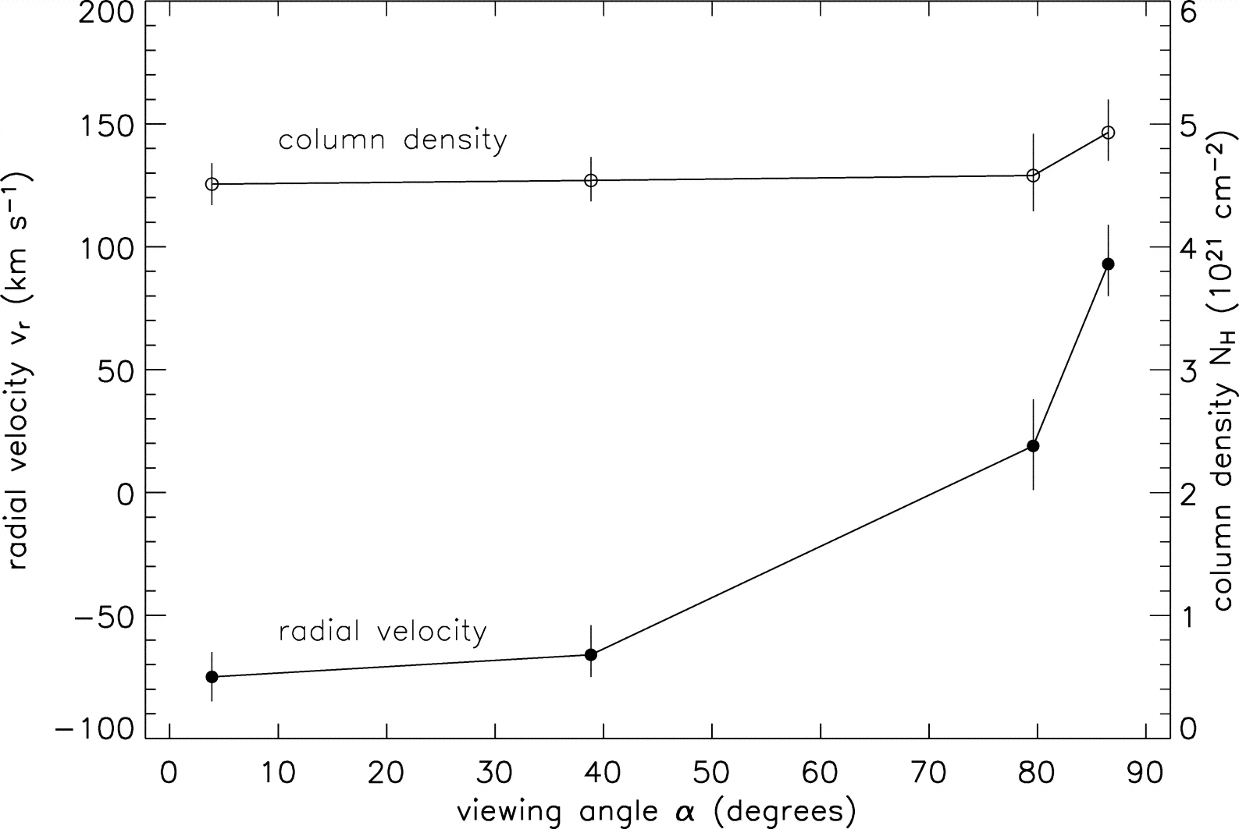
θ¹ Ori C column density (from x-ray absorption) vs. phase
pole-on
equator-on
Notes:
53

Slide 54
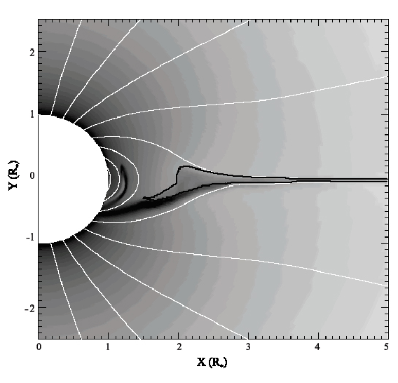
Emission measure
contour encloses T > 10⁶ K

Slide 55
Helium-like species’ forbidden-to-intercombination line ratios – f/i or z/(x+y) – provide information about the location of the hot plasma

Slide 56
Helium-like ions (e.g. O⁺⁶, Ne⁺⁸, Mg⁺¹⁰, Si⁺¹², S⁺¹⁴) – schematic energy level diagram
1s2p ¹P
10-20 eV
1s2p ³P
1s2s ³S
resonance (w)
1-2 keV
forbidden (z)
intercombination (x+y)
g.s. 1s² ¹S

Slide 57
Ultraviolet light from the star’s photosphere drives photoexcitation out of the ³S level
1s2p ¹P
UV
1s2p ³P
1s2s ³S
resonance (w)
forbidden (z)
intercombination (x+y)
g.s. 1s² ¹S

Slide 58
Weakening the forbidden line and strengthening the intercombination line
1s2p ¹P
UV
1s2p ³P
1s2s ³S
resonance (w)
forbidden (z)
intercombination (x+y)
g.s. 1s² ¹S

Slide 59
The f/i ratio is thus a diagnostic of the local UV mean intensity…
1s2p ¹P
UV
1s2p ³P
1s2s ³S
resonance (w)
forbidden (z)
intercombination (x+y)
g.s. 1s² ¹S

Slide 60
…and thus the distance of the x-ray emitting plasma from the photosphere
1s2p ¹P
UV
1s2p ³P
1s2s ³S
resonance (w)
forbidden (z)
intercombination (x+y)
g.s. 1s² ¹S

Slide 61
θ¹ Ori C
Mg XI
Notes:
61

Slide 62
R_{fir}=1.2 R*
R_{fir}=2.1 R*
R_{fir}=4.0 R*

Slide 63
He-like f/i ratios and the x-ray light curve both indicate that the hot plasma is somewhat closer to the photosphere of θ¹ Ori C than the MHD models predict.

Slide 64
So, in θ¹ Ori C, the X-rays tell us about the magnetospheric conditions in several ways:
High X-ray luminosity
X-ray hardness (high plasma temperatures)
Periodic variability (rotation and occultation)
Narrow emission lines (confinement)
f/i ratios quantify location
Notes:
64

Slide 65
What about other magnetic massive stars?
Notes:
65

Slide 66
θ¹ Ori C has a hard X-ray spectrum with narrow lines
Notes:
66

Slide 67
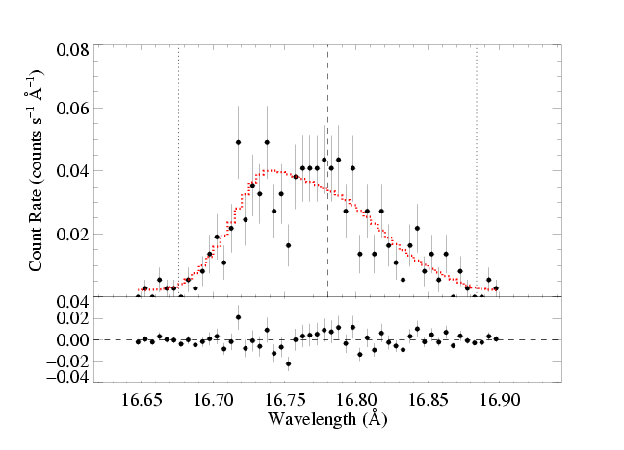
θ¹ Ori C has a hard X-ray spectrum with narrow lines
…HD191612 and ζ Ori have soft X-ray spectra with broad lines
-v_{inf}
λ_{o}
+v_{inf}
Fe XVII in ζ Ori
Notes:
67

Slide 68
ζ Ori
θ¹ Ori C
Notes:
68

Slide 69
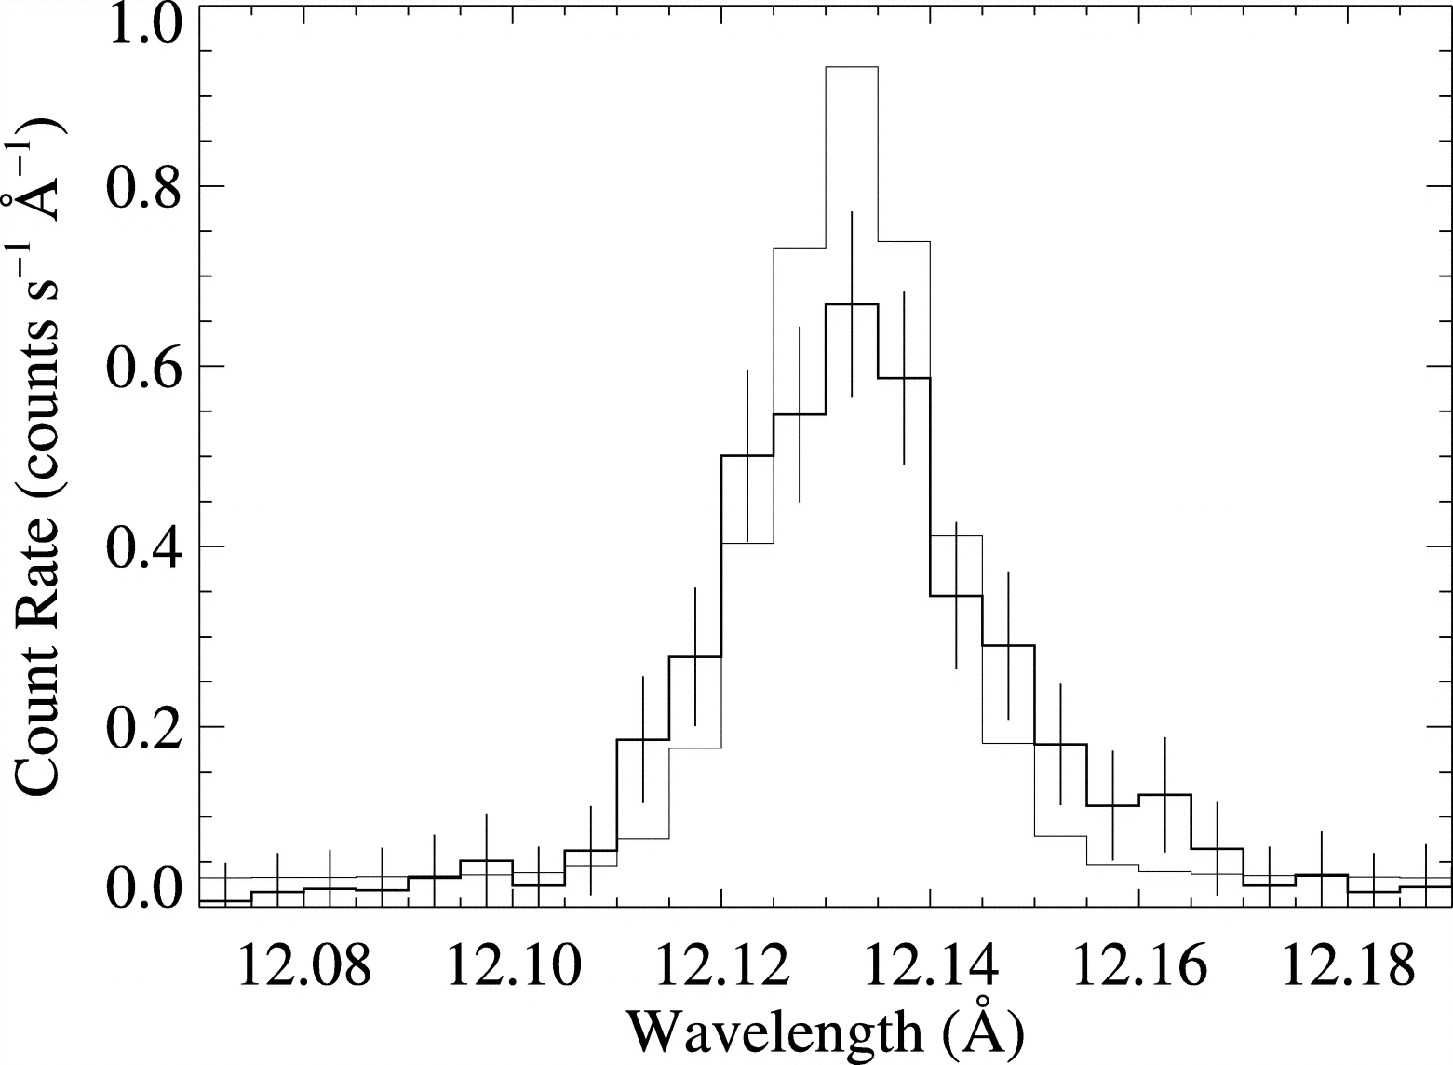
τ Sco does have a hard spectrum and narrow lines
Ne Lyα compared to instrumental response: narrow
Notes:
69

Slide 70
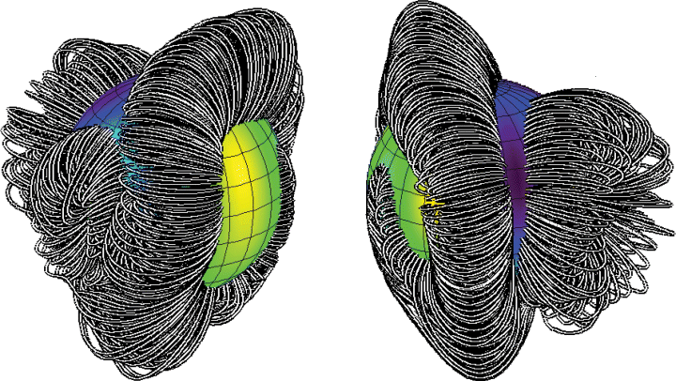
τ Sco: closed loop region is near the star…
Notes:
70

Slide 71
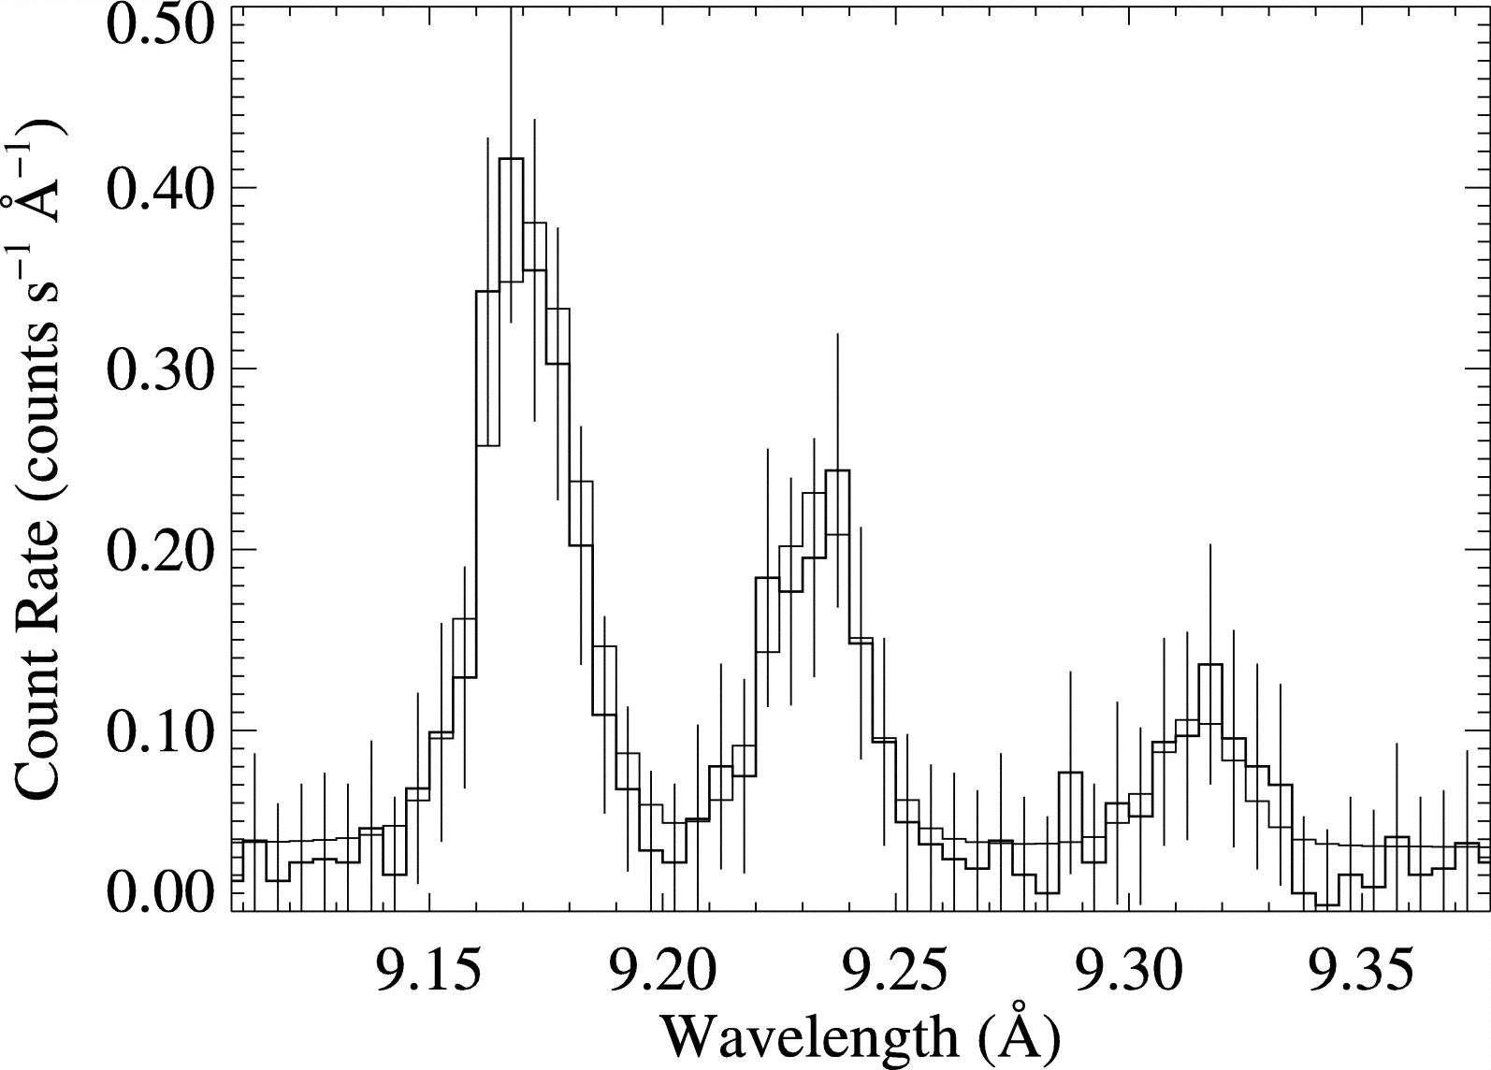
τ Sco: closed loop region is near the star…
…f/i ratios tell us X-rays are far from the star (~3R_{star})
i
f
Notes:
71

Slide 72
Do He-like f/i ratios provide evidence of hot plasma near the photospheres of O stars?
Notes:
72

Slide 73
Do He-like f/i ratios provide evidence of hot plasma near the photospheres of O stars?
No, I’m afraid they do not.
Notes:
73

Slide 74
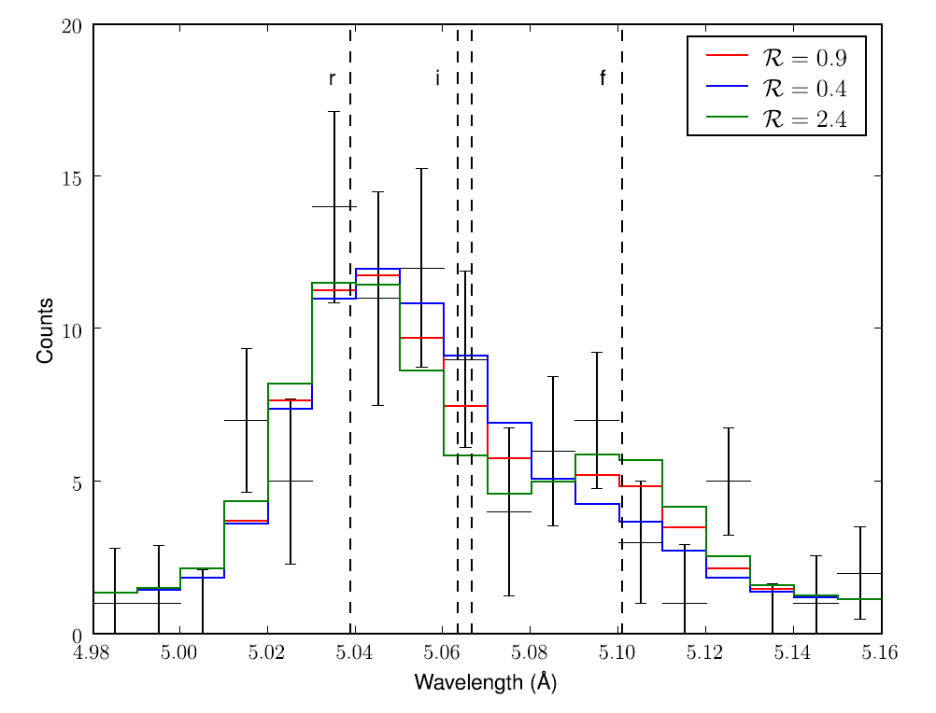
Features are very blended in most O stars: here, the three models are statistically indistinguishable
locations span 1.1 R_{star} to infinity
ζ Pup S XV Chandra MEG
Notes:
74

Slide 75
σ Ori E (η* ~ 10⁷: RRM+RFHD)
Notes:
75

Slide 76
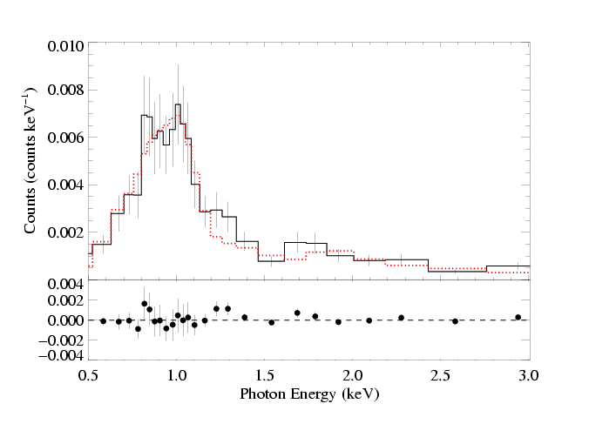
Chandra ACIS (low-resolution, CCD) spectrum
Notes:
76

Slide 77
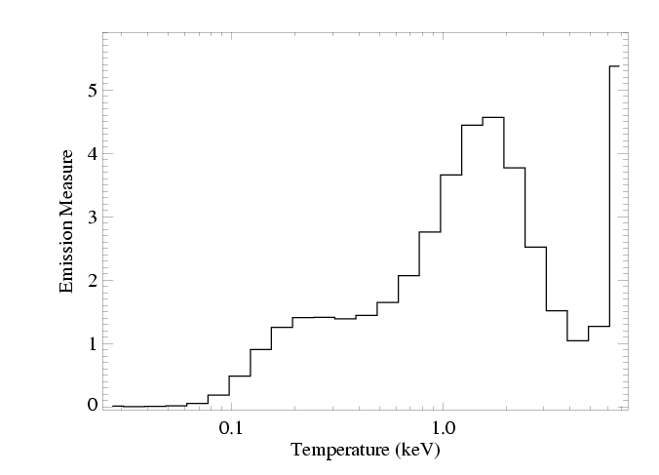
DEM derived from Chandra ACIS spectrum
Notes:
77

Slide 78
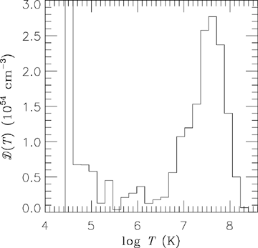
DEM from RFHD modeling
Notes:
78

Slide 79
Observed & theoretical DEMs agree well
Notes:
79

Slide 80
Notes:
80

Slide 81
Conclusions
MCWS dynamical scenario explains θ¹ Ori C well…but, location of hot plasma may be even closer to the star; UV absorption line phase dependence isn’t right.
Most other magnetic massive stars have X-ray emission that is different from θ¹ Ori C
Some have soft X-ray spectra with broad lines
Closed field regions may not always be associated with the X-rays (τ Sco)
f/i ratios, hard X-rays, variability in massive stars…not unique to magnetic field wind interaction

Slide 82
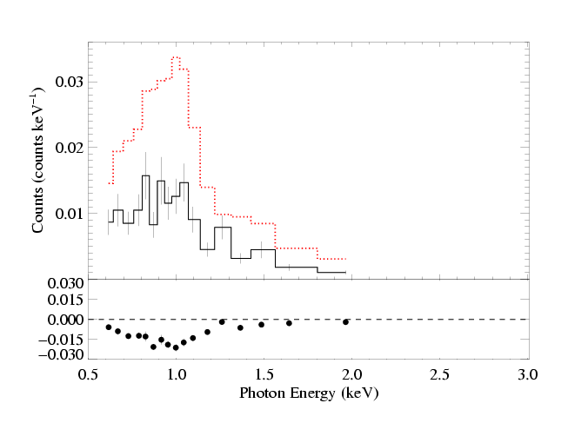
X-ray flux levels vary over time
Chandra
XMM
Notes:
82

Slide 83
Notes:
83

Slide 84
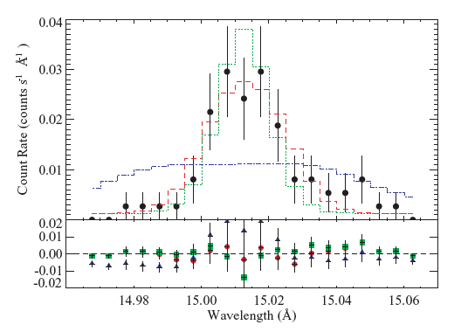
β Crucis (B0.5 V): lines are narrow!
unresolved
wind-broadened
best-fit
Fe XVII line
Notes:
84

Slide 85
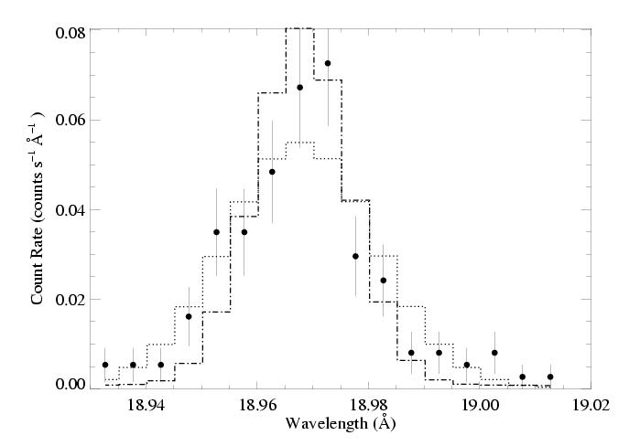
β Cru: O VIII Ly-α line
Notes:
85

Slide 86
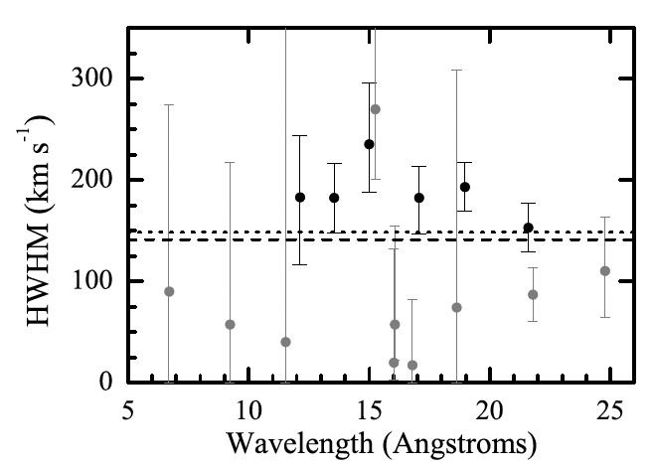
Notes:
86

Slide 87
Later-type massive stars with weaker winds… X-ray production is hard to explain…
Not just narrow lines, but also high flux levels: β Cru, θ Car, σ Ori A
Notes:
87

Slide 88
Notes:
88

Slide 89
Notes:
89

Slide 90
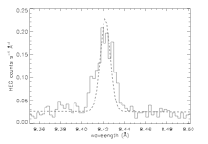
Notes:
90

Slide 91
Notes:
91

Slide 92
Notes:
92

Slide 93
Notes:
93

Slide 94
Notes:
94

Slide 95
What about late O and early B stars with big filling factors and narrow lines?
Notes:
95

Slide 96
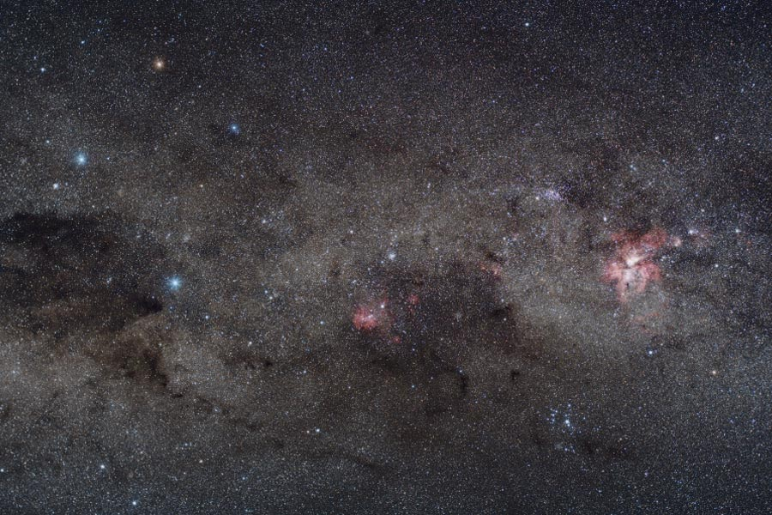
Yuri Beletsky (ESO)
Notes:
96

Slide 97
Notes:
97

Slide 98
Notes:
98

Slide 99
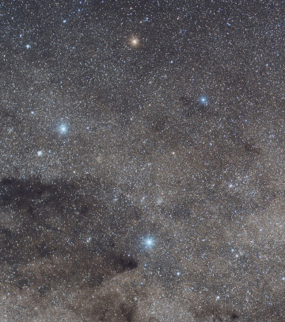
Crucis
aliases:
Mimosa
HD 111123
a massive (16 M_{sun}), luminous (34,000 L_{sun}), hot (30,000 K) star
…but not quite as hot, massive, and luminous as an O star: a B0.5 III star
Notes:
99

Slide 100
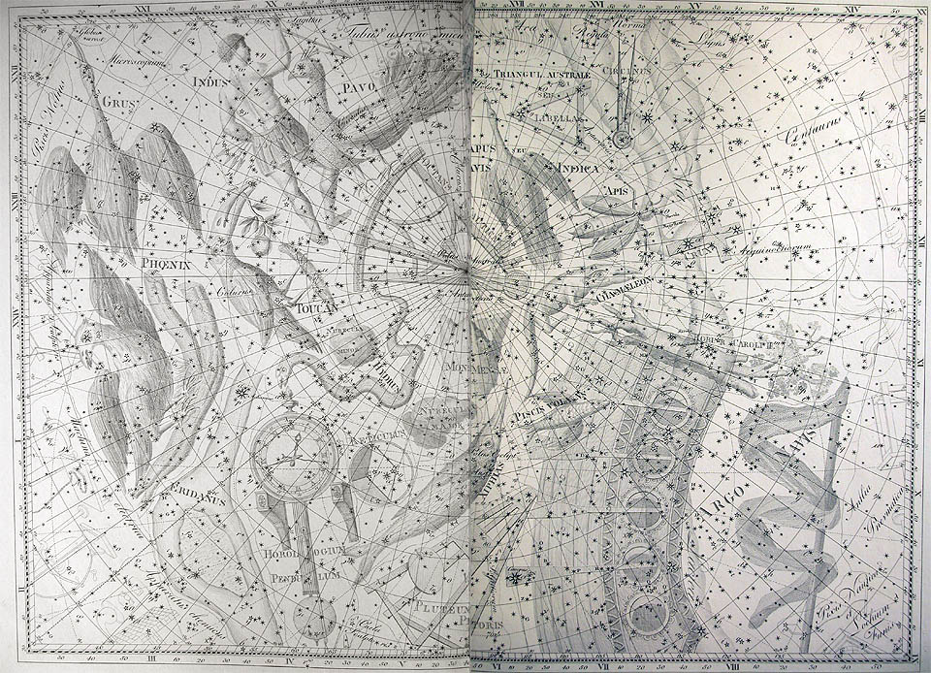
Notes:
100

Slide 101
Notes:
101

Slide 102
Notes:
102

Slide 103
β Crucis (B0.5 V): lines are narrow!
unresolved
wind-broadened
best-fit
Fe XVII line
Notes:
103

Slide 104
β Cru: O VIII Ly-α line
Notes:
104

Slide 105
Notes:
105

Slide 106
Later-type massive stars with weaker winds… X-ray production is hard to explain…
Notes:
106

Slide 107
Notes:
107

Slide 108
But what about magnetic stars with soft X-rays?
Notes:
108

Slide 109
Notes:
109

Slide 110
Chandra HETGS/MEG spectrum (R ~ 1000 ~ 300 km s⁻¹)
ζ Pup
Si
Mg
Ne
Fe
O
H-like
He-like
Notes:
110

Slide 111
Notes:
111

Slide 112
What about zeta Ori?
Notes:
112

Slide 113
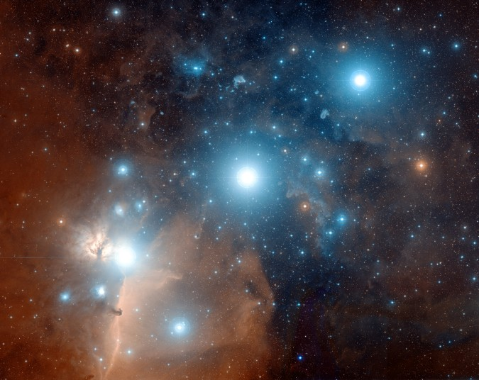
ζ Ori: O9.5

Slide 114
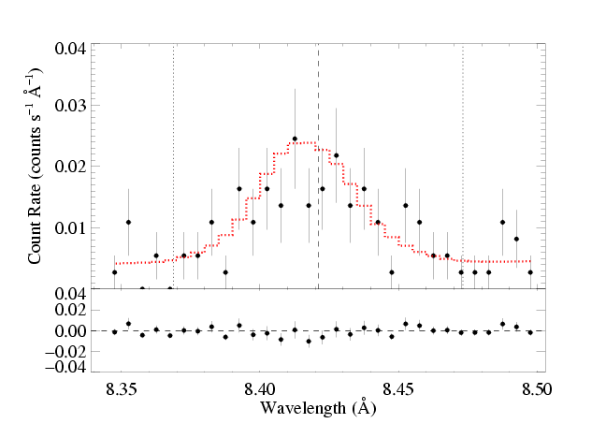
ζ Ori: O9.5 - less massive
Mg XII Lyman-α: τ* = 0.1

Slide 115
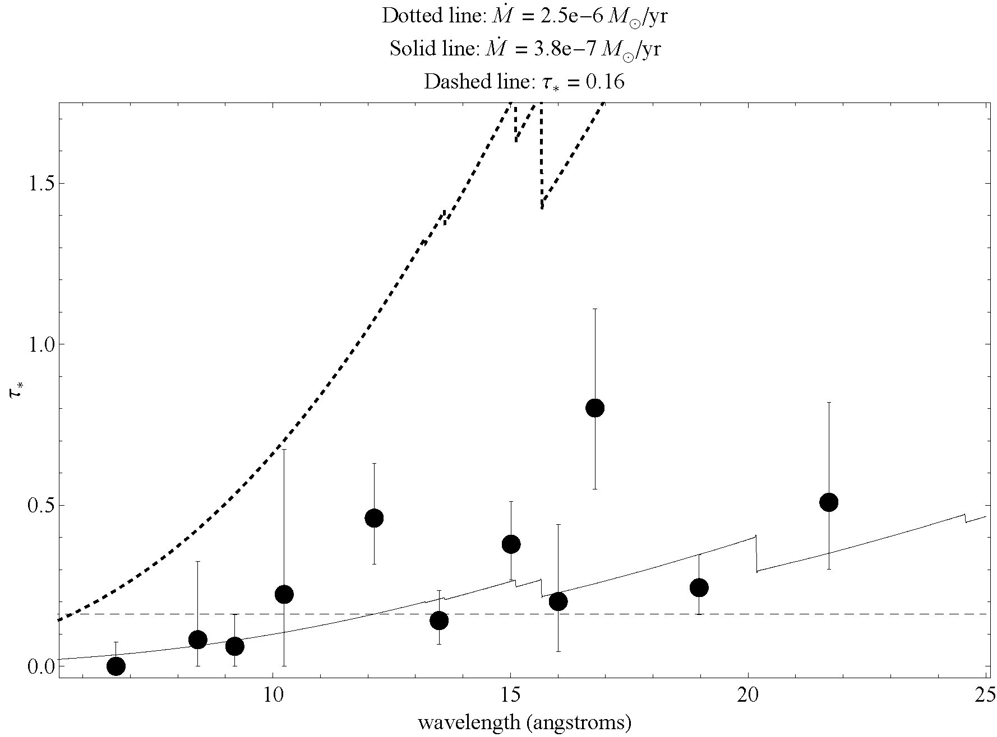

Slide 116
Notes:
116

Slide 117
Notes:
117

Slide 118
Rotating tilted dipole
Simulation/visualization courtesy R. Townsend

Slide 119
Notes:
119

Slide 120
Massive star X-rays vs. Solar-type X-rays

Slide 121
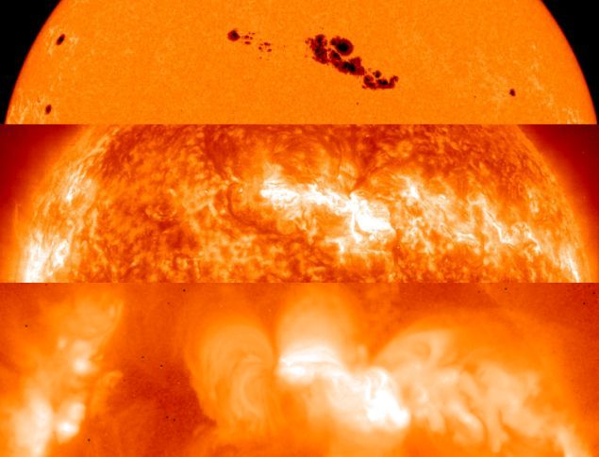
The Sun at different wavelengths
Optical 5800 K
SOHO EUV few 10⁵ K
YOKOH x-ray few 10⁶ K

Slide 122
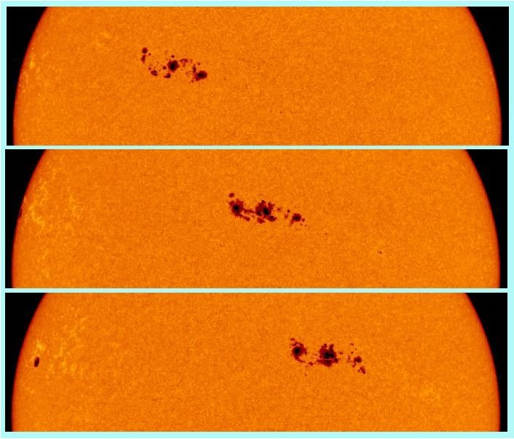
rotation
convection

Slide 123
Notes:
123

Slide 124
Notes:
124

Slide 125
Notes:
125

Slide 126
Mg XII Ly-α in θ¹ Ori C compared to instrumental profile
Notes:
126

Slide 127
Ne X Ly-α in θ¹ Ori C : cooler plasma, broader – some contribution from “standard” instability wind shocks
Notes:
127

Slide 128
θ¹ Ori C column density (from x-ray absorption) vs. phase
pole-on
equator-on
Notes:
128

Slide 129
Notes:
129

Slide 130
Notes:
130

Slide 131
Notes:
131

Slide 132
Notes:
132

Slide 133
Chandra HETGS/MEG spectrum (R ~ 1000 ~ 300 km s⁻¹)
θ¹ Ori C
Si
Mg
Fe
Ne
H-like
He-like
Notes:
133

Slide 134
Notes:
134

Slide 135
ζ Pup
Low-mass star (Capella) for comparison
Notes:
135

Slide 136
ζ Pup
Ne X
Ne IX
Fe XVII
Capella
Notes:
136

Slide 137
ζ Pup massive
Capella low mass
Notes:
137

Slide 138
The x-ray emission lines are broad: agreement with rad hydro simulations
ζ Pup
But… they’re also blue shifted and asymmetric
Is this predicted by the wind shock scenario?
Notes:
138

